Slide 1
Right now, small businesses need a big boost.
The Lights On Covid Recovery Loan

Slide 2
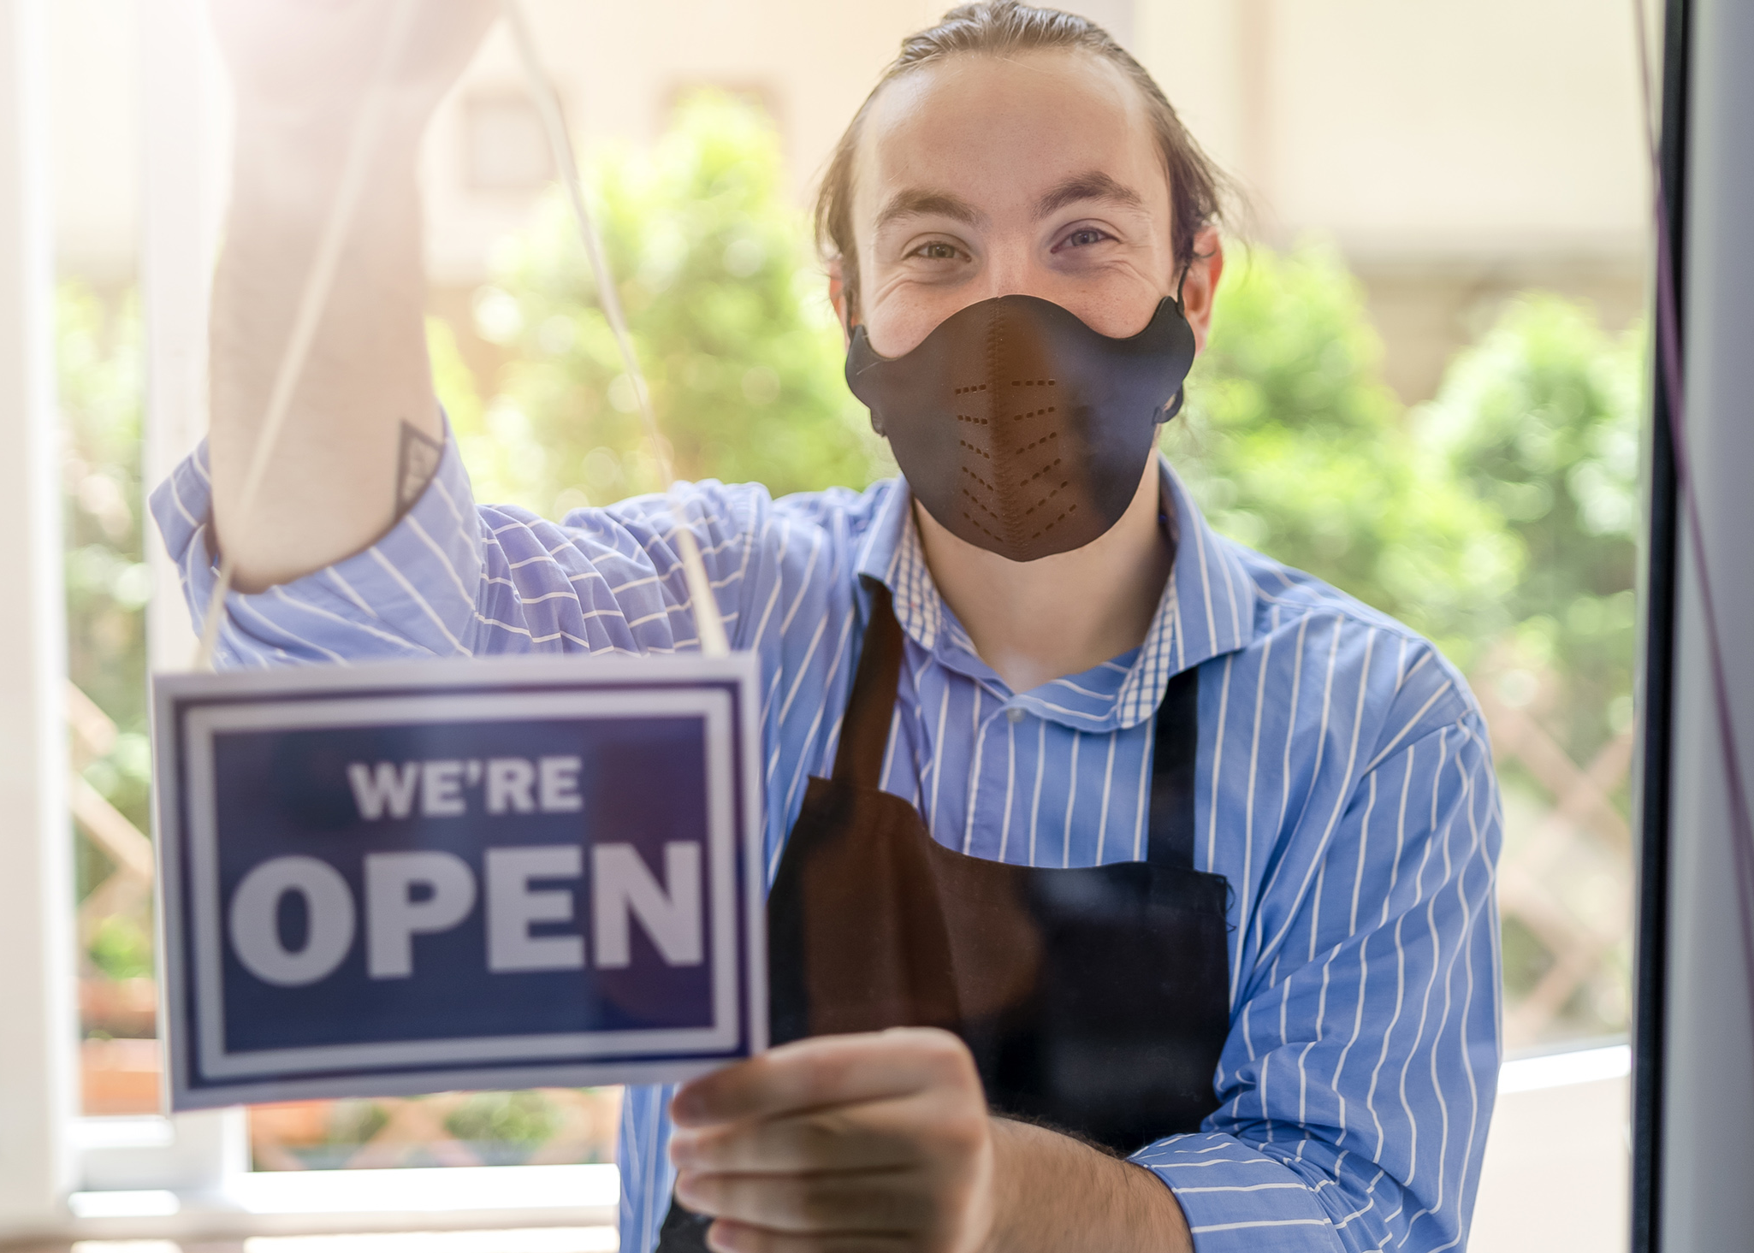
A microloan program to help businesses recover from Covid-19.
Loans for small to mid-sized businesses in the Triad region
Created to provide relief for businesses suffering from Covid-19 economic loss
Emphasis on downtown and agricultural business applicants
Locally administered, funded by the US Economic Development Administration

Slide 3
Terms & benefits that work in your favor.
0% interest rate, 5-year term
Non-forgivable loans up to $50,000
Streamlined application
Can be used for payroll, benefits, overhead, and other debt

Slide 4
What you can do, and how you can help.
Apply today for a microloan to help your business recover
Encourage other business owners who are struggling financially to apply
Help get the word out on social media or any other way you can
Find out more at PTRC.org/LightsOnLoan

Slide 5
Covid-19 hit the NC Triad pretty hard.
Apply today for a loan that will help your small business fight back.

