Slide 1
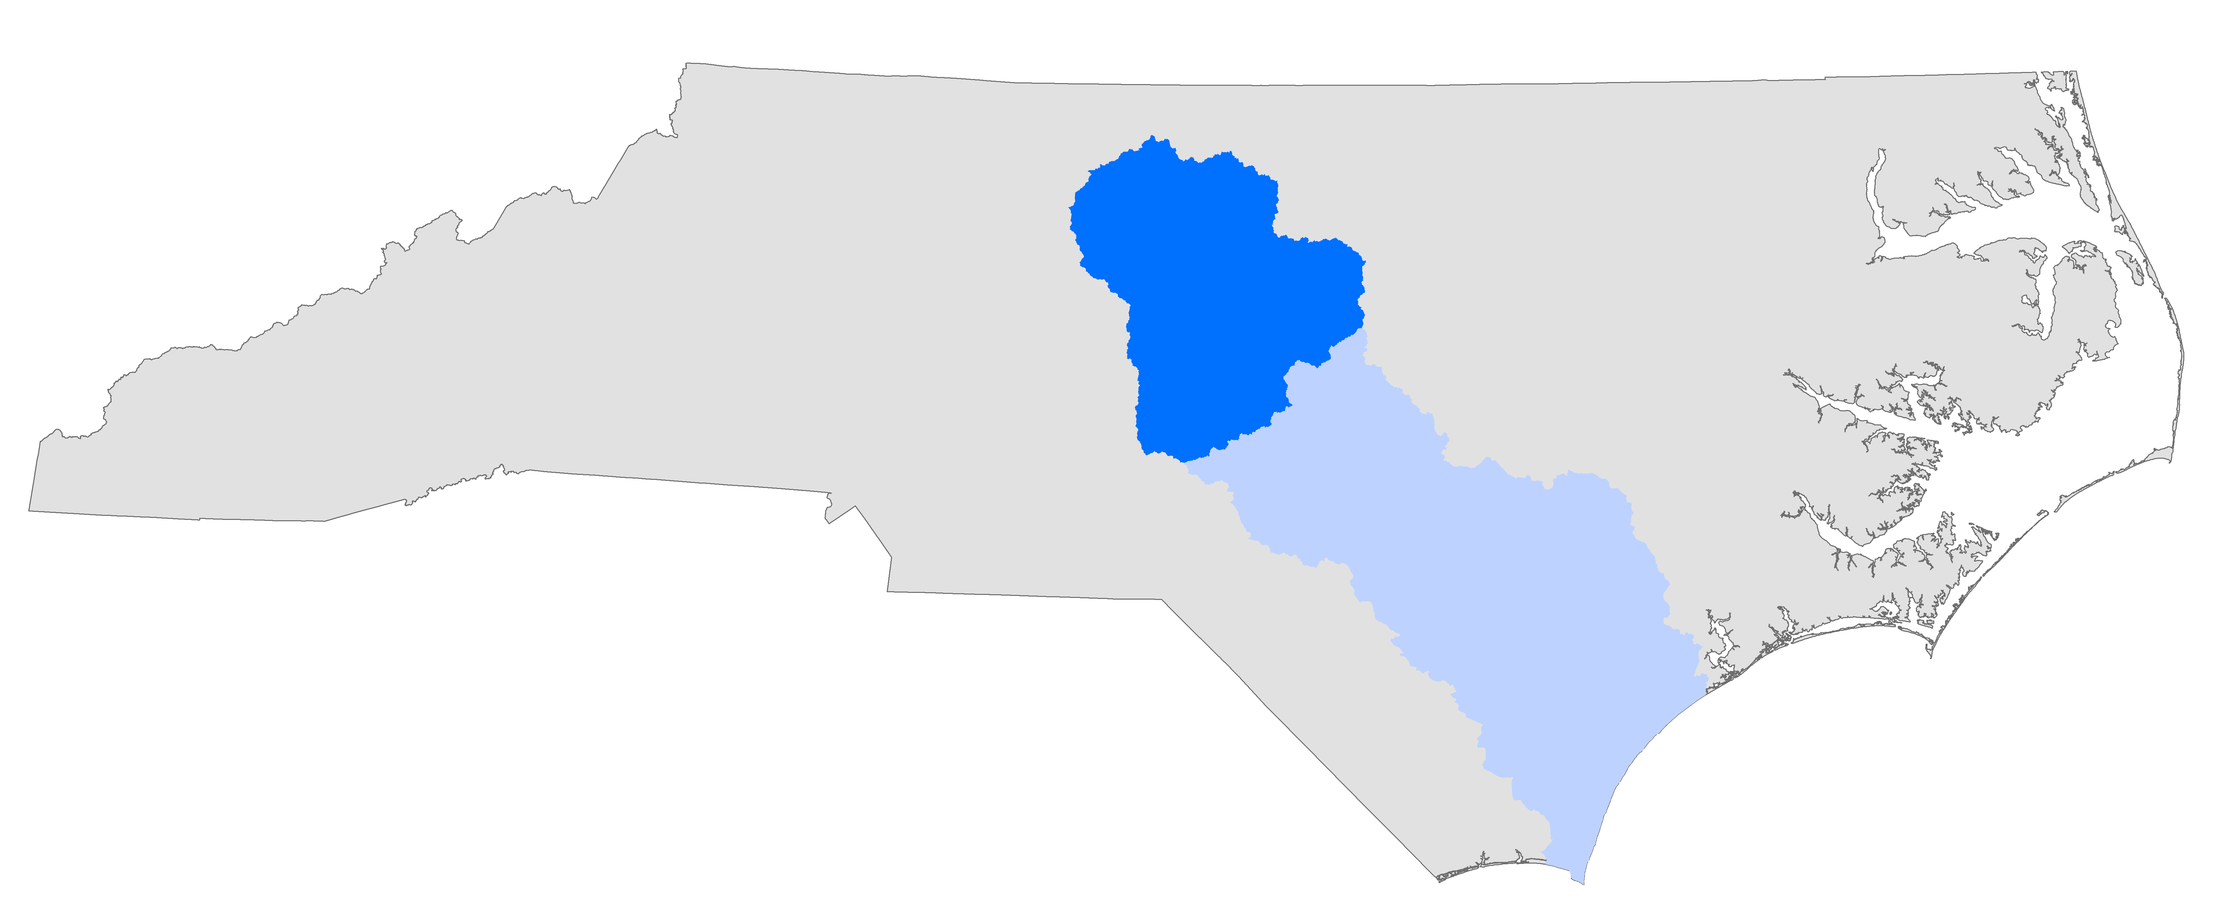
Upper Cape Fear
River Basin Association
Board Meeting – February 2nd, 2021

Slide 2

Financial Report
FY2019-2020 & FY2020-2021 Thus Far
2

Slide 3
FY19-20 Financial Report
Revenues | FY2019-2020 Budget | FY 2019-2020 Actual
Membership Dues | $137,451.00 | $137,119.00
Interest Earned | $1,200.00 | $1,126.61
Total Revenues | $138,651.00 | $138,245.61
- 1 outstanding due $1,096, 1 late payment of $764
Expenses
Meritech | $100,020.00 | $99,713.52
Database | $1,500.00 | $1,625.00
Insurance | $2,496.00 | $2,527.00
TJCOG | $20,000.00 | $20,000.00
PTRC | $20,000.00 | $20,000.00
Bank Fees | $0.00 | $302.88
CPU Services & Fees | $0.00 | $69.99
Legal Services | $0.00 | $150.00
Total Expenses | $144,016.00 | $144,388.39
- Overestimated special study costs in FY19-20
- New database management contract
- Insurance increase slightly higher than anticipated
- Analysis & interest expenses
- Should have been charged to the COGs account,
will be corrected this FY
Net to/from Fund Balance | -$5,365.00 | -$6,142.78
Contingency Balance | $191,353.37 | $190,575.59
3

Slide 4
FY2020-2021 Thus Far
Revenues | FY 2020-2021 Budget | FY 2020-2021 To Date | FY 2020-2021 Projected
Membership Dues | $137,451.00 | $135,478.00 | $137,451.00
Interest Earned | $1,200.00 | $89.33 | $178.66
Total Revenues | $138,651.00 | $135,567.33 | $137,629.66
- 1 outstanding due of $1,973
- Interest rates significantly lower than
anticipated this year due to COVID
Expenses
Meritech | $98,518.00 | $41,768.18 | $97,600.74
Database | $1,625.00 | $1,625.00 | $1,625.00
Insurance | $2,572.00 | $2,572.00 | $2,572.00
TJCOG | $20,000.00 | $10,000.00 | $20,000.00
PTRC | $20,000.00 | $10,000.00 | $20,000.00
Bank Fees | $450.00 | $0.00 | $0.00
CPU Services & Fees | $0.00 | $0.00 | -$69.99
Legal Services | $0.00 | $0.00 | -$150.00
Total Expenses | $143,165.00 | $65,965.18 | $141,577.75
- Overestimated special study costs in FY20-21
- Bank fees waived for time being
- Correction for erroneous charges in FY19-20
Net to/from Fund Balance | -$4,514.00 | $69,602.15 | -$3,948.09
Contingency Balance | $186,061.59 | $260,177.74 | $186,627.50

Slide 5
FY2021-2022
PROPOSED BUDGET & MEMBER DUES
5

Slide 6
FY2021-2022 Proposed Budget – Option 1
Revenues | FY 2020-2021 Projected | FY 2021-2022 Proposed Budget | FY 2022-2023 Projected Budget
Membership Dues | $137,451.00 | $137,451.00 | $137,451.00
Interest Earned | $178.66 | $0.00 | $0.00
Total Revenues | $137,629.66 | $137,451.00 | $137,451.00
Expenses
Meritech | $97,600.74 | $97,308.16 | $99,254.40
Database | $1,625.00 | $1,625.00 | $1,625.00
Insurance | $2,572.00 | $2,623.44 | $2,675.91
TJCOG | $20,000.00 | $20,000.00 | $20,000.00
PTRC | $20,000.00 | $20,000.00 | $20,000.00
Bank Fees | $0.00 | $0.00 | $0.00
CPU Services & Fees | -$69.99 | $0.00 | $0.00
Legal Services | -$150.00 | $0.00 | $0.00
Total Expenses | $141,577.75 | $141,556.60 | $143,555.31
Net to/from Fund Balance | -$3,948.09 | -$4,105.60 | -$6,104.31
Contingency Balance | $186,627.50 | $182,521.90 | $176,417.59

Slide 7
FY2021-2022 Proposed Member Dues
Option 1 – No Increase

Slide 8
FY2021-2022 Proposed Budget – Option 2
Revenues | FY 2020-2021 Projected | FY 2021-2022 Proposed Budget | FY 2022-2023 Projected Budget
Membership Dues | $137,451.00 | $138,825.51 | $140,213.77
Interest Earned | $178.66 | $0.00 | $0.00
Total Revenues | $137,629.66 | $138,825.51 | $140,213.77
Expenses
Meritech | $97,600.74 | $97,308.16 | $99,254.40
Database | $1,625.00 | $1,625.00 | $1,625.00
Insurance | $2,572.00 | $2,623.44 | $2,675.91
TJCOG | $20,000.00 | $20,000.00 | $20,000.00
PTRC | $20,000.00 | $20,000.00 | $20,000.00
Bank Fees | $0.00 | $0.00 | $0.00
CPU Services & Fees | -$69.99 | $0.00 | $0.00
Legal Services | -$150.00 | $0.00 | $0.00
Total Expenses | $141,577.75 | $141,556.60 | $143,555.31
Net to/from Fund Balance | -$3,948.09 | -$2,731.09 | -$3,341.54
Contingency Balance | $186,627.50 | $183,896.41 | $180,554.87

Slide 9
FY2021-2022 Proposed Member Dues
Option 2 – 1% Increase

Slide 10
FY2021-2022 Proposed Budget – Option 3
Revenues | FY 2020-2021 Projected | FY 2021-2022 Proposed Budget | FY 2022-2023 Projected Budget
Membership Dues | $137,451.00 | $140,200.02 | $143,004.02
Interest Earned | $178.66 | $0.00 | $0.00
Total Revenues | $137,629.66 | $140,200.02 | $143,004.02
Expenses
Meritech | $97,600.74 | $97,308.16 | $99,254.40
Database | $1,625.00 | $1,625.00 | $1,625.00
Insurance | $2,572.00 | $2,623.44 | $2,675.91
TJCOG | $20,000.00 | $20,000.00 | $20,000.00
PTRC | $20,000.00 | $20,000.00 | $20,000.00
Bank Fees | $0.00 | $0.00 | $0.00
CPU Services & Fees | -$69.99 | $0.00 | $0.00
Legal Services | -$150.00 | $0.00 | $0.00
Total Expenses | $141,577.75 | $141,556.60 | $143,555.31
Net to/from Fund Balance | -$3,948.09 | -$1,356.58 | -$551.29
Contingency Balance | $186,627.50 | $185,270.92 | $184,719.63

Slide 11
FY2021-2022 Proposed Member Dues
Option 3 – 2% Increase

Slide 12


THANK YOU
Insert Image
Cameron Colvin
Water Resources Planner
ccolvin@ptrc.org

