Slide 1
Duke Energy North Carolina Update
Piedmont Triad Regional Council
Aug. 17, 2020

Slide 2
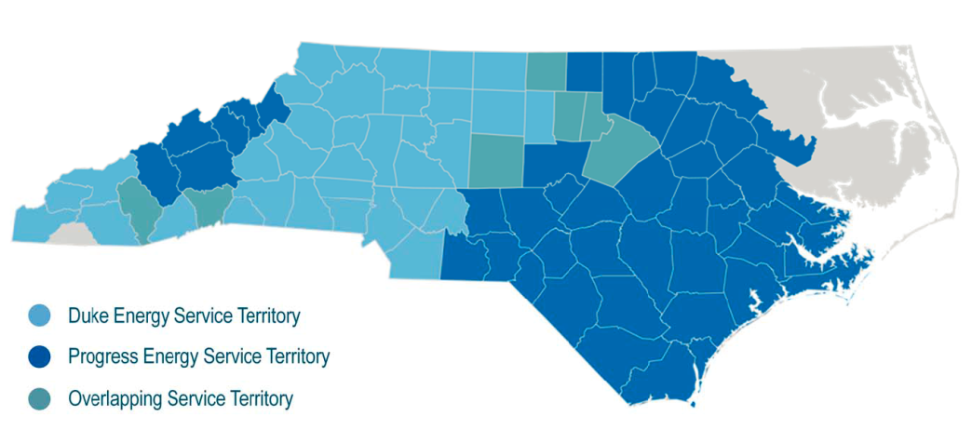
Duke Energy – North Carolina
117 years of service
3.5 million retail customers in 83 counties
15,000 employees; 25,000 retirees
$200 million in property taxes to local
governments
56,000 square miles of service territory
More than 32,000 megawatts of electric
generating capacity in the Carolinas
Two utilities
Duke Energy Carolinas
Duke Energy Progress
Donated more than $20 million to charitable causes in North Carolina in 2020
Helped attract about $6 billion in capital investments and more than 8,000 jobs to the state in 2020
Notes:
This data is as of Dec. 31, 2020

Slide 3
Grid Improvement in North Carolina
Building a smarter grid for
YOU
Give More Options and Control
Improve reliability
over energy use and tools to save money
to avoid outages and speed restoration
EXPAND SOLAR AND RENEWABLES
Strengthen the grid
across a two-way, smart-thinking grid
against physical and cyber impacts
Notes:
To achieve the clean energy priorities that we’ve laid out in the Carbon Plan we need to lean into new technology like battery storage and renewables. That’s also going to require some strategic grid improvements.
Grid investments and operational flexibility are critically important to both the pace and the reliability of the energy transition. Grid investments enable the interconnection of solar, storage and other renewable resources.
What do I mean when I say grid?
The power grid is a complex machine that delivers power from power plants to your home or business. Sometimes, it helps to think of the power grid as a road system, upon which electricity travels across regions and towns, to you.

Slide 4
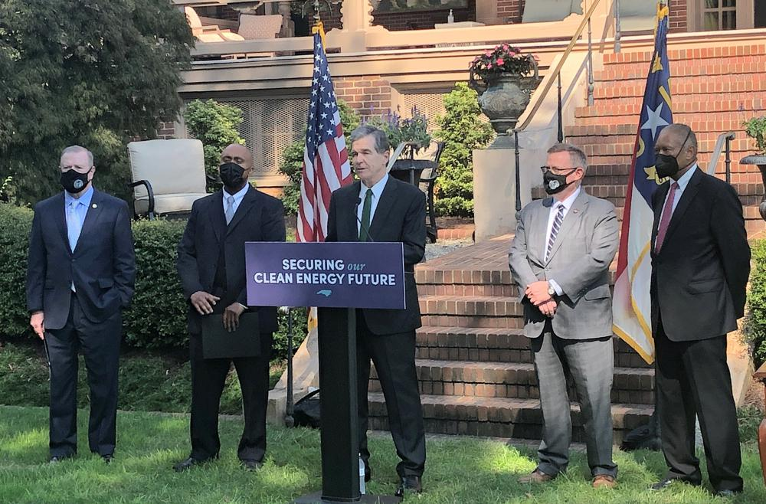
Our Clean Energy Transition
Bipartisan legislation signed by
Gov. Cooper in October 2021
Puts state on path to cleaner energy
Prioritizes affordable prices and reliable power
Targets a 70 percent reduction in carbon emissions by 2030, net-zero by 2050
Critical stakeholder input
Notes:
Lots of work is underway to reduce carbon dioxide emissions at our power plants through the Carolinas Carbon Plan.
In May, Duke Energy filed its Carbon Plan with the N.C. Utilities Commission. This plan was written with the critical input from hundreds of interested organizations across the Carolinas. More than 500 individuals representing over 300 organizations from North Carolina and South Carolina met and provided input. We used their feedback to draft the Carolinas Carbon Plan. It’s a roadmap for cleaner power but most importantly is still makes affordability and reliability a top priority.
The carbon plan targets emissions at the company’s power plants with a goal of reducing CO2 by 70 percent by 2030 and achieving net zero emissions by 2050.
The Carolinas Carbon Plan is the direct result of bipartisan, landmark legislation passed by the General Assembly and the Governor last October. The legislation required these significant carbon reductions, and our company was required to work with stakeholders and develop the plan that we submitted in May.
Now the Utilities Commission will review it. They are holding their own public hearings on the plan. Later this year, they will produce the final results.

Slide 6
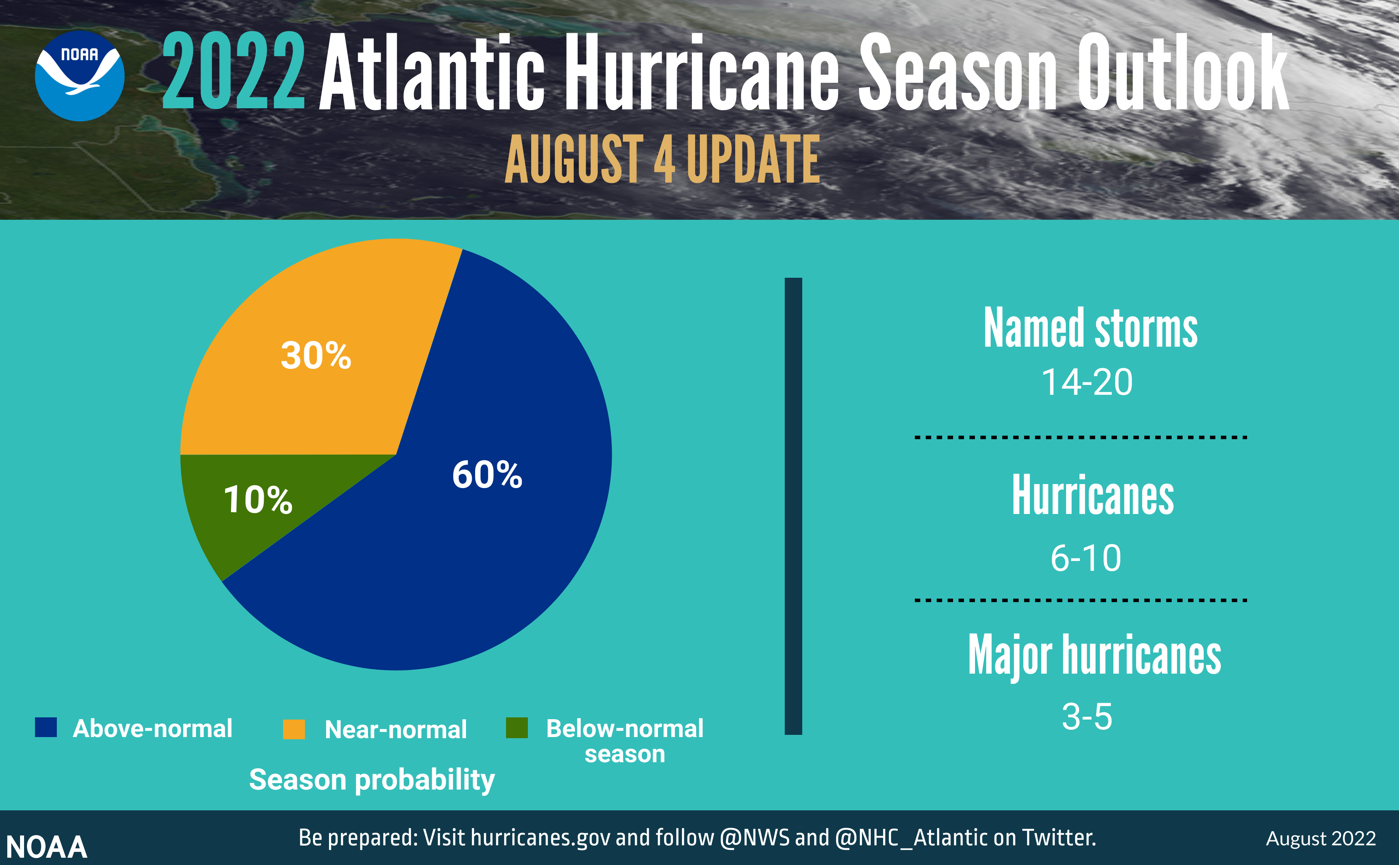
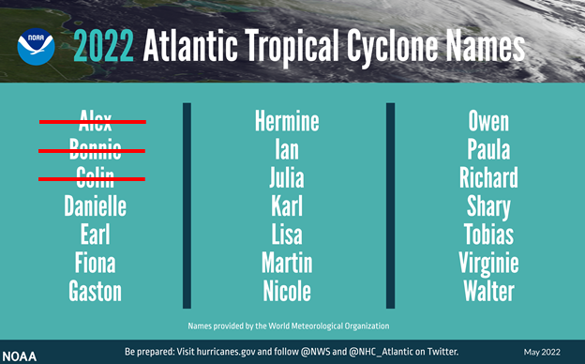
Update: NOAA & CSU Tropical Outlooks
Notes:
An important part of our grid resiliency work is to prepare for storms and hurricanes. You can see the update tropical outlook released by NOAA earlier this month.
Our own Duke Energy meteorologists are predicting 19 named storms, 9 hurricanes, 4 major hurricanes and 5 gulf storms.
This is a slight decrease in overall storm activity from last year but still above average active season. We have a detailed storm response plan. Hank and I are your contacts during storm events.

Slide 7
Questions?

