Slide 1
Forever Chemical Update
Paul Calamita
AquaLaw

Slide 2
Agenda
Forever Chemical Overview
US EPA’s Drinking Water Maximum Contaminant Levels for PFAS
NC PFAS Surface and Ground Water Standards Development
PFAS litigation v. PFAS manufacturers & Settlements to Date
PFAS litigation v. Upstream Sources
Recommended Steps for Localities
Q&A

Slide 3
Forever Chemical Overview
Family of thousands of chemicals found in most household products
All of us have PFAS chemicals in our bodies
US EPA is regulating PFAS chemicals
PFAS manufacturers are phasing out PFAS use
Manufacturers have been sued and are settling

Slide 4
←

Slide 5
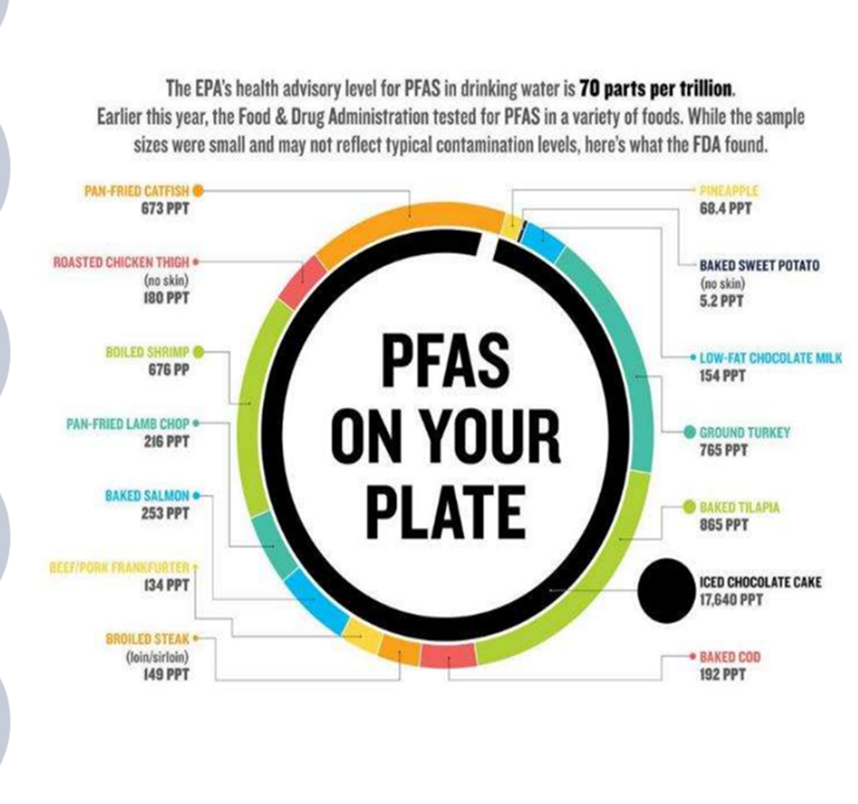
/

Slide 7
All about the “__________proof”
Alternatives for water proofing
Stain proofing alternatives are tougher
Bullet proof?

Slide 8
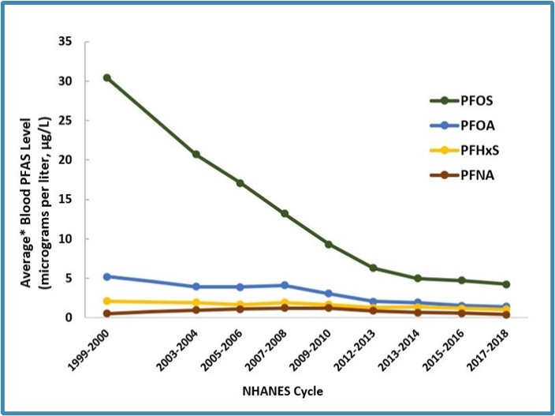
American Blood Serum PFOS/PFOA Levels

Slide 9
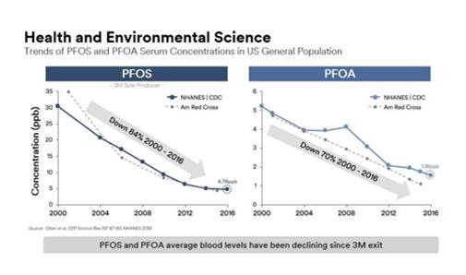

Slide 10
Manufacturers Are Abandoning PFAS
3M phaseout of PFAS chemicals by end of 2025
Other companies no longer accepting product formulas requiring PFAS chemicals
Military/medical remain tough to change

Slide 11
90 Percent PFOS/PFOA Reduction in American Blood Levels
What is missing?
Health Clusters?
How about reduced health impacts?
Will the final bit of reduction magically bring the health benefits?

Slide 12
American Blood Serum PFOS/PFOA Levels

Slide 13
EPA MCLs for PFAS
Drinking Water Maximum Contaminant Levels

Slide 14
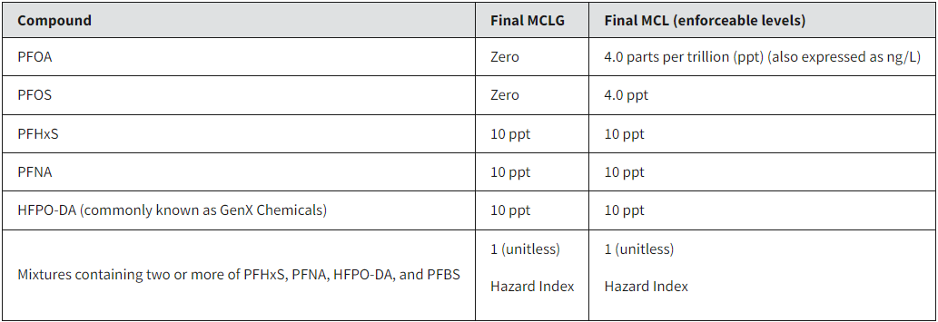
EPA’s MCLs
5-year compliance schedule (April 2029)

Slide 15
Impact Nationwide
3-6,000 water systems will have to install this technology
All within the next five years
Significant capital and annual O&M costs
Will become “state-of-the-art” tech for water systems
To address many emerging contaminants

Slide 16
Appeals Pending
AWWA/AMWA
Rarely appeal
American Chemistry Society/Nat’l Society of Manufacturers
Chemours

Slide 17
Implications of the MCLs for North Carolina
One of THE most heavily impacted states
Numerous large water systems exceed the 4 ppt level for PFOS and/or PFOA
Billions of dollars of PFAS barrier technology needed
Very expensive annual O&M
Uncertainty about residuals given CERCLA hazardous substances designation for PFOA/PFOS

Slide 18
NC DRAFT State Surface and Ground Water PFAS Criteria
DEQ pushing PFAS Surface & Ground Water Criteria
Would be THE most stringent surface water PFAS criteria in U.S.
PFOA
0.01 ppt (non-water supply)
0.001 ppt (water supply)
PFOS
0.06 ppt

Slide 19
State Surface Water PFAS Criteria
Effluent limits using a two-tiered approach:
Tier 1: Combined PFOA + PFOS > 20 ppt – you get effluent limits
Tier 2: Combined PFOA + PFOS < 20 ppt – effluent limits deferred

Slide 20
Consequences of State Surface Water Criteria
Impaired waters statewide?
Implications for:
Existing dischargers
Expanding dischargers
New dischargers

Slide 21
Consequences (Con’t)
Could end land application of biosolids
Biosolids have ppb levels of PFAS
Proposed instream criteria are ppt

Slide 22
EMC Trying to Slow DEQ’s Roll….
EMC skeptical of the DEQ’s proposed criteria
Water Quality Committee deferred request to September
Need more time to review Regulatory Impact Analysis
Groundwater Committee also deferred request to September
But will consider PFOA, PFOS, & GenX (HFPO-DA) during that meeting

Slide 23
Alternative Approach: PFAS Minimization
Surface Water Quality Criteria for PFAS do not appear to be ready for prime time
A tried and true alternative is to require industrial sources to evaluate and minimize, to the extent practicable, PFAS (and 1,4-Dioxane) discharges
Cooperative minimization plans are good for the industries and for POTWs
Sliding scale of scrutiny depending on whether a downstream water plant is impacted
Stay tuned about this

Slide 24
PFAS litigation v. PFAS manufacturers & Settlements to Date
Litigation v. PFAS manufacturers
Alleges that manufacturers knew of harm presented by chemicals and buried it
Settlements to Date
3M (approx. $10-12B)
Dupont/Chemours/Corteva ($1.2B)
Tyco ($750M)
BASF ($316M)
More to come

Slide 25
PFAS litigation v. PFAS manufacturers & Settlements to Date
Settlements require release of companies for drinking water and some additional claims
Many NC communities have opted out and will wait their turn for litigation schedules against the defendants
3M stock up >50% over the past year
Important to try to identify upstream sources and manufacturers of the chemicals found in your drinking water

Slide 26
PFAS Litigation v. Upstream Sources
Some water utilities have brought lawsuits against upstream industrial sources
Direct dischargers
Indirect dischargers (through POTWs)
May ensnare POTWs….

Slide 27
What Your Community Should Do
Characterize
Characterize PFAS levels
Drinking Water
Wastewater
Biosolids
Domestic sources….
Disclose
Disclose/post all results
Work
Work with industries to characterize and minimize their contributions
Watch
Watch for hot spots (landfills, land application fields, property)

Slide 28
Thank you for your service!

