Slide 1
Swearing Creek Watershed Restoration Plan
GIS Methodology

Slide 2
GIS Methodology
Past Local Watershed Projects (Project Selection)
New Techniques for Swearing Creek
Piedmont Together Scenario Modeling & Green Infrastructure Network – how to apply

Slide 3
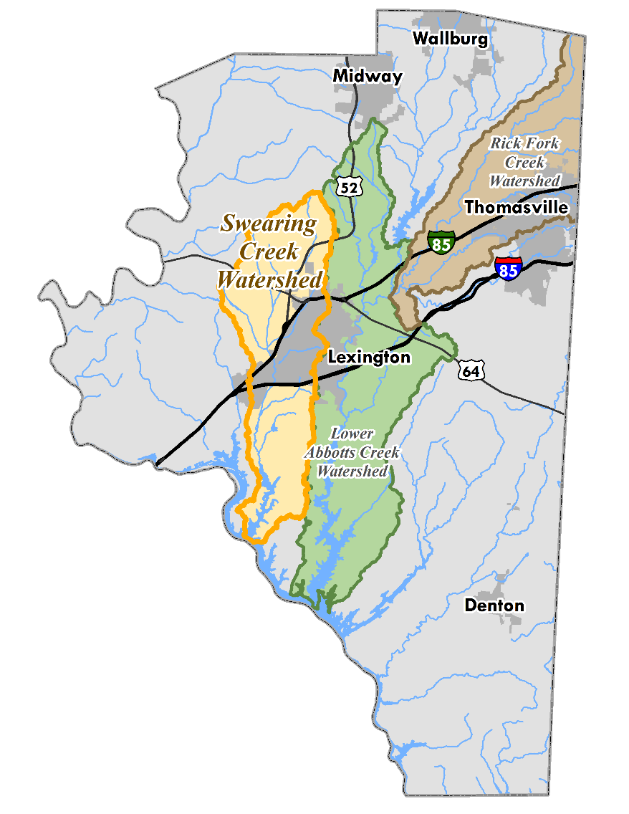
Past Local Watershed Projects
Lower Abbotts Creek
Rich Fork Creek

Slide 4
Lower Abbotts Creek
Watershed Assessment
Field Assessment (focused on 6 out of 10 subwatersheds)
1,733 opportunities identified at 830 sites using 17 BMP categories
Restoration Plan – to coordinate needs identified in the assessment
4 phases outline actions steps to implement:
10 policy recommendations
25 projects

Slide 5
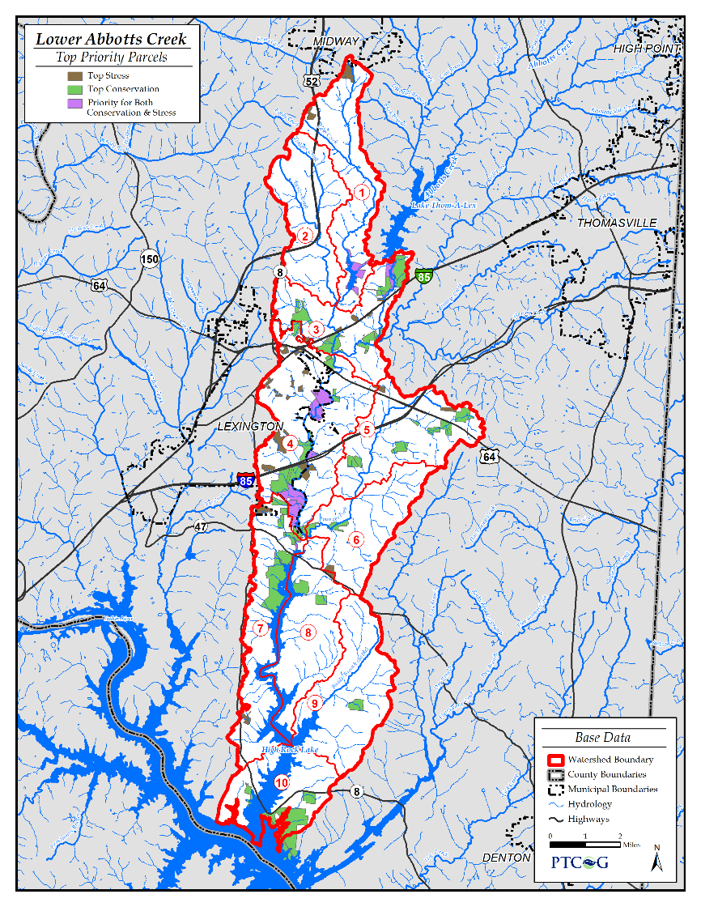
Lower Abbotts Creek
GIS Analysis to identify and rank projects
50 restoration opportunities
50 conservation sites

Slide 6
Lower Abbotts Creek
Conservation Input Layers

Slide 7
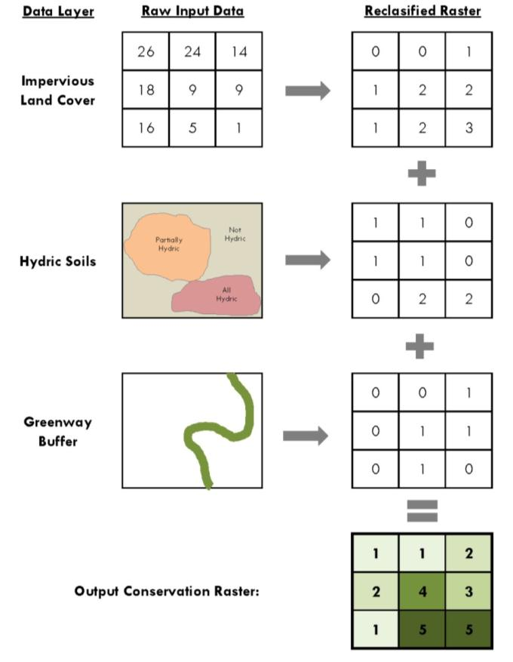
Lower Abbotts Creek
Putting the data layers together:

Slide 8
Lower Abbotts Creek
Putting the data layers together:

Slide 9
Lower Abbotts Creek
Putting the data layers together:

Slide 10
Lower Abbotts Creek
Putting the data layers together:

Slide 11
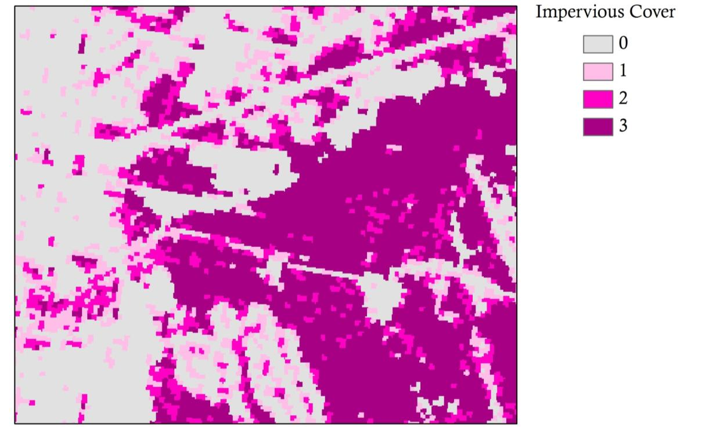
Putting the data layers together:

Slide 12
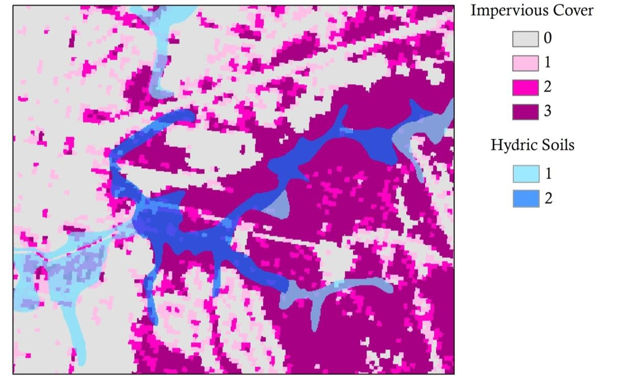
Putting the data layers together:

Slide 13
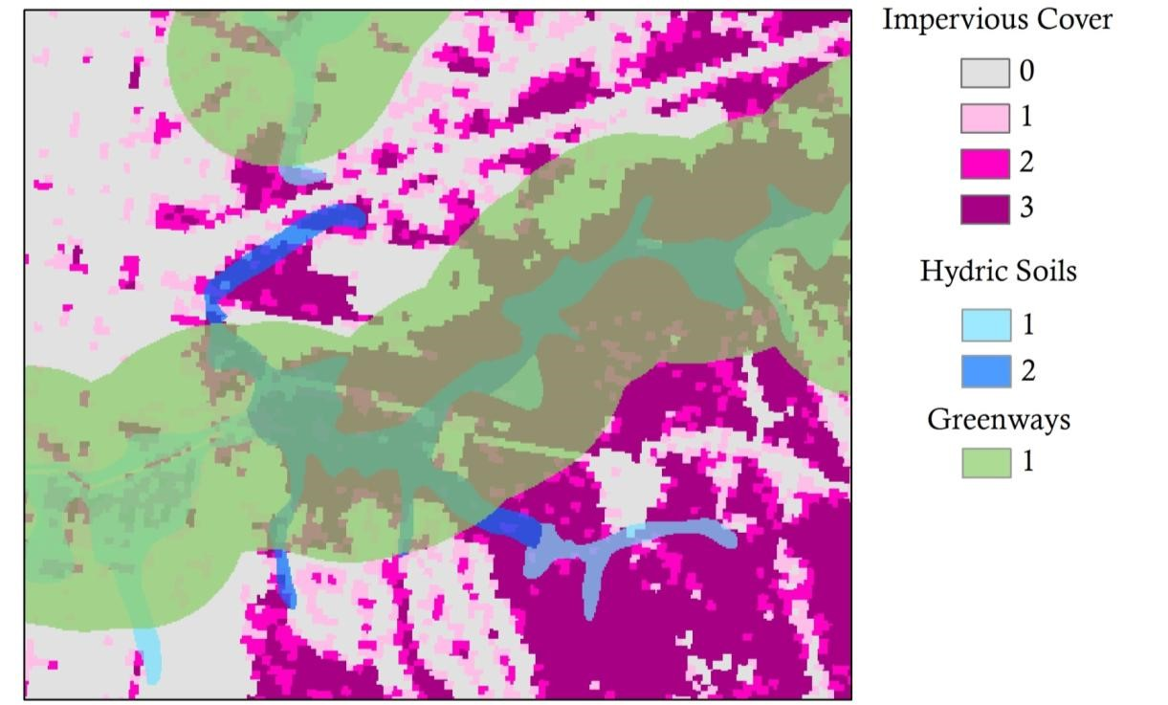
Putting the data layers together:

Slide 14
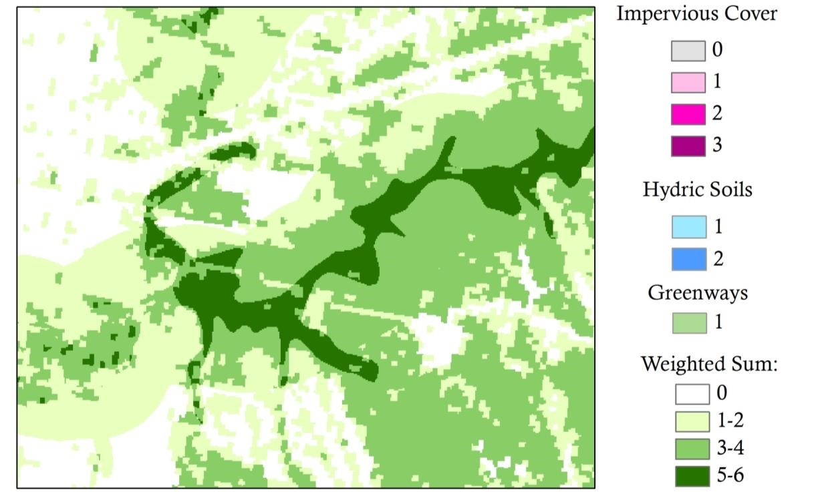
Weighted Sum Tool

Slide 15
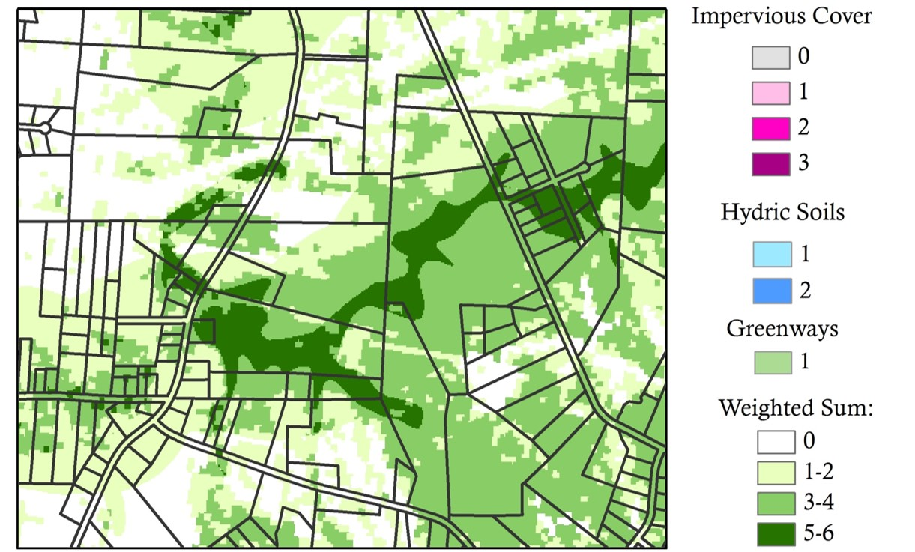
Overlay parcel boundaries

Slide 16
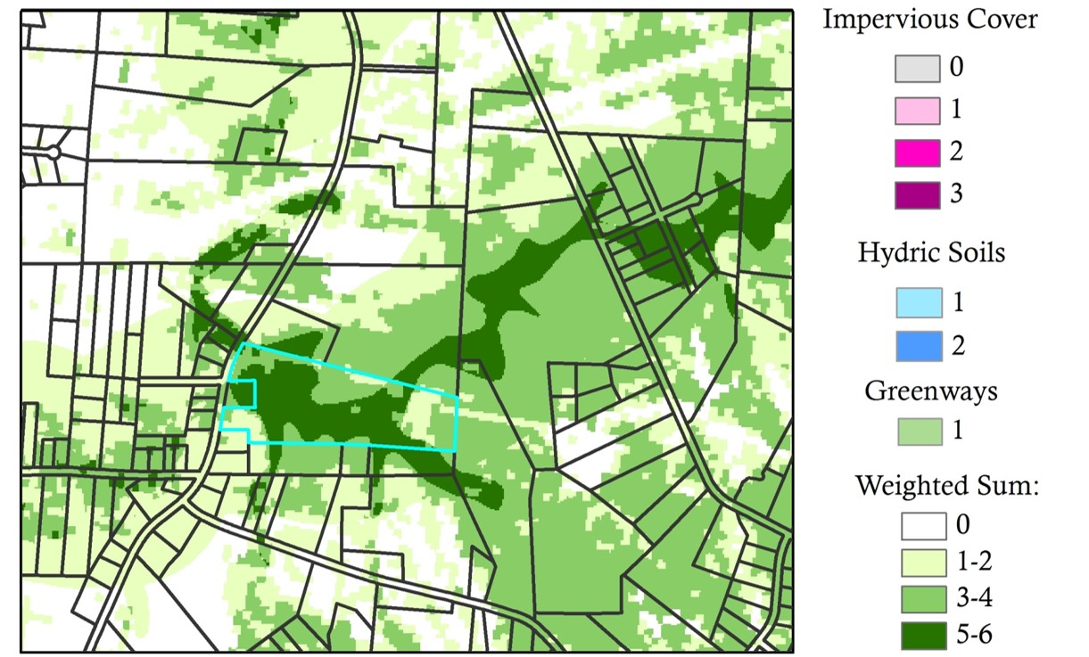
Zonal Statistics to rank mean values

Slide 17
Lower Abbotts Creek
Conservation Output Raster

Slide 18
Lower Abbotts Creek
Stress Input Layers

Slide 19
Lower Abbotts Creek
Future Growth Input Layers

Slide 20
Lower Abbotts Creek
Stress Output Raster

Slide 21
Lower Abbotts Creek
Project Atlas

Slide 22
New Techniques for Swearing Creek
Buffer Analysis
GIS to guide field work

Slide 23
Buffer Analysis
Riparian buffer analysis to build upon GIS model
Review vegetated cover within 100-foot stream buffer for each stream segment
5 tiered system:
Pristine – complete cover
Impacted – majority cover with some human activity
Managed – human activity actively degrades streams; buffer absent on one side
Degraded – buffer mostly absent on both sides
Absent – no vegetated buffer

Slide 24
Elkin Water Supply Watershed
Buffer analysis
Stream Health

Slide 25
Elkin Water Supply Watershed
Buffer analysis
Stream Health

Slide 26
Buffer Analysis
NHD Flowline provides 364 stream segment

Slide 27
Buffer Analysis
NHD Flowline provides 364 stream segment
ArcHydro burned-in 2,103 stream segments

Slide 28
GIS Modeling to Guide Fieldwork
Predictions for:
Sediment loads
Nitrogen & phosphorus loads
Bacterial impairment
BMP Sites
Model potential benefits of potential BMP sites
Runoff based on landuses

Slide 29
GIS Modeling to Guide Fieldwork
Better Assessment Science Integrating Point and NonPoint Sources (BASINS)
Generalized Watershed Loading Function (GWLF)
Assesses non-point source flow and sediment and nutrient loading from urban and rural watersheds
Simulates runoff, sediment, and nutrient loadings (N & P) from a watershed given land covers
Pollutant Loading Estimator (PLOAD)
Computes nonpoint source loads based on annual precipitation, land uses and BMPs

Slide 30
GIS Modeling to Guide Fieldwork
Soil and Water Assessment Tool (SWAT)
Simulates quality and quantity of surface and ground water
Predicts the environmental impact of land use, land management practices and climate change
~~~~~~~~~~~~~~~~~~~~~~~~~~~~~~~~~~~~
System for Urban Stormwater Treatment and Analysis INtegration (SUSTAIN)
Identifies cost-effective methods to address stormwater (BMPs)

Slide 31
GIS Modeling to Guide Fieldwork
http://stormwater.pca.state.mn.us/index.php/Available_stormwater_models_and_selecting_a_model

Slide 32
Piedmont Together Work – how do we incorporate?
Green Infrastructure Network
Scenario Modeling
MapViewers

Slide 33
Green Infrastructure Network
Input Layers:
Water (PTRC regional assessment)
Biodiversity (state assessment)
Farm & Forest
PUV
Prime Farmland Soils
Contiguous Forest Cover

Slide 34
Scenario Modeling
Trend Development

Slide 35
Scenario Modeling
1. Efficient

Slide 36
Scenario Modeling
2. Connections

Slide 37
Scenario Modeling
3. Conservation

Slide 38
Scenario Modeling
3. Hybrid

Slide 39
Map Viewers
http://ptrc.maps.arcgis.com/home/
Piedmont Together
Swearing Creek

