Slide 1
Phytoplankton Sampling Protocols Development Department of Environmental Quality Division of Water Resources
July 31st, 2018

Slide 2
Why do we need them?
Algal blooms occur in the Cape Fear River
Algae known to produce toxins
Large long river
Monitoring/Assessing blooms requires multiple agencies
2013 Seventy one miles of visible flecks and swirls
Coordinated response:
DWR (WSS, FRO, WiRO) Coalitions (MCFRBA & LCFRP), ACOE, PWS, WTP & DPH
2015 Bloom reported after the Toledo water crisis
Coordinated response:
DWR (WSS, WiRO), PWS, DPH, WTPs, & Coalitions (MCFRBA & LCFRP)
Cape Fear River Water Quality Model Development

Slide 3
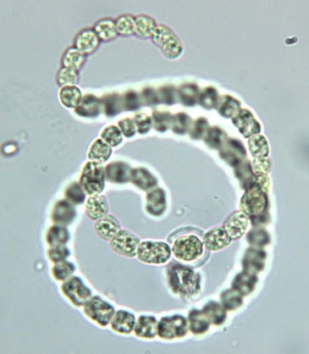
Current protocols insufficient
Developed for routine monitoring
Episodic protocols too general
Encompasses all algae, aquatic plants and related organisms
Random bottles (i.e. Water, Gatorade, gelato)
Health concerns not major focus
Needs to address
In-house Cyanotoxin analytical capabilities
Collection and handling important!
Quality Assurance
Results must be legally defensible

Slide 4
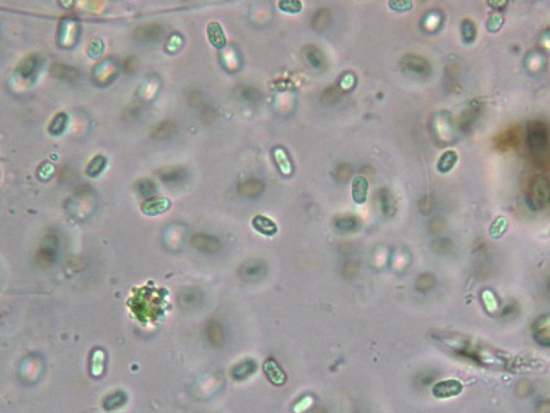
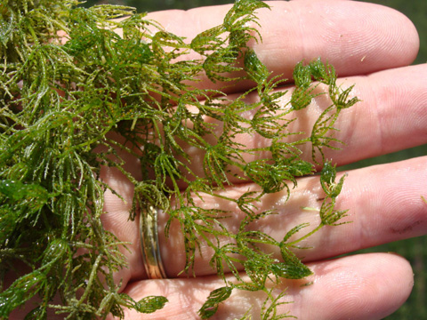
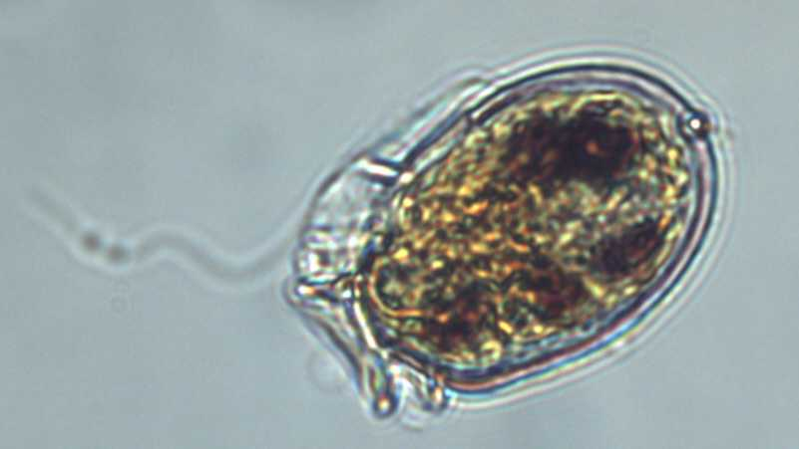
Algae Basics
Not plants!
Diverse group of somewhat related organisms
Algae forms: Phytoplankton, Filamentous & Periphyton
Procedures concentrate on phytoplankton:
Algae in water column
Concentration varies
Spatial and temporal
Quantification/Densities
Blooms move!
Flowing water
Wind and waves

Slide 5
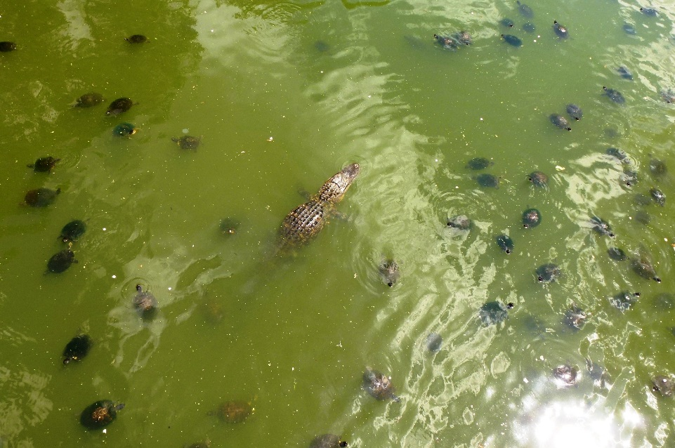
How difficult can it be?
Find a bloom
Put it in a bottle
Send it to a phycologist
How many phycologists do you know?
Everything relies on:
Communication
Coordination
Contacts
PRACTICE!

Slide 6
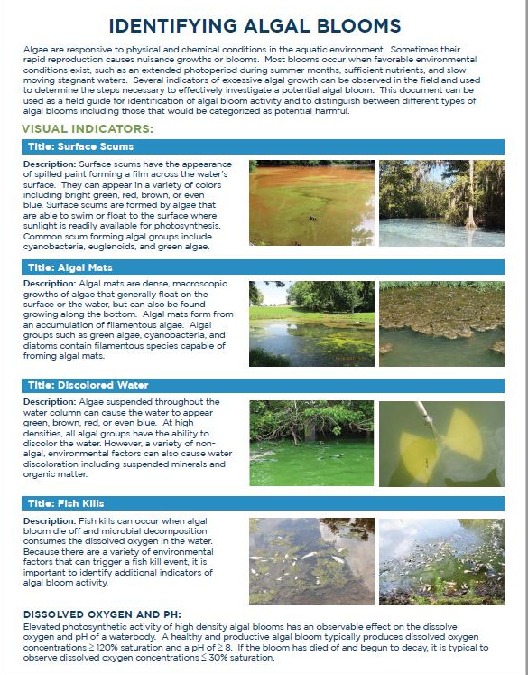
Challenges
What do you sample?
Water column
Photic vs grab
Surface film
Shipping and handling
When to preservative
Quantification requires it
Toxin analysis? Maybe.
Recreational: no
Finished drinking water: yes

Slide 7
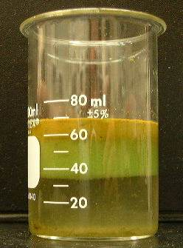
What is the question?
Multiple protocols to select from
Photic vs grab
Quantification
Surface scoop
Exposure risk assessment
Recreational
Shoreline, surface & water column
Aquatic life
Water column
Drinking water
Source (raw) and finished
Division of Public Health: Health Risk Evaluations (HREs)
HREs based on:
Cell counts
Toxin levels (ug/L or ppb)
May (often) require more than one sample

Slide 8
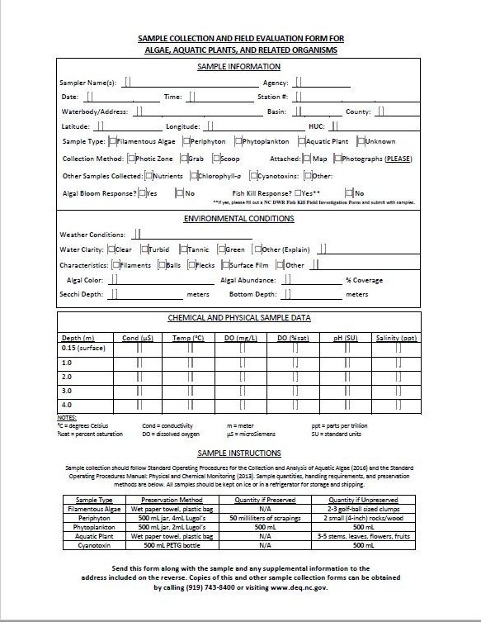
Supplies, Equipment & Documents
Draft Algal Bloom and Cyanotoxin
- Field Collection and Response Protocol
Sample collection form
Physical parameters: meters
Dissolved oxygen & pH
Chemical parameters: bottles and coolers
Chlorophyll-a & nutrients
Phytoplankton:
Bottle selection important
Disposable
lugol’s solution stains
PTEG
Reusable
Wash
Glass amber

Slide 9
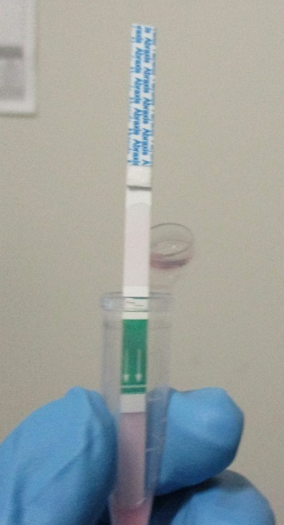
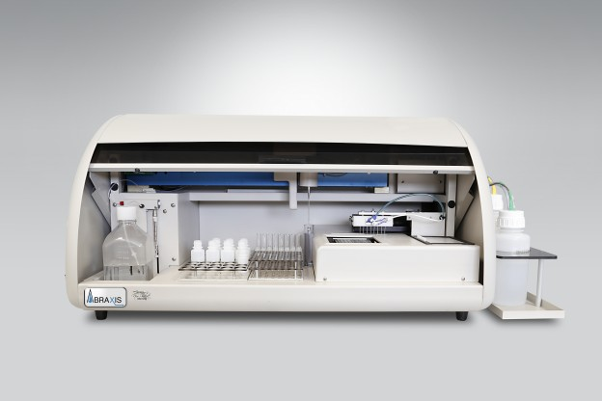
Cyanotoxin Testing Development
Field Staff/Regional Office
Abraxis cyanotoxin test strips
Rapid assessment
Field or office use
Available for a range of toxins
Freshwater, marine, recreational & finished drinking water
Currently evaluating Microcystin recreational (10 µg/L)
Water Sciences Section Chemistry Laboratory
Abraxis Cyanotoxin Automated Assay System
ELIZA instrument
Quality assurance and Quality Control procedures
sample collection, handling & processing procedures

Slide 10
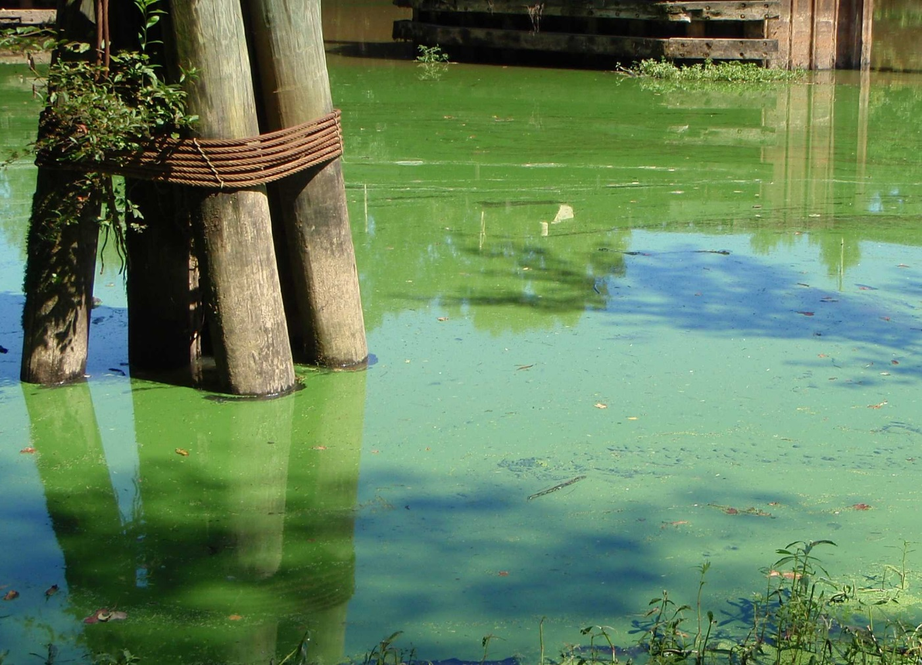
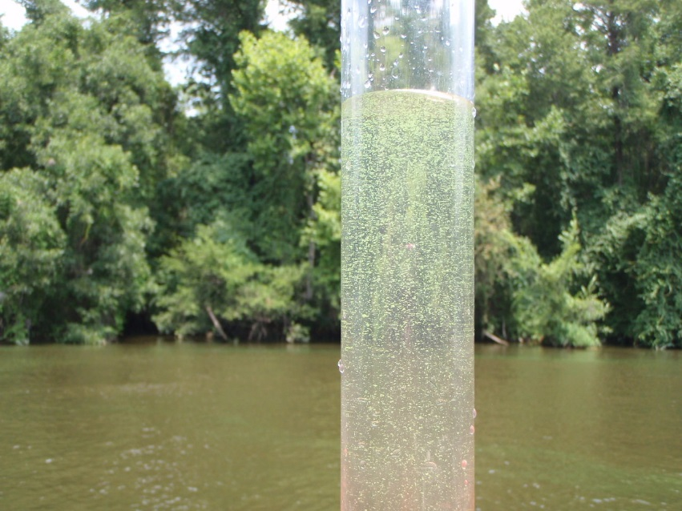
Conclusion
Phyto sampling protocols needed
Can be field tested
Multiple agencies/organizations can follow
Blooms can be better documented
Exposure risks be better evaluated
Data is comparable
Data is defensible

Slide 11
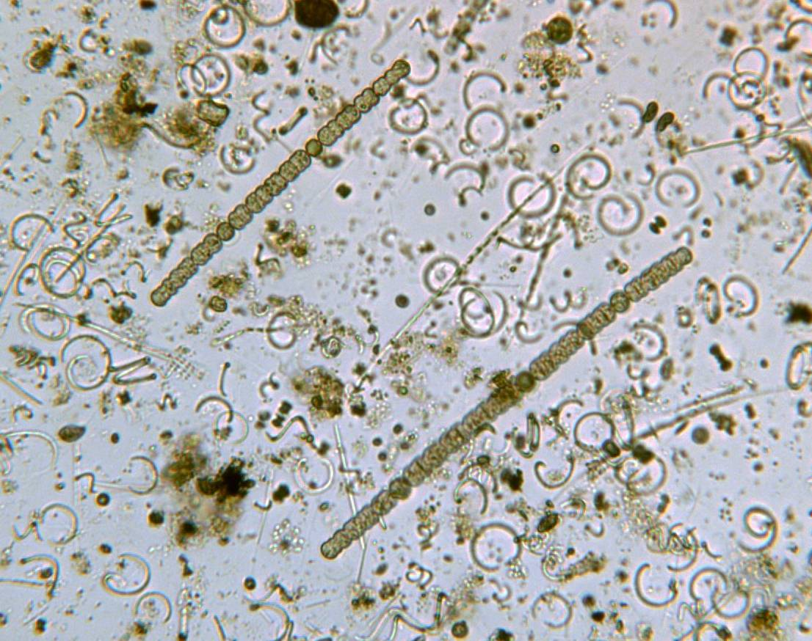
Contact Information: Ecosystems Branch
Brian Wrenn: Supervisor
brian.wrenn@ncdenr.gov
(919) 743-8409
Leigh Stevenson
leigh.Stevenson@ncdenr.gov
(919) 743-8451
Elizabeth Fensin
elizabeth.Fensin@ncdenr.gov
(919) 743-8421
Mark Vander Borgh
mark.vanderborgh@ncdenr.gov
(919) 743-8423

