Slide 1
Algal Blooms and Cyanotoxins in Jordan Lake, NC
Dan Wiltsie
NC Division of Water Resources
Upper Cape Fear River Basin Association
Technical Advisory Committee meeting
July 31, 2018

Slide 2
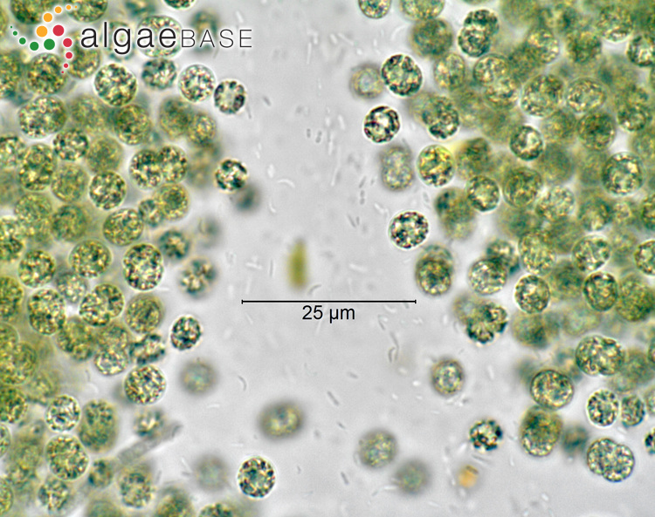
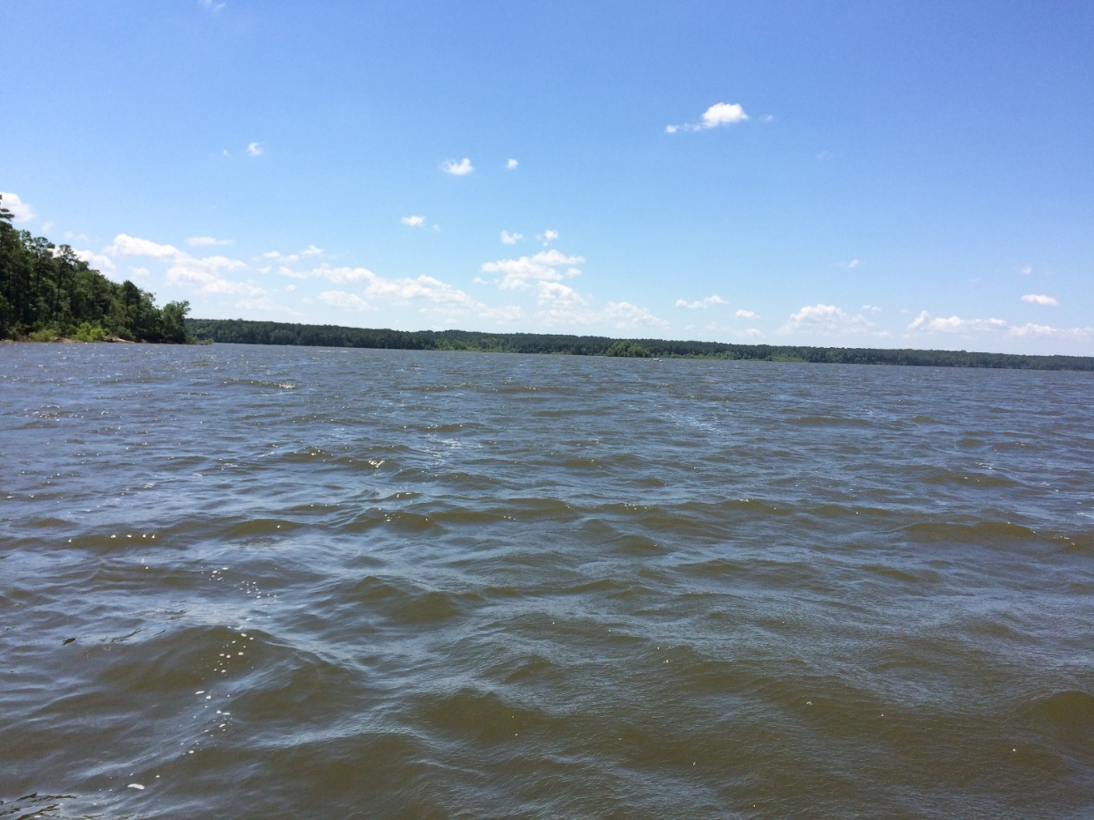
Cyanobacterial Harmful Algal Blooms (CyanoHABs) and Jordan Lake
Cyanobacteria
- blue-green algae
Jordan Lake
Built from 1967 to 1983
Flood control, drinking water, recreation
Has been monitored for a long time
(NC Division of Water Resources)
Microcystis spp.
Popular Science
2014
Notes:
Microcystis: http://www.algaebase.org/search/species/detail/?species_id=30050
Fish: https://www.climate.gov/sites/default/files/lake-erie-algae-bloomFish_large.jpg
Bloom: https://www.popsci.com/article/science/lake-eries-toxic-algal-bloom-seen-space#page-2
Sign: https://phys.org/news/2015-06-algal-blooms-ponds-lakes.html
For fish – only mention low oxygen levels caused by degradation of bloom
For size – these organisms are microscopic, but collectively they can be seen from space
CyanoHAB – created by proliferation of cyanobacteria (blue-green algae)
Have been reported as early as 16th century by explorers in the Gulf of Mexico. They’ve been around a long time and people have been studying them, but they’re getting worse now
Effects – decreased water quality, low oxygen levels, fish kills, decreased tourism, closed fisheries, toxin production?
Costs – water monitoring, drinking water treatment, impacted recreational use and fisheries = annually millions to billions of dollars (not just in U.S.)
Lake Erie – caused drinking water ban for over 400,000 people in Ohio and Michigan
Say who, what and why before going into details
Background – important in food web, debate over whether they are getting worse (increasing in frequency), tied to nutrient eutrophication (agriculture and urban) and temperature increase (climate change)
Don’t mention difference between cyanobacteria and microeuks (just that they are all algae)
Lake Erie – small cell sizes but can see bloom from space
Will come back to toxins
Effects - Not one of these is the main cause (so only call them known contributing factors)

Slide 3
CyanoHABs in Jordan Lake
Research questions
Are there spatiotemporal patterns for phytoplankton assemblages?
Can environmental parameters be identified as drivers of phytoplankton abundance and/or composition shifts?
Are cyanotoxins present and can they be linked to environmental conditions?

Slide 4
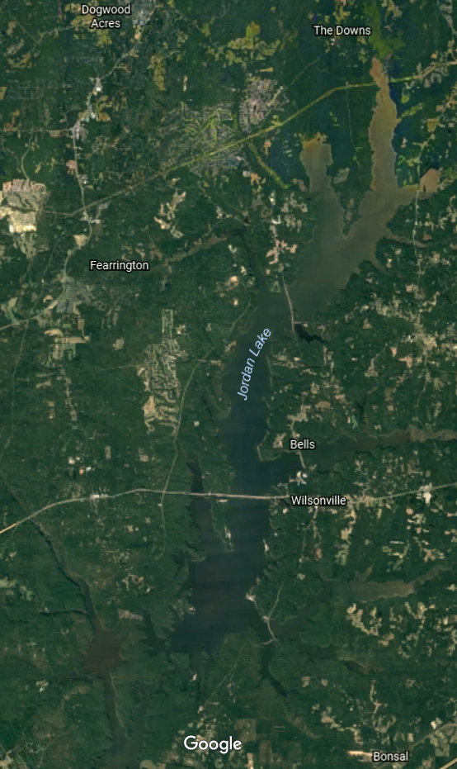
Jordan Lake
New Hope Creek
Morgan Creek
Sampling and methods
6 year time series
Biweekly to monthly sampling
Biological (algal abundance and composition)
Environmental parameters
Chemical (NH₃, NO_{x}, TKN, TP, turbidity)
Physical (temperature, dissolved oxygen, pH)
Meteorological (precipitation, wind speed, solar radiation)
Hydrological (river flows)
Toxin sampling
D
F
E
G
A
Haw River
B
H
C
I
Dam
Notes:
If more details are needed, you can ask at the end
Physicochemical, hydrologic, climatic parameters (more details later)

Slide 5
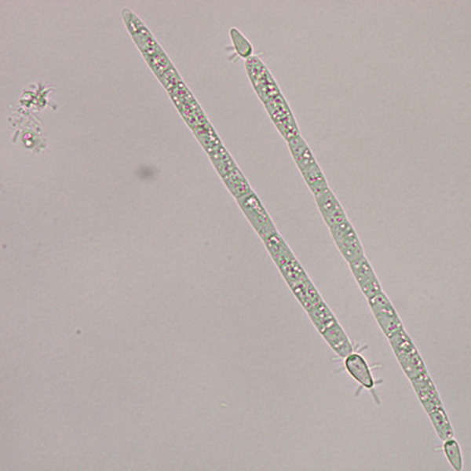
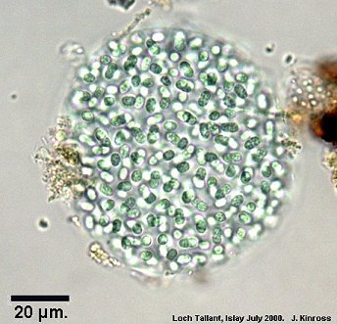
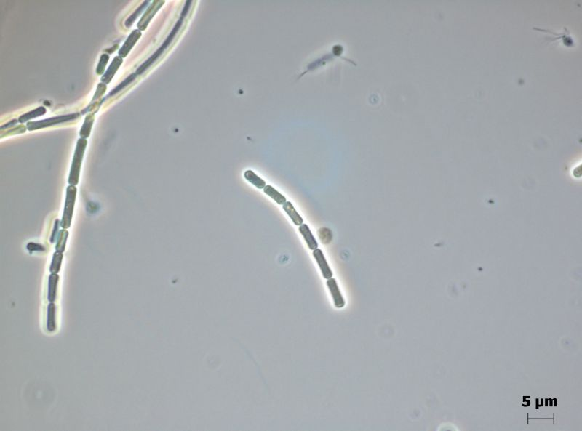
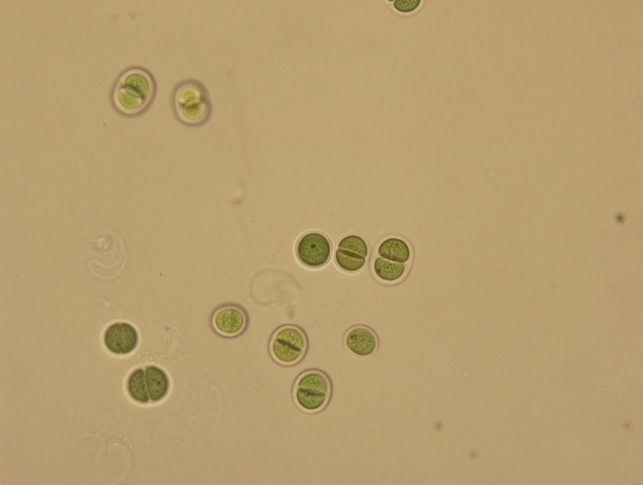
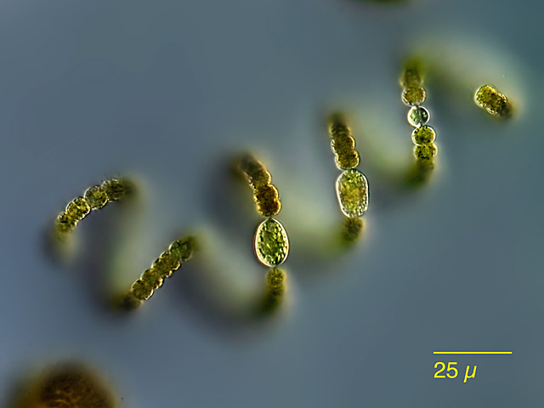
1. Are there spatiotemporal patterns for phytoplankton assemblages?
NCCOS NOAA
Algal Web
Culture Collection Yerseke
Cylindrospermopsis spp.
Aphanocapsa spp.
Pseudanabaena spp.
Cawthron Institute
Mikro Forum
Chroococcus spp.
Microcystis spp.
Dolichospermum spp.
Notes:
Cylindrospermopsis: https://products.coastalscience.noaa.gov/pmn/image_gallery_freshwater_plankton.aspx
Aphanocapsa: http://algalweb.net/aphanocapsa3.jpg
Pseudanabaena: https://ccy.nioz.nl/Cyanobacteria/CCY0391
Chroococcus: http://cultures.cawthron.org.nz/ciccm/index.php?-table=cultures&-action=browse&id=%3D187
Microcystis: http://www.algaebase.org/search/species/detail/?species_id=30050
Dolichospermum: http://www.mikroskopie-forum.de/index.php?topic=7102.0
Explain difference between phytoplankton, cyanobacteria and microeukaryotes
Several toxins produced by several genera but do not do so all the time. Most common in general but also in JL
Single cell to colonial, filamentous

Slide 6
Cyanobacterial composition changes at 3 long-term sites
2011
2012
2013
2014
2015
2016
Monthly and seasonal but no inter-annual trends
Low spatial variability
2 year shifts in dominant genus
Cell density (x10⁶ cells mL⁻¹)
Notes:
Here – start with three long term sites
Trends – summer blooms (seasonal variability), weaker spatial trends. Diff members in the most abundant that change from yr to yr but main guys always there
Chl a biomasss proxy increased during summer Look at more detail at all 3 long term stations, find that there was seasonal and monthly trends and 6 most abundant organisms (95%) were present. 2 year shifts seen at all 3 sites.
Bring in main points

Slide 7
2. Can environmental parameters be identified as drivers of phytoplankton abundance and/or composition shifts?
Chemical
NO_{x} (nitrate plus nitrite)
NH₃ (ammonia)
TKN (total Kjeldahl nitrogen)
Organic N plus ammonia
TP (total phosphorus)
TKN:TP
Turbidity
Physical
Temperature
DO (dissolved oxygen)
pH
Meteorological
Precipitation
Wind speed
PAR (Photosynthetically Active Radiation)
Hydrological
Morgan Creek flow
New Hope Creek flow
Haw River flow
Notes:
Highlight which ones we found a relationship with and they are only a few of them
Are these env parameters correlated with each other? Are these collinear
Other parameters that were not collinear
Temp didn’t show up (surprise)
Precip and wind speed (bringing nutrients in and mixing – surprise)

Slide 8
2. Can environmental parameters be identified as drivers of phytoplankton abundance and/or composition shifts?
Chemical
NO_{x} (nitrate plus nitrite)
NH₃ (ammonia)
TKN (total Kjeldahl nitrogen)
Organic N plus ammonia
TP (total phosphorus)
TKN:TP
Turbidity
Physical
Temperature
DO (dissolved oxygen)
pH
Meteorological
Precipitation
Wind speed
PAR (Photosynthetically Active Radiation)
Hydrological
Morgan Creek flow
New Hope Creek flow
Haw River flow
Nitrogen species as consistent driver of biomass and density changes
Notes:
Highlight which ones we found a relationship with and they are only a few of them
Are these env parameters correlated with each other? Are these collinear
Other parameters that were not collinear
Temp didn’t show up (surprise)
Precip and wind speed (bringing nutrients in and mixing – surprise)

Slide 9
2. Can environmental parameters be identified as drivers of phytoplankton abundance and/or composition shifts?
Chemical
NO_{x} (nitrate plus nitrite)
NH₃ (ammonia)
TKN (total Kjeldahl nitrogen)
Organic N plus ammonia
TP (total phosphorus)
TKN:TP
Turbidity
Physical
Temperature
DO (dissolved oxygen)
pH
Meteorological
Precipitation
Wind speed
PAR (Photosynthetically Active Radiation)
Hydrological
Morgan Creek flow
New Hope Creek flow
Haw River flow
Nitrogen species as consistent driver of biomass and density changes
Dissolved N and temperature best explain genera composition shifts
Notes:
Highlight which ones we found a relationship with and they are only a few of them
Are these env parameters correlated with each other? Are these collinear
Other parameters that were not collinear
Temp didn’t show up (surprise)
Precip and wind speed (bringing nutrients in and mixing – surprise)

Slide 10
2. Can environmental parameters be identified as drivers of phytoplankton abundance and/or composition shifts?
Chemical
NO_{x} (nitrate plus nitrite)
NH₃ (ammonia)
TKN (total Kjeldahl nitrogen)
Organic N plus ammonia
TP (total phosphorus)
TKN:TP
Turbidity
Physical
Temperature
DO (dissolved oxygen)
pH
Meteorological
Precipitation
Wind speed
PAR (Photosynthetically Active Radiation)
Hydrological
Morgan Creek flow
New Hope Creek flow
Haw River flow
Nitrogen species as consistent driver of biomass and density changes
Dissolved N and temperature best explain genera composition shifts
Meteorological parameters did not correlate well with shifts
Notes:
Highlight which ones we found a relationship with and they are only a few of them
Are these env parameters correlated with each other? Are these collinear
Other parameters that were not collinear
Temp didn’t show up (surprise)
Precip and wind speed (bringing nutrients in and mixing – surprise)

Slide 11
3. Are cyanotoxins present and can they be linked to environmental conditions?
Toxin removal - WTPs
Over 12 cyanotoxin classes
5 different types of toxins tested
MCY Guidelines (EPA)
Drinking water (10-day health advisories)
0.3 µg L⁻¹ for infants
1.6 µg L⁻¹ for adults
Recreational water
4 µg L⁻¹
Toxin | Main Effect | National Guidelines | Comparable Toxin
Microcystin (MCY) | Hepatotoxin | Yes | Sarin
Cylindrospermopsin (CYN) | Hepatotoxin | Yes | Strychnine
Anatoxin-a (ANA) | Neurotoxin | No | Curare
Saxitoxin (STX) | Neurotoxin | No | Ricin
β-N-methylamino-L-alanine (BMAA) | Neurotoxin | No
Notes:
MCY – 80 congeners, most studied toxin
All toxins can be lethal at high doses, but acute exposure can lead to rashes, respiratory problems
Routes of production and effects of multiple toxins are not well understood
Water treatment plants have robust, effective methods in place to remove these toxins from raw water before becoming drinking water
Big picture – no national guidelines b/c not much research has been done
Last column – comparisons with other chemicals (Cheung paper)

Slide 12
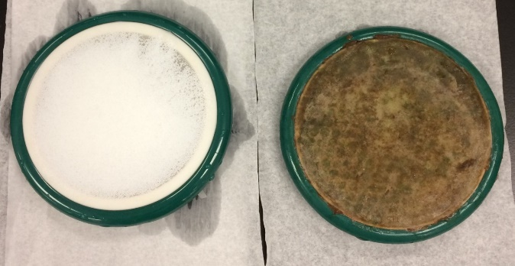
Complicating issues
SPATTs (Solid Phase Adsorption Toxin Tracking)
Pros
Time-integrative signal
Low detection limit
Fresh to marine application
Multiple toxin detection
Easy to deploy and recover
Cons
Semi-quantitative
No link to regulatory limit
What toxin ranges are found naturally?
Multiple toxins present?
Lack of epidemiological studies

Slide 13
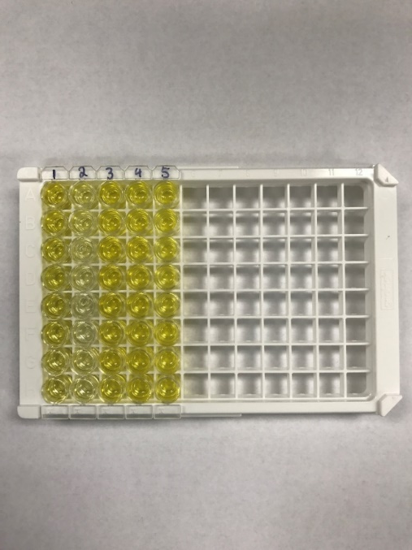
New Hope Creek
Toxin testing
Morgan Creek
SPATTs
(Sites E and G)
Grab samples
(Sites A through G)
Enzyme-Linked Immunosorbent Assay (ELISA)
D
F
E
G
A
Haw River
B
H
C
I
Dam
Notes:
Mention again that 4 out 5 toxins were discovered based on grab and SPATT samples (reiterate that this is only dissolved, not total which is dissolved plus particulate)
Talk about different axes. Primary axis is SPATT data (columns) and secondary axis is grab (symbols). Mention that the units are different and so direct comparisons (and matching SPATT data to recreational and drinking guidelines) is impossible.
SPATTs were able to more consistently detect MCY than grab samples. CYN was detected more via grab samples than SPATTs. And ANA was found consistently based on both (this is what we expect to find). However, both methods showed that all three toxins are found year round in lake.
Bring in map, x axis on each, lines for years, increase font size
Could truly mean that there is more MCY than CYN
Bring in main points
Boxes around the small columns for MCY SPATTs

Slide 14
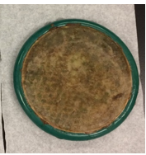
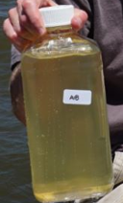
Toxin presence
(site E)
SPATTs detected MCY year-round
2015
Microcystin
2016
Cylindrospermopsin
Limited data for CYN
ng toxin [g resin]⁻¹ d⁻¹
ng toxin mL⁻¹
Anatoxin-a
Consistent SPATT and grab data for ANA
Notes:
Mention again that 4 out 5 toxins were discovered based on grab and SPATT samples (reiterate that this is only dissolved, not total which is dissolved plus particulate)
Talk about different axes. Primary axis is SPATT data (columns) and secondary axis is grab (symbols). Mention that the units are different and so direct comparisons (and matching SPATT data to recreational and drinking guidelines) is impossible.
SPATTs were able to more consistently detect MCY than grab samples. CYN was detected more via grab samples than SPATTs. And ANA was found consistently based on both (this is what we expect to find). However, both methods showed that all three toxins are found year round in lake.
Bring in map, x axis on each, lines for years, increase font size
Could truly mean that there is more MCY than CYN
Bring in main points
Boxes around the small columns for MCY SPATTs

Slide 15
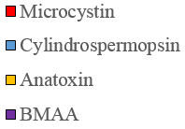
Seasonal toxin presence throughout the lake
Microcystin and anatoxin were correlated
Anatoxin positively correlated with TKN:TP
Saxitoxin not detected (n=40)
Multiple toxins at multiple locations (43%)
First record of cylindrospermopsin, anatoxin-a and BMAA in Jordan Lake
Notes:
MCY and ANA correlation – if one was there, so was the other one
ANA and TKN:TP correlation – indicates shifts in nutrient ratios could be important for ANA production
Limitations – number of positive samples, may not be measuring pertinent parameters

Slide 16
Lingering questions/future research
Tying assemblage information to toxins
Chronic exposure to year-round, low toxin levels?
Exposure to multiple toxins?
Potential food web accumulations (fish, shellfish consumption)?
Different resins for different toxins (chemistry)
Notes:
Jumping into lake: http://www.advisor.ca/tax/tax-news/legacy-of-the-family-cottage-2422
Boat: http://www.reelretreat.com/fishing.html
Inner tube: http://www.gettyimages.com/detail/photo/teenage-boy-on-inner-tube-by-lake-portrait-high-res-stock-photography/200510682-002
Considering large population growth in area (and expected to continue), routine monitoring is essentially to protecting human and ecosystem health.
Mention three metrics for risk assessments (MCY concentration, Chl a concentration and cyanobacterial abundance)
Bring chl a and MCY maps in (symbols with only none, low mod and high risk in text box beside it to be used for both) and label both maps as simply chl a and MCY
Put in definition (10% of summer concentrations)
Bring in all lingering questions at once
Maps – box around NC showing coverage

Slide 17
Thank you!
Questions?

Slide 18
Acknowledgments
North Carolina Division of Water Resources (NC DWR) – Jason Green, Mark Vander Borgh, Elizabeth Fensin
Master’s thesis committee – Dr. Astrid Schnetzer, Dr. Chris Osburn, Dr. Nathan Hall
Plankton Ecology lab
Tarek Aziz and Dan Obenour, Dept. of Civil, Construction, and Environmental Engineering
Raphe Kudela, UCSC
Bob Clarke, PRIMER-E Ltd.
NC Sea Grant
Urban Water Consortium (UWC)/Water Resources Research Institute (WRRI)
Notes:
Include Jason, etc.

Slide 19
Status of knowledge of toxins in NC
Location | Month, year | Water body | Toxin | Ave (µg L⁻¹) | n | Reference
Apex | Aug 2015 – | Jordan Lake | MCY | 0.06 | 65 | This study
 | Dec 2016 |  | CYN | 0.02 | 63
 |  |  | ANA | 0.11 | 69
 |  |  | BMAA STX | 9.32 ND | 64 40
Piedmont | Jun – Aug 2002 | 11 reservoirs (including | MCY | 0.17 | 6 | Touchette et
 |  | Jordan Lake) | STX (1 lake) |  |  | al., 2007
Statewide | Jun – Jul 2007 | 10 reservoirs | MCY | 0.25 | 1 or 2 | Loftin et al., 2016
Waterville | Oct 2007 | Waterville Reservoir | MCY | 824.3 | 3 | Allender et al., 2009
Riegelwood | Fall 2009, Summer 2012 | Cape Fear River | MCY | Positive | Not given | Isaacs et al., 2014
Piedmont | Jun 2011 – Sep 2012 | 4 reservoirs | MCY | 0.19 | 5 | Grubbs et al., 2014
Notes:
Data thief program to give actual concentrations – before thesis submission
Get rid of asterisks
Few studies
Box over toxin column (first of its kind multiple toxins in addition to MCY)
Second box – for month, year. Only one that has done year round studies for multiple sites
Put in other toxins that were found
List STX for this study and label ND

Slide 20
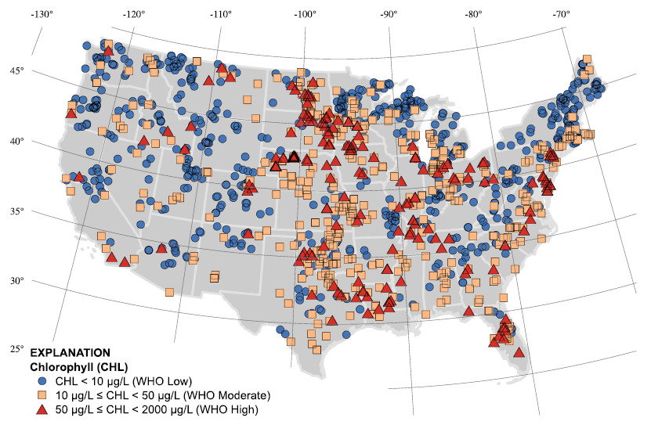
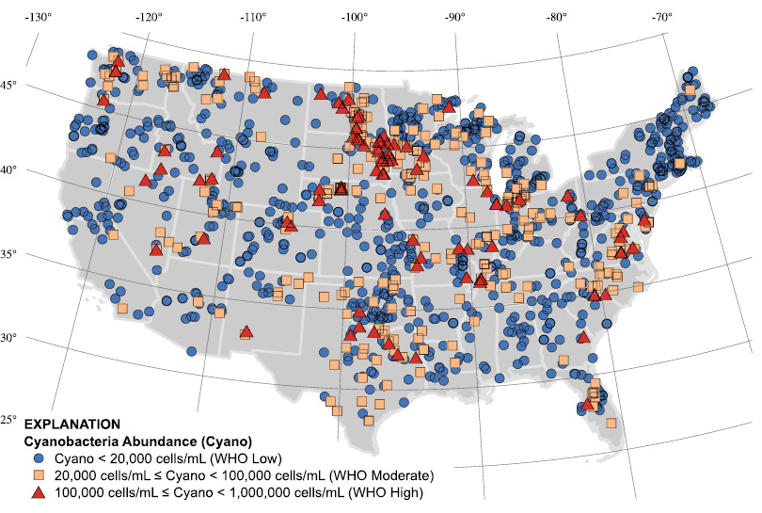
Environmental Protection Agency (EPA) National Lakes Assessment 2007
v
v
v
Loftin et al., 2016
Notes:
Why MCY? Most studied (also have some for CYN)
None for ANA, STX and BMAA
Continued research is necessary to understand causes and protect human and ecosystem health
Bring in cyano abundance map
Using proxies to determine toxins (chl a and abundance)
Bring in 4 main points
Map first, with MCY map beside it, then bring in plot

Slide 21
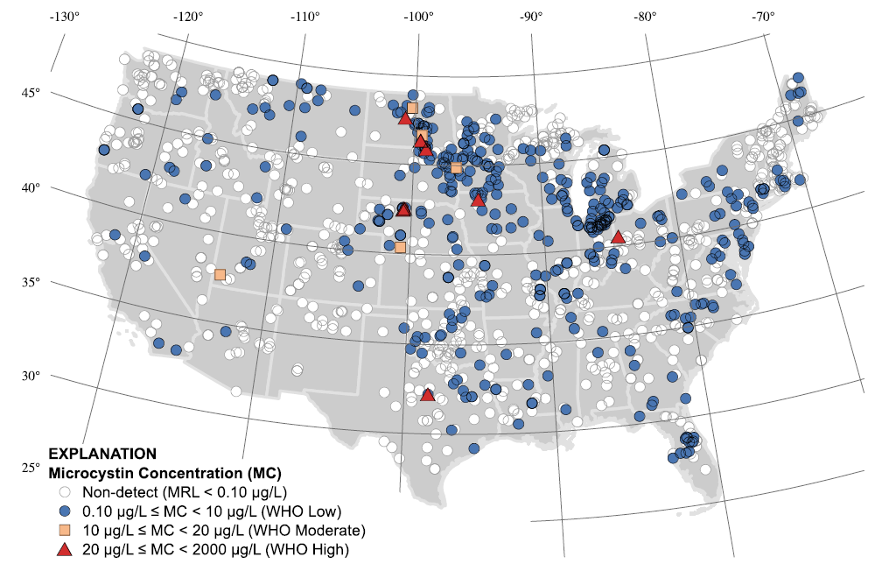
Loftin et al., 2016
v
v
v
v
v
Loftin et al., 2016
Notes:
4 main points from Loftin
MCY most commonly detected cyanotoxin (more research is needed to understand occurrence of other toxins)
Toxins detected in almost every state (92%)
Cyanotoxin risk assessment is complex
MCY risk estimates based on WHO guidelines varied depending on used metric even though potential MCY cyanobacteria were dominant in most samples
Why MCY? Most studied (also have some for CYN)
None for ANA, STX and BMAA
Using proxies to determine MCY concentration (chl a and abundance)
Map first, with MCY map beside it, then bring in plot

Slide 22
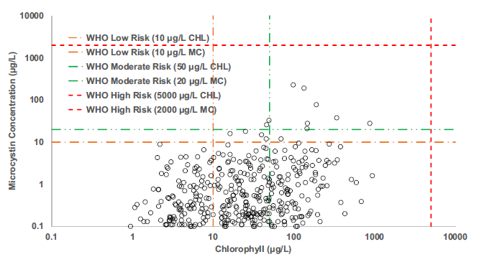
Loftin et al., 2016

Slide 23
Site ID | DWR ID | Lat (ºN) | Long (ºW) | From | To | n | Ave. Water Column Depth (m)
A | CPF086F | 35.794 | 79.004 | Jan 2011 | Dec 2016 | 98 | 5.06
B | CPF087D | 35.742 | 79.021 | Jan 2011 | Dec 2016 | 96 | 7.67
C | CPF055C | 35.687 | 79.083 | Jan 2011 | Dec 2016 | 95 | 5.87
D | CPF086CUPS | 35.837 | 79.001 | Oct 2014 | Jun 2016 | 26 | 1.47
E | CPF086C | 35.825 | 78.998 | Oct 2014 | Dec 2016 | 34 | 2.92
F | CPF081A1B | 35.836 | 78.976 | Oct 2014 | Jun 2016 | 25 | 1.82
G | CPF081A1C | 35.815 | 78.983 | Oct 2014 | Dec 2016 | 32 | 3.16
H | CPF055C1 | 35.699 | 79.082 | Oct 2014 | Jun 2016 | 27 | 2.25
I | CPF055C6 | 35.682 | 79.078 | Oct 2014 | Jun 2016 | 27 | 8.50

Slide 24
Parameter | Units | Collecting agency | Day delays
Sample depthª | m | NC DWR
Temperature^{b} | ºC | NC DWR
Dissolved oxygen^{b} | mg L⁻¹ | NC DWR
pH^{b} |  | NC DWR
NH₃^{c} | mg L⁻¹ | NC DWR
NO_{x}^{c} | mg L⁻¹ | NC DWR
TKN^{c} | mg L⁻¹ | NC DWR
TP^{c} | mg L⁻¹ | NC DWR
Turbidity^{c} | NTU | NC DWR
Drought index^{d} |  | NC DWR
Precip^{d} | cm | State Climate Office of NC | 0, 5, 10
Wind speed^{d} | m s⁻¹ | State Climate Office of NC | 0, 5
PAR^{d} | W m⁻² | State Climate Office of NC | 4
Morgan Creek flow^{d} | m³ s⁻¹ | USGS: Morgan Creek near Chapel Hill, NC (35.89333ºN, 79.01972ºW, 02097517) | 0, 5, 10
New Hope Creek flow^{d} | m³ s⁻¹ | USGS: New Hope Creek near Blands, NC (35.885ºN, 78.96528ºW, 02097314) | 0, 5, 10
Haw River flow^{d} | m³ s⁻¹ | USGS: Haw River near Bynum, NC (35.76528ºN, 79.13583ºW, 02096960) | 0, 5, 10

Slide 25
 | Month |  | Season |  | Year |  | Site
 | R | P | R | P | R | P | R | P
Temperature | 0.702 | 0.0001 | 0.614 | 0.0001 |  | NS |  | NS
Chl a |  | NS |  | NS |  | NS | 0.133 | 0.0001
NO_{x} | 0.185 | 0.0001 | 0.194 | 0.0001 |  | NS | 0.215 | 0.0001
NH₃ | 0.086 | 0.0001 | 0.091 | 0.0001 | 0.183 | 0.0001 |  | NS
TKN | 0.022 | 0.018 | 0.015 | 0.042 |  | NS | 0.21 | 0.0001
TP |  | NS |  | NS |  | NS | 0.385 | 0.0001
TKN:TP |  | NS | 0.025 | 0.003 |  | NS | 0.335 | 0.0001
DO | 0.197 | 0.0001 | 0.146 | 0.0001 | 0.031 | 0.015 |  | NS
pH | 0.103 | 0.0001 | 0.103 | 0.0001 |  | NS | 0.07 | 0.0001
Turbidity | 0.021 | 0.012 | 0.038 | 0.0001 | 0.028 | 0.013 | 0.346 | 0.0001
Precipitation | 0.054 | 0.0002 |  | NS | 0.044 | 0.011
Wind speed | 0.154 | 0.0001 | 0.066 | 0.0001 | 0.118 | 0.0001
PAR | 0.333 | 0.0001 | 0.253 | 0.0001 |  | NS
Morgan Creek flow | 0.221 | 0.0001 | 0.188 | 0.0001 | 0.094 | 0.0001
New Hope Creek flow | 0.266 | 0.0001 | 0.193 | 0.0001 | 0.054 | 0.0003
Haw River flow | 0.249 | 0.0001 | 0.201 | 0.0001 | 0.038 | 0.0006

Slide 26
Site |  | Temp | Chl a | NO_{x} | NH₃ | TKN | TP | TKN:TP | DO | pH | Turb | n
 |  | (ºC) | (µg L⁻¹) | (mg L⁻¹) | (mg L⁻¹) | (mg L⁻¹) | (mg L⁻¹) |  | (mg L⁻¹) |  | (NTU)
A | Min | 4.37 | 9.00 | 0.01 | 0.01 | 0.70 | 0.04 | 7.69 | 3.23 | 5.33 | 6.50 | 98
 | Max | 30.78 | 99.00 | 0.41 | 0.18 | 1.50 | 0.13 | 21.75 | 13.33 | 9.17 | 35.00
 | Ave | 20.66 | 47.21 | 0.07 | 0.04 | 0.98 | 0.08 | 13.39 | 8.02 | 7.69 | 14.24
B | Min | 6.26 | 7.10 | 0.01 | 0.01 | 0.58 | 0.00 | 12.67 | 4.60 | 6.57 | 3.40 | 96
 | Max | 30.53 | 57.00 | 0.41 | 0.20 | 1.10 | 0.06 | 36.67 | 12.83 | 8.90 | 17.00
 | Ave | 20.53 | 28.57 | 0.09 | 0.04 | 0.78 | 0.04 | 20.60 | 8.00 | 7.60 | 7.05
C | Min | 4.04 | 4.60 | 0.01 | 0.01 | 0.50 | 0.04 | 5.08 | 4.10 | 6.77 | 4.30 | 95
 | Max | 31.45 | 72.00 | 1.10 | 0.18 | 1.10 | 0.16 | 20.5 | 13.46 | 9.43 | 60.00
 | Ave | 21.56 | 31.26 | 0.37 | 0.03 | 0.82 | 0.08 | 11.46 | 9.07 | 7.97 | 12.78
D | Min | 5.65 | 21.00 | 0.01 | 0.01 | 0.72 | 0.06 | 7.50 | 5.59 | 5.47 | 11.00 | 26
 | Max | 32.45 | 116.00 | 1.40 | 0.06 | 1.50 | 0.16 | 16.67 | 13.12 | 9.52 | 70.00
 | Ave | 19.97 | 58.91 | 0.24 | 0.02 | 1.04 | 0.10 | 10.89 | 9.69 | 8.09 | 30.48
E | Min | 5.29 | 20.00 | 0.01 | 0.01 | 0.68 | 0.05 | 7.86 | 4.97 | 5.47 | 7.90 | 34
 | Max | 31.37 | 116.00 | 0.59 | 0.08 | 1.40 | 0.14 | 20.00 | 12.82 | 9.40 | 40.00
 | Ave | 20.03 | 59.84 | 0.11 | 0.02 | 1.02 | 0.08 | 12.59 | 9.43 | 8.05 | 19.14
F | Min | 4.95 | 9.10 | 0.02 | 0.01 | 0.63 | 0.05 | 6.54 | 4.67 | 5.43 | 14.00 | 25
 | Max | 31.75 | 128.00 | 0.60 | 0.14 | 1.80 | 0.24 | 30.00 | 13.20 | 9.30 | 80.00
 | Ave | 19.85 | 76.00 | 0.14 | 0.03 | 1.16 | 0.13 | 9.43 | 9.32 | 8.05 | 37.81
G | Min | 4.65 | 23.00 | 0.01 | 0.01 | 0.71 | 0.05 | 8.57 | 4.61 | 5.57 | 7.90 | 32
 | Max | 31.25 | 120.00 | 0.48 | 0.08 | 1.40 | 0.14 | 18.80 | 12.52 | 9.07 | 45.00
 | Ave | 19.88 | 62.30 | 0.09 | 0.02 | 1.03 | 0.09 | 12.09 | 9.17 | 7.90 | 21.77
H | Min | 4.24 | 1.00 | 0.09 | 0.01 | 0.45 | 0.05 | 5.14 | 6.10 | 6.91 | 5.00 | 27
 | Max | 30.46 | 59.00 | 1.50 | 0.32 | 1.30 | 0.29 | 13.20 | 13.54 | 8.70 | 180.00
 | Ave | 18.80 | 17.92 | 0.64 | 0.05 | 0.83 | 0.12 | 7.35 | 9.58 | 7.78 | 26.26
I | Min | 4.54 | 6.90 | 0.02 | 0.01 | 0.50 | 0.05 | 5.56 | 5.47 | 7.00 | 5.00 | 27
 | Max | 31.14 | 67.00 | 0.83 | 0.25 | 1.10 | 0.22 | 18.20 | 13.19 | 9.31 | 160.00
 | Ave | 19.38 | 30.46 | 0.36 | 0.05 | 0.82 | 0.08 | 11.58 | 9.59 | 7.93 | 19.59
 | Average Std dev | 20.07 0.79 | 45.83 19.61 | 0.23 0.19 | 0.03 0.01 | 0.94 0.13 | 0.09 0.03 | 12.15 3.64 | 9.10 0.65 | 7.90 0.65 | 21.01 9.45

Slide 27
Parameter | Min | Max | Ave
Precipitation (cm) | 0.00 | 0.02 | 0.01
Wind speed (m s⁻¹) | 1.11 | 8.20 | 4.07
PAR (W m⁻²) | 39.38 | 371.79 | 172.34
Morgan Creek flow (m³ s⁻¹) | 0.10 | 0.21 | 0.12
New Hope Creek flow (m³ s⁻¹) | 0.09 | 0.29 | 0.14
Haw River flow (m³ s⁻¹) | 1.53 | 275.52 | 27.79

Slide 28
Group | Genus | Species
Diatom | Achnanthidium | spp.
 | Aulacoseira | spp.
 | Navicula | spp.
 | Synedra | spp.
 | Unknown centric | spp.
Chlorophyte | Ankistrodesmus | spiriliformis
 | Ankistrodesmus | falcatus
 | Coelastrum | spp.
 | Crucigenia | crucifera
 | Dictyosphaerium | pulchellum
 | Kirchneriella | spp.
 | Scenedesmus | bijuga
 | Scenedesmus | quadricauda
 | Scenedesmus | bicaudatus
 | Tetrastrum | heterocanthum
Chrysophyte | Ochromonas | spp.
Cryptophyte | Cryptomonas | spp.
 | Komma | caudata
Euglenophyte | Trachelomonas | spp.
Prymnesiophyte | Chrysochromulina | spp.
Cyanobacteria | Anabaenopsis | circularis
 | Aphanizomenon | spp.
 | Aphanocapsa | delicatissima
 |  | pulchra
 | Aphanothece | saxicola
 | Chroococcus | spp.
 | Cylindrospermopsis | raciborskii
 | Dolichospermum | circinale
 |  | planctonicum
 |  | spiroides
 |  | spp.
 | Merismopedia | punctata
 | Microcystis | aeruginosa
 |  | firma
 | Planktolyngbya | undulata
 | Pseudanabaena Raphidiopsis | spp. spp.

Slide 29
Density |  |  |  |  |  |  |  | Biovolume
Cyano |  |  |  |  |  |  |  | Cyano
 | Month |  | Season |  | Year |  |  |  | Month |  | Season |  | Year
Site | R | P | R | P | R | P |  | Site | R | P | R | P | R | P
A | 0.225 | 0.0001 | 0.249 | 0.0001 |  | NS |  | A | 0.234 | 0.0001 | 0.262 | 0.0001 |  | NS
B | 0.214 | 0.0001 | 0.19 | 0.0001 |  | NS |  | B | 0.106 | 0.002 | 0.118 | 0.0006 | 0.045 | 0.016
C | 0.415 | 0.0001 | 0.416 | 0.0001 |  | NS |  | C | 0.384 | 0.0001 | 0.376 | 0.0001 |  | NS
A-C | 0.260 | 0.0001 | 0.254 | 0.0001 | 0.013 | 0.037 |  | A-C | 0.225 | 0.0001 | 0.224 | 0.0001 | 0.03 | 0.001
Microeuk |  |  |  |  |  |  |  | Microeuk
 | Month |  | Season |  | Year |  |  |  | Month |  | Season |  | Year
Site | R | P | R | P | R | P |  | Site | R | P | R | P | R | P
A | 0.065 | 0.021 |  | NS | 0.299 | 0.0001 |  | A |  | NS |  | NS | 0.227 | 0.0001
B |  | NS |  | NS | 0.294 | 0.0001 |  | B |  | NS |  | NS | 0.169 | 0.0001
C |  | NS | 0.046 | 0.044 | 0.208 | 0.0001 |  | C |  | NS |  | NS | 0.169 | 0.0001
A-C | 0.043 | 0.002 | 0.022 | 0.046 | 0.261 | 0.0001 |  | A-C | 0.032 | 0.015 |  | NS | 0.179 | 0.0001
Total phytoplankton |  |  |  |  |  |  |  | Total phytoplankton
 | Month |  | Season |  | Year |  |  |  | Month |  | Season |  | Year
Site | R | P | R | P | R | P |  | Site | R | P | R | P | R | P
A | 0.239 | 0.0001 | 0.248 | 0.0001 | 0.092 | 0.0003 |  | A | 0.137 | 0.0001 | 0.145 | 0.0001 | 0.200 | 0.0001
B | 0.220 | 0.0001 | 0.198 | 0.0001 | 0.081 | 0.0006 |  | B |  | NS | 0.048 | 0.037 | 0.153 | 0.0001
C | 0.389 | 0.0001 | 0.398 | 0.0001 | 0.051 | 0.02 |  | C | 0.183 | 0.0001 | 0.173 | 0.0001 | 0.140 | 0.0001
A-C | 0.262 | 0.0001 | 0.251 | 0.0001 | 0.083 | 0.0001 |  | A-C | 0.139 | 0.0001 | 0.119 | 0.0001 | 0.160 | 0.0001

Slide 30
 | Density |  |  | Biovolume
 | Site |  |  | Site
 | R | P |  | R | P
Cyano | 0.07 | 0.0001 |  | 0.053 | 0.0001
Microeuk | 0.137 | 0.0001 |  | 0.209 | 0.0001
Total phytoplankton | 0.102 | 0.0001 |  | 0.113 | 0.0001

Slide 31
Toxin | Sample Type | Aveª | Rangeª | Positive (%) | Total n | LDL (µg L⁻¹) | Rec Thresh (µg L⁻¹) | Drink Thresh (µg L⁻¹)
MCY | Diss | 0.056 | 0 - 1.98 | 15 | 65 | 0.10 | 4.0 | 0.3 (infant)
 | SPATT | 36.202 | 0 - 347.45 | 92 | 24 |  |  | 1.6 (adult)
ANA | Diss | 0.112 | 0 - 0.683 | 57 | 69 | 0.10
 | SPATT | 3.971 | 0.31 - 13.28 | 100 | 23
CYN | Diss | 0.025 | 0 - 0.83 | 10 | 63 | 0.04 | 8.0 | 0.7 (infant)
 | SPATT | 0.006 | 0 - 0.05 | 13 | 24 |  |  | 3.0 (adult)
BMAA | Diss | 1.612 | 0 - >500 | 16 | 64 | 4.00
STX | Diss | 0.000 | 0 | 0 | 40 | 0.015

Slide 32
 | Month |  | Season |  | Year |  | Site
 | R | P | R | P | R | P | R | P
MCY SPATT |  | NS | 0.194 | 0.024 |  | NS |  | NS
ANA SPATT |  | NS |  | NS |  | NS |  | NS
ANA dissolved |  | NS |  | NS |  | NS | 0.094 | 0.018

Slide 33
 | Cyano | Cyano | Microeuk | Microeuk | Diss MCY | Diss ANA | NH₃ | NO_{x}
 | (cells mL⁻¹) | (mm³ m⁻³) | (cells mL⁻¹) | (mm³ m⁻³) | (µg L⁻¹) | (µg L⁻¹) | (mg L⁻¹) | (mg L⁻¹)
Chl a | 0.555 | 0.515 | 0.358 | 0.447 | 0.101 | -0.166 | -0.352 | -0.540
Cyano (cells mL⁻¹) |  | 0.851 | 0.367 | 0.469 | 0.272 | 0.125 | -0.257 | -0.586
Cyano (mm³ m⁻³) |  |  | 0.314 | 0.364 | 0.313 | 0.132 | -0.229 | -0.499
Microeuk (cells mL⁻¹) |  |  |  | 0.329 | 0.408 | -0.008 | -0.154 | -0.295
Microeuk (mm³ m⁻³) |  |  |  |  | 0.055 | 0.277 | -0.210 | -0.349
Dissolved MCY |  |  |  |  |  | 0.270 | -0.044 | -0.102
Dissolved ANA |  |  |  |  |  |  | -0.135 | -0.106

Slide 34
 | TKN | TP | TKN:TP | Turb | Temp | DO | pH
 | (mg L⁻¹) | (mg L⁻¹) |  | (NTU) | (ºC) | (mg L⁻¹)
Chl a | 0.705 | 0.217 | 0.110 | 0.164 | 0.322 | -0.018 | 0.441
Cyano (cells mL⁻¹) | 0.498 | -0.022 | 0.306 | -0.112 | 0.524 | -0.309 | 0.458
Cyano (mm³ m⁻³) | 0.492 | 0.061 | 0.229 | 0.002 | 0.470 | -0.229 | 0.437
Microeuk (cells mL⁻¹) | 0.314 | 0.049 | 0.089 | 0.068 | 0.175 | -0.081 | 0.200
Microeuk (mm³ m⁻³) | 0.282 | -0.031 | 0.158 | -0.105 | 0.238 | -0.101 | 0.231
Dissolved MCY | 0.147 | -0.023 | 0.200 | -0.075 | 0.150 | -0.017 | 0.255
Dissolved ANA | -0.016 | -0.183 | 0.326 | -0.230 | 0.150 | -0.125 | 0.043

Slide 35
 | Adj. R² | Parameter 1 | Parameter 2 | Parameter 3 | Parameter 4 | n
Chl a | 0.680 | NH₃ | NO_{x} | TKN | DO | 427
Cyano (cells mL⁻¹) | 0.521 | NO_{x} | TKN | DO | pH | 446
Cyano (mm³ m⁻³) | 0.406 | NO_{x} | TKN | pH |  | 452
Microeuk (cells mL⁻¹) | 0.132 | NO_{x} | TKN |  |  | 454
Microeuk (mm³ m⁻³) | 0.189 | NH₃ | NO_{x} | TKN | Turbidity | 454

Slide 36
Location | Month, year | Water body | Toxin | Ave (µg L⁻¹) | Range (µg L⁻¹) | n | Method | Reference | Particle fraction
Apex | Oct 2014 – | Jordan Lake | MCY | 0.06 | BDL - 1.98 | 65 | ELISA | This study | Dissolved
 | Dec 2016 |  | CYN | 0.02 | BDL - 0.83 | 63
 |  |  | ANA | 0.11 | BDL - 0.68 | 69
 |  |  | BMAA | 9.32 | BDL - ADL | 64
Piedmont | Jun – | Jordan Lake | MCY | 0.20* | ND | 6 | ELISA | Touchette | ND
 | Aug 2002 | Kerr Scott Reservoir | MCY | 0.30* | ND | 6 |  | et al.,
 |  | Tuckertown Reservoir | MCY | 0.12* | ND | 6 |  | 2007
 |  | Oak Hollow Lake | MCY | 0.10* | ND | 6
 |  | Falls Lake | MCY | 0.22* | ND | 6
 |  | Narrows Reservoir | MCY | 0.15* | ND | 6
 |  | Lake Rhodhiss | MCY | 0.25* | ND | 6
 |  | Lake Michie | MCY | 0.15* | ND | 6
 |  | High Rock Lake | MCY | 0.05* | ND | 6
 |  | Lake Tillery | MCY | 0.35* | ND | 6
 |  | High Point Lake | MCY | 0.12* | ND | 6
Waterville | Oct 2007 | Waterville Reservoir | MCY | 824.3 | ND | 3 | LC-MS | Allender et al., 2009 | Particulate

Slide 37
Location | Month, year | Water body | Toxin | Ave (µg L⁻¹) | Range (µg L⁻¹) | n | Method | Reference | Particle Fraction
Riegelwood | Fall 2009, Summer 2012 | Cape Fear River | MCY | Positive | ND | ND | LC-MS | Isaacs et al., 2014 | Particulate
Piedmont | Jun 2011 – | City Lake | MCY | 0.22 | BDL – 0.31 | 6 | ELISA | Grubbs et | Dissolved
 | Sep 2012 | Oak Hollow Lake | MCY | 0.21 | BDL – 0.26 | 4 |  | al., 2014
 |  | Randleman Reservoir | MCY | 0.17 | BDL – 0.18 | 7
 |  | Lake Mackintosh | MCY | 0.17 | BDL – 0.17 | 5
Statewide | Jun – | Lake Lee | MCY | 0.21 | 0.17 – 0.24 | 2 | ELISA | Loftin et | Dissolved
 | Jul 2007 | Lake Rhodhiss | MCY | 0.14 | BDL - 0.14 | 2 |  | al., 2016
 |  |  | STX | 0.03 | BDL - 0.03 | 2
 |  | Lake Orange Lake Fisher | MCY MCY | 0.54 0.17 | 0.54 0.17 | 1 1
 |  | High Rock Lake | MCY | 0.52 | 0.52 | 1
 |  | Lake Townsend | MCY | 0.16 | 0.16 | 1
 |  | Falls Lake | MCY | 0.28 | 0.28 | 1
 |  | Lake Hickory | MCY | 0.16 | 0.16 | 1
 |  | Beaverdam Lake | MCY | 0.23 | 0.23 | 1
 |  | Graham-Mebane Lake | MCY | 0.11 | 0.11 | 1
Total Ave (MCY) |  |  |  | 0.22

Slide 38
Parameter | Average value | Risk Threshold Assignment | Risk Threshold Concentration
Chl a | 58.6 | High | >50 µg L⁻¹
(µg L⁻¹)
Cyano den | 765,000 | High | >100,000 cells mL⁻¹
(cells mL⁻¹)
MCY | 0.120 | Low | 0.1 - 10 µg L⁻¹
(µg L⁻¹)
CYN | 0.046 | Low | 0.05 - 1 µg L⁻¹
(µg L⁻¹)

Slide 39
2011
2012
2013
2014
2015
2016

Slide 40
2011
2012
2013
2014
2015
2016
A
B
C
D

Slide 41
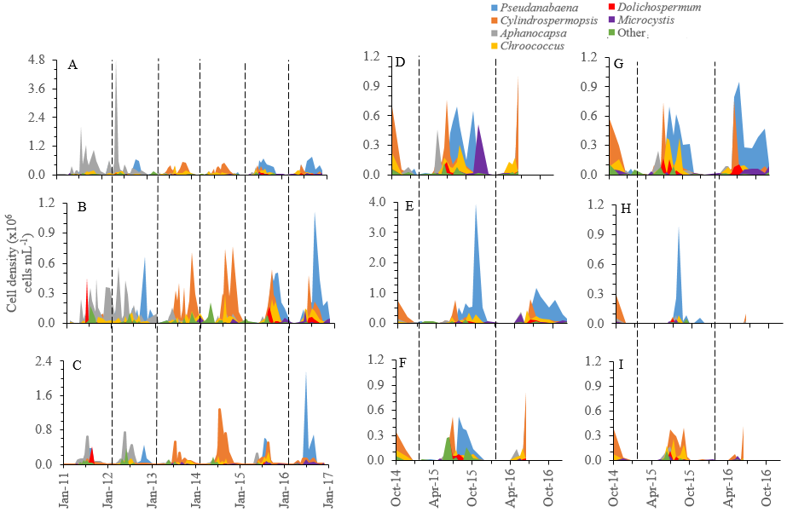

Slide 43
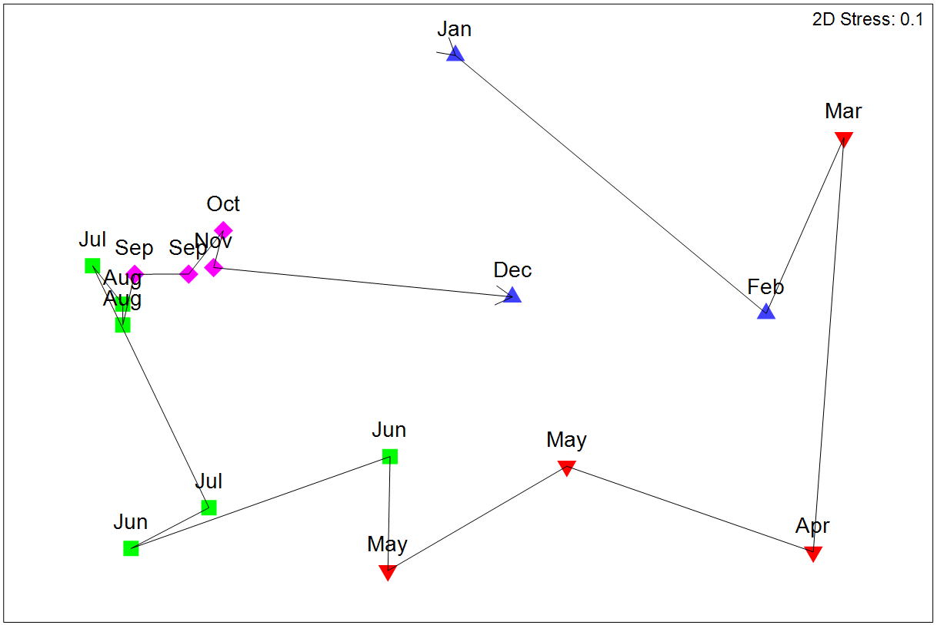
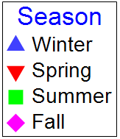

Slide 45
Picture References
Slide 4: http://www.algaebase.org/search/species/detail/?species_id=30050; https://eoimages.gsfc.nasa.gov/images/imagerecords/84000/84125/LakeErieBloom_amo_2014215_lrg.jpg
Slide 6: http://www.algaebase.org/search/species/detail/?species_id=30050; https://en.wikipedia.org/wiki/Microcystin-LR#/media/File:Microcystin-LR.svg
Slide 7: https://en.wikipedia.org/wiki/Cylindrospermopsin#/media/File:Cylindrospermopsin_structure2.png

Slide 46
2011
2012
2013
2014
2015
2016
Notes:
In order, we have water temperature, chlorophyll a, Nox (nitrate plus nitrite), NH3 (ammonia), TKN:TP (total Kjeldahl nitrogen [particulate and dissolved organic N plus ammonia] to total phosphorous)
We see variability in these environmental parameters (temp and chl a – high in summer), nutrients higher in winter (being taken up phytoplankton in the summer)

Slide 47
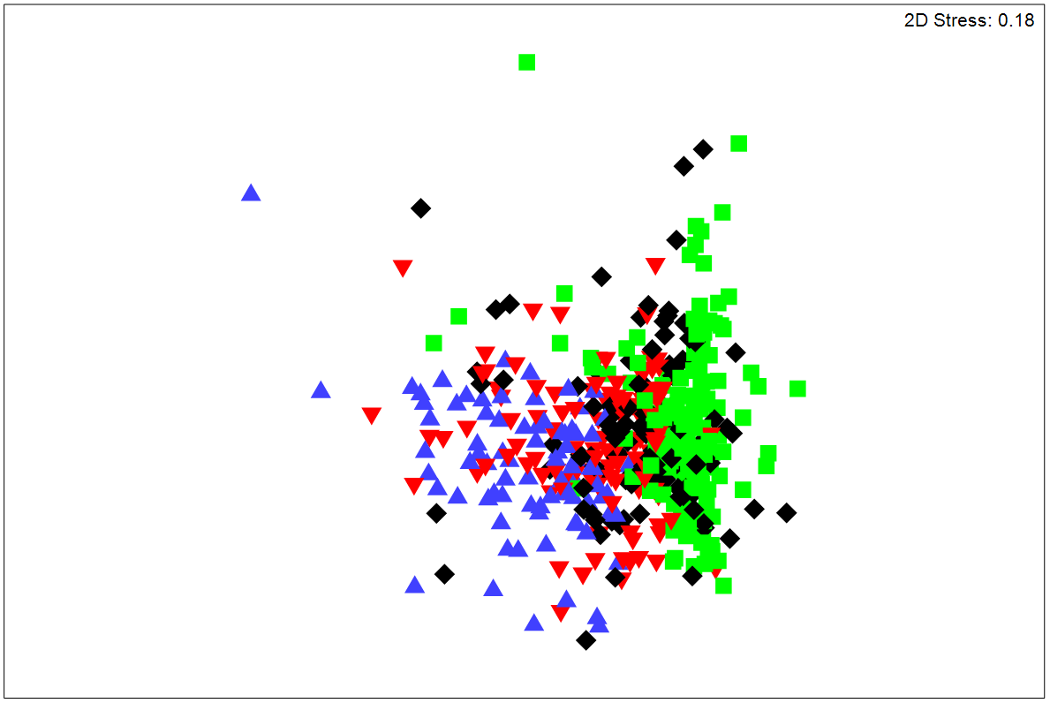
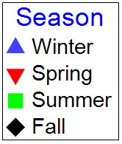
Environmental Parameters
Temperature
Chl a
NO_{x}
NH₃
TKN
TP
TKN:TP
DO
pH
Turbidity

Slide 48
Environmental Drivers
 | Cyano | Cyano | Microeuk | Microeuk | NH₃ | NO_{x} | TKN | Temp | pH
 | (cells mL⁻¹) | (mm³ m⁻³) | (cells mL⁻¹) | (mm³ m⁻³) | (mg L⁻¹) | (mg L⁻¹) | (mg L⁻¹) | (ºC)
Chl a | 0.555 | 0.515 | 0.358 | 0.447 | -0.352 | -0.540 | 0.705 | 0.322 | 0.441
Cyano (cells mL⁻¹) |  | 0.851 | 0.367 | 0.469 | -0.257 | -0.586 | 0.498 | 0.524 | 0.458
Cyano (mm³ m⁻³) |  |  | 0.314 | 0.364 | -0.229 | -0.499 | 0.492 | 0.470 | 0.437
Microeuk (cells mL⁻¹) |  |  |  | 0.329 | -0.154 | -0.295 | 0.314 | 0.175 | 0.200
Microeuk (mm³ m⁻³) |  |  |  |  | -0.210 | -0.349 | 0.282 | 0.238 | 0.231

Slide 49
Main environmental drivers
2011
2012
2013
2014
2015
2016
Chl a
NH₃, NO_{x}, TKN, DO
Adjusted R²=0.680
(n=427)
Cyanobacterial cell density
NO_{x}, TKN, DO, pH
Adjusted R²=0.521
(n=446)
Microeukaryote cell density
NO_{x}, TKN
Adjusted R²=0.132
(n=454)
Notes:
Explain what is happening here: all 9 sites combined. Chl a on top, then total cyanobacterial cell densities and finally total microeukaryote cell density
R2 values are adjusted coefficient of determination. This tells us which environmental parameters are able to best explain variations in biomass proxies (Chl a and cell density). For example, 68% of the variation about the mean for Chl a is explained by changes in NH3, Nox, TKN and DO
Bring main points in with each graph (bring them in one on one)
That could be ID’d based on what we had

