Slide 1
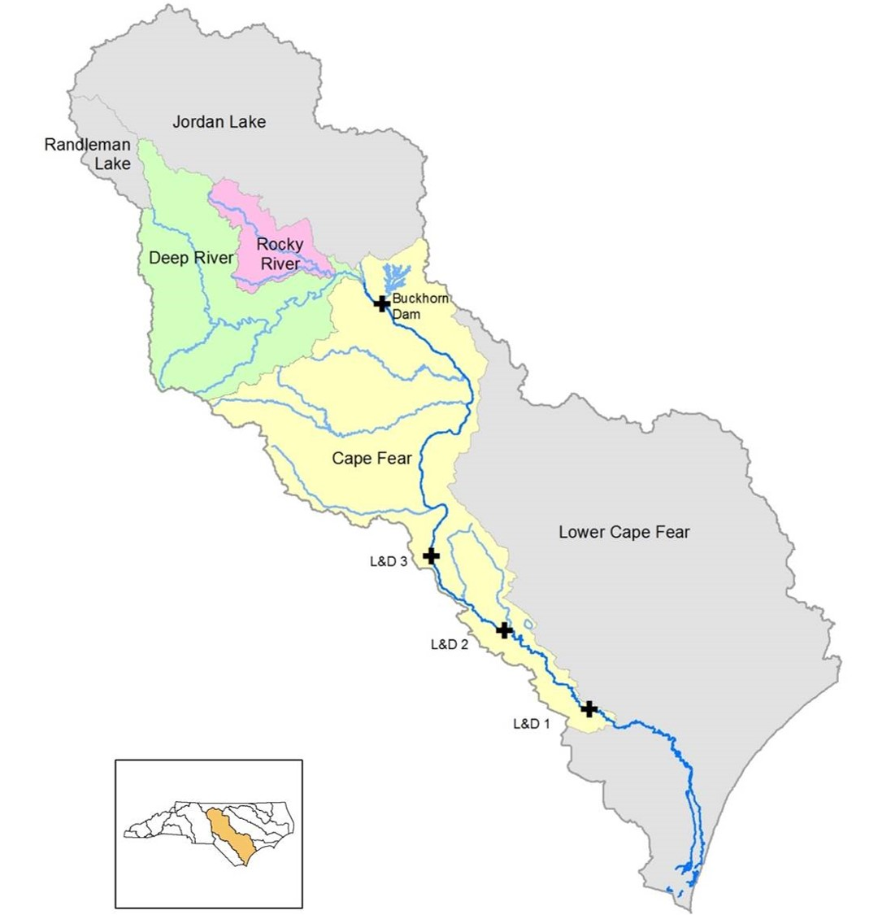
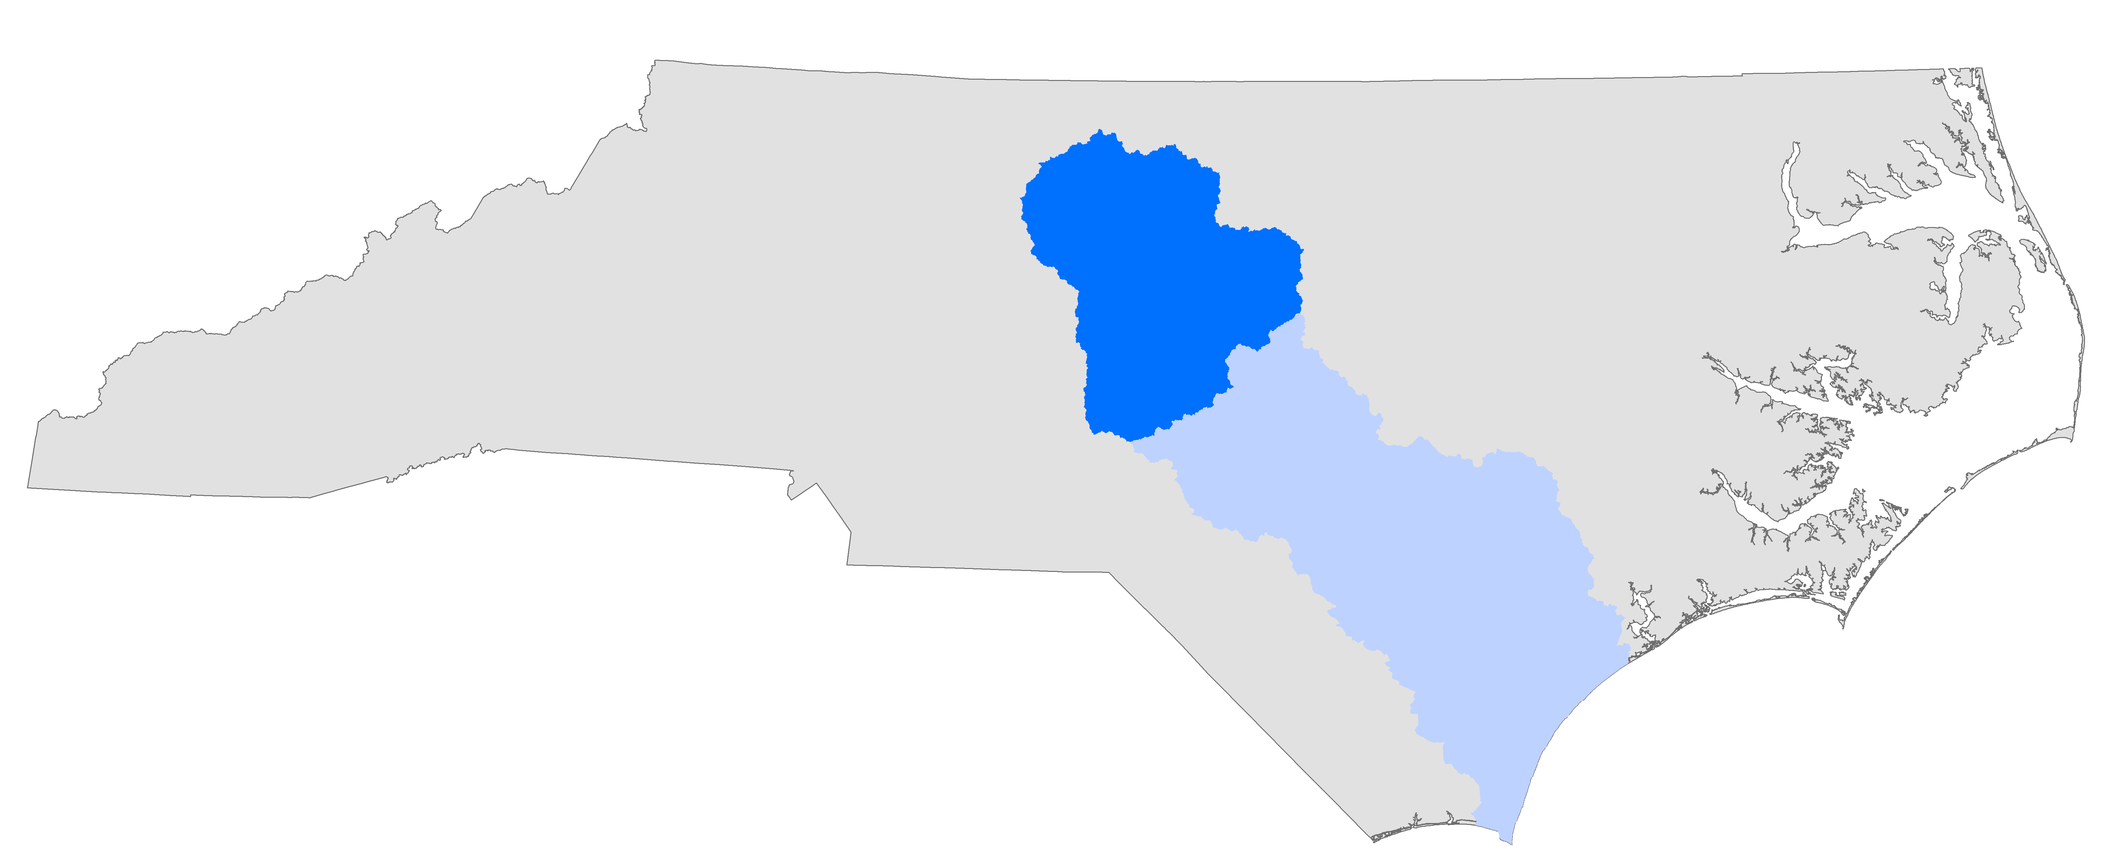
Cape Fear
Monitoring Plan Overview

Slide 2
General Information
DWR Modeling Branch is requesting additional monitoring over a 2-year period
Additional samples would be used to help develop a model to assist with NPDES permitting
If approved, additional monitoring would begin in January 2019

Slide 3
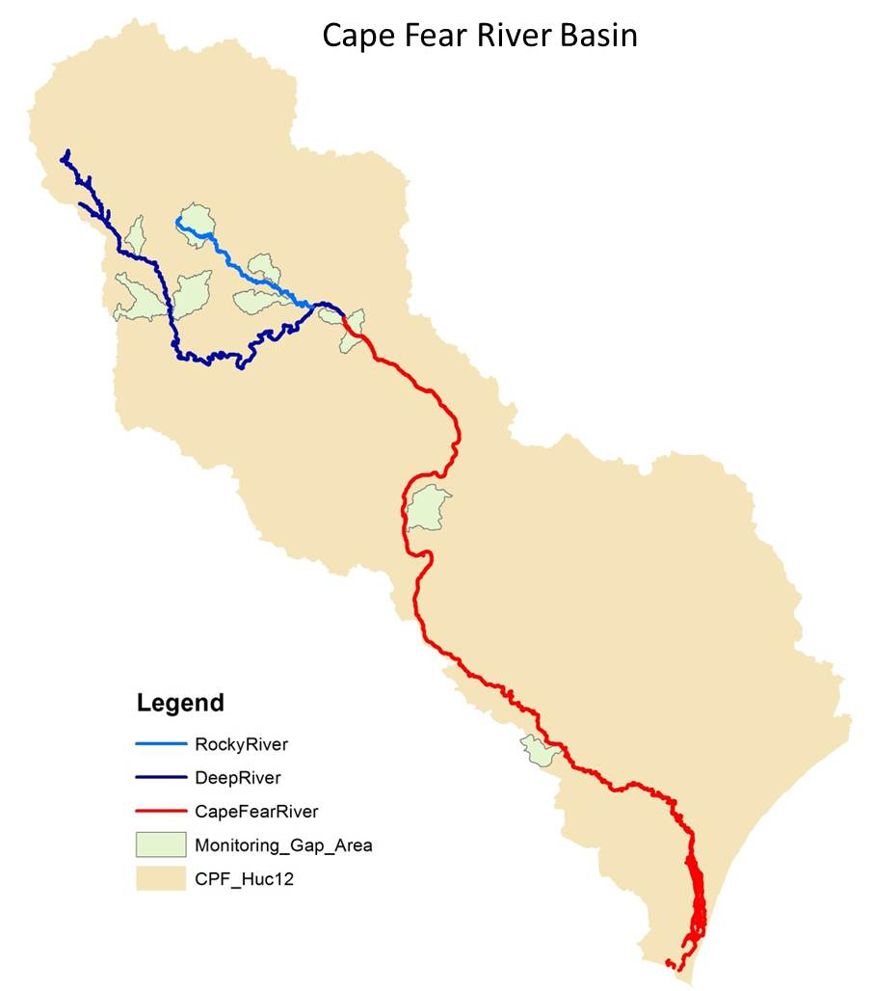
New Temporary Monitoring Stations (DWR)
DWR are establishing 9 new sampling sites as part of this 2-year monitoring effort
These sites will be monitored on a monthly basis
Monitoring data will fill existing coverage gaps and assist with model calibration and validation
Watersheds | Receiving River | Station Location |  | Road Crossing
 |  | Longitude | Latitude
Bush Creek | Deep River | -79.713 | 35.753 | SR 2226:
Brush Creek | Deep River | -79.583 | 35.602 | SR 22 and 42
Richland Creek | Deep River | -79.619 | 35.608 | SR 2873
Headwaters Rocky River | Rocky River | -79.493 | 35.802 | SR1362
Landrum Creek | Rocky River | -79.275 | 35.688 | NC 902
Bear Creek | Rocky River | -79.212 | 35.635 | SR 2156
Gulf Creek | Cape Fear River | -79.027 | 35.566 | SR#1916
Headwaters Locks Creek | Cape Fear River | -78.855 | 35.047 | SR 1006
Carvers Creek | Cape Fear River | -78.404 | 34.453 | NC 87

Slide 4
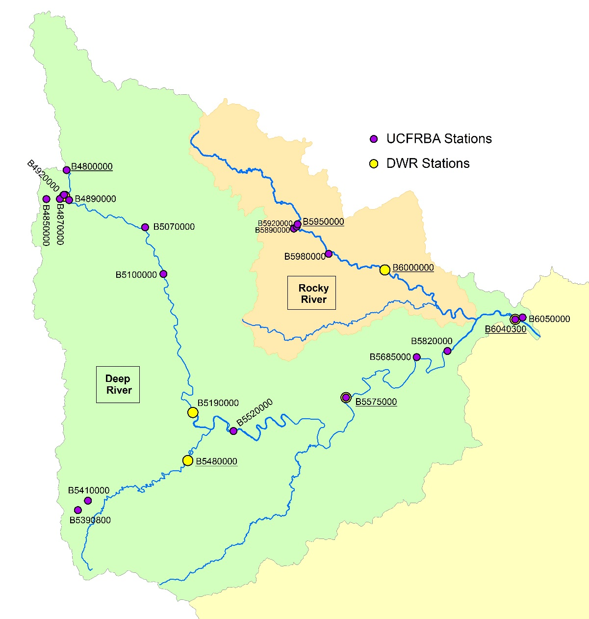
Existing Stations Identified for Additional Monitoring
(Upper Basin)
Station ID | Waterbody | Location Description | Agency | Intended Use
B4800000 | Deep River | Deep Riv at SR 2122/2128 Worthville Rd at Worthville | UCFRBA | Headwater
B5480000 | Bear Creek | Bear Creek at NC 705 at Robbins | DWR | Tributary Input
B5575000 | Deep River | Deep Riv at NC 42 at Carbonton | DWR | Calibration
B6040300 | Deep River | Deep Riv at SR 1011 Old US 1 nr Moncure | DWR | Calibration
B5950000 | Rocky River | Rocky Riv at US 64 near Siler City | UCFRBA | Calibration
B6000000 | Rocky River | Rocky Riv at NC 902 nr Pittsboro | DWR | Calibration
Additional sampling sites
Additional monitoring of nutrients, turbidity, & TSS needed during summer months (May-September)
New Parameters:
  Chlorophyll-a
  Ortho-p
  TOC
  BOD5
  Long term BOD (CBOD removed)

Slide 5
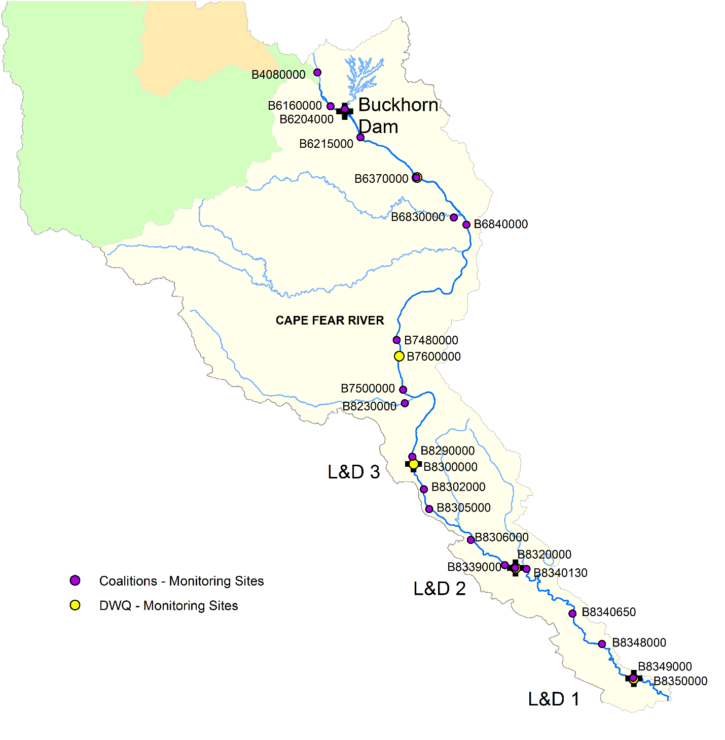
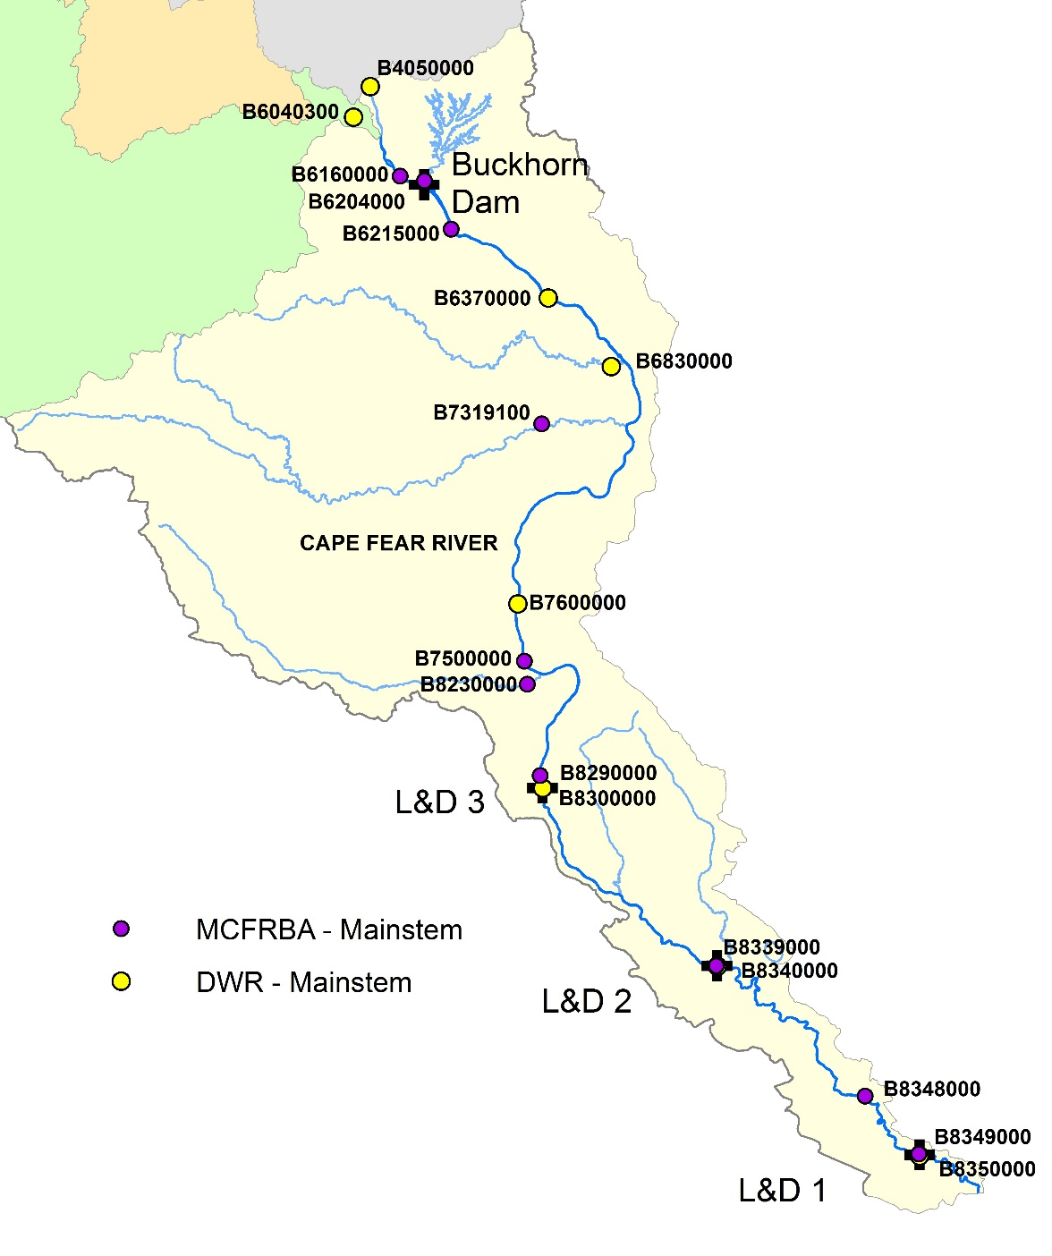
Revised Plan
New Addition
Revised
Plan for additional
sampling
Dropped sites

Slide 6
Number of Additional Collections by Parameter (over 2 year period)
 | UCFRBA |  | MCFRBA
Station | B4800000 | B5950000 | B6160000 | B6204000 | B6215000 | B7319100 | B7500000 | B8230000 | B8290000 | B8339000 | B8348000 | B8349000
Grab or Composite | G | G | G | G | G | G | C | G | C | C | C | C
Boat or Bridge | Bridge | Bridge | Bridge | Bridge | Bank | Bridge | Boat | Bridge | Boat | Boat | Boat | Boat
Total # of Extra Trips | 0 | 0 | 0 | 10 | 0 | 10 | 0 | 10 | 0 | 0 | 0 | 0
Physicals (DO, pH, cond, temp)* | 0 | 0 | 0 | 10 | 0 | 10 | 0 | 10 | 0 | 0 | 0 | 0
ammonia | 10 | 10 | 10 | 10 | 10 | 10 | 10 | 10 | 10 | 10 | 10 | 10
nitrite/nitrate | 10 | 10 | 10 | 10 | 10 | 10 | 10 | 10 | 10 | 10 | 10 | 10
tkn | 10 | 10 | 10 | 10 | 10 | 10 | 10 | 10 | 10 | 10 | 10 | 10
tp | 10 | 10 | 10 | 10 | 10 | 10 | 10 | 10 | 10 | 10 | 10 | 10
turbidity | 10 | 10 | 10 | 10 | 10 | 10 | 10 | 10 | 10 | 10 | 10 | 10
sus residue | 10 | 10 | 10 | 10 | 10 | 10 | 10 | 10 | 10 | 10 | 10 | 10
chla | 34 | 34 | 10 | 34 | 34 | 34 | 34 | 34 | 10 | 10 | 34 | 10
ortho-p | 34 | 34 | 34 | 34 | 34 | 34 | 34 | 34 | 34 | 34 | 34 | 34
TOC | 34 | 34 | 34 | 34 | 34 | 34 | 34 | 34 | 34 | 34 | 34 | 34
BOD5** | 24 | 24 | 24 | 24 | 24 | 24 | 0 | 24 | 24 | 24 | 0 | 24
BOD20 or 30 | 2 | 2 | 0 | 2 | 2 | 2 | 0 | 2 | 2 | 2 | 0 | 2
phyto*** | 0 | 0 | 24 | 0 | 0 | 0 | 0 | 0 | 24 | 24 | 0 | 24
* Physicals = DO, pH, cond, and temp should include secchi depth for composite samples ** DWR will review BOD5 data after the first year of collection, if the majority of BOD5 data is below detection limit for any station, there will be no requirement for a second year for BOD5 or BOD20 or 30.
*** While DWR is asking coalition to collect sample for phytoplankton composition, DWR will perform the actual analysis

Slide 7
Estimated Costs
UCFRB | Reporting |  |  | Cost | Cost
Parameter | Limit | Method | Quantity/ | Per | Per
 | (mg/L) |  | 2 years | Test | 2 Years
BOD, 5 day | 2.0 | SM 5210B | 48 | $25.00 | $1,200.00
BOD20 or 30 | 2.0 | SM 5210B | 4 | $75.00 | $300.00
Total Suspended Solids | 2.5 | SM2540D | 20 | $9.00 | $180.00
Ammonia, Nitrogen | 0.1 | EPA 350.1 | 20 | $12.00 | $240.00
TKN | 0.2 | EPA 351.2 | 20 | $21.00 | $420.00
Nitrate/Nitrite, Nitrogen | 0.10 | EPA 353.2 | 20 | $15.00 | $300.00
Phosphorus, total | 0.05 | EPA 200.7 | 20 | $12.00 | $240.00
Ortho-Phosphate | 0.05 | SM 4500P E | 68 | $45.00 | $3,060.00
Chlorophyll A | 0.001 | EPA 445 | 68 | $80.00 | $5,440.00
TOC | 1 | SM 5310C | 68 | $45.00 | $3,060.00
Turbidity | 1.0 NTU | EPA 180.1 | 20 | $10.00 | $200.00
Extra Trips | - | - | 0 | - | $0.00
Phyto | - | - | 0 | - | $0.00
TOTAL | - | - | - | - | $14,640.00
or $7,320.00/year

Slide 8
Middle Cape Fear River Basin Association
Estimated Costs
  $70,810.00 over 2 years or $35,405.00/year
Agreed to help fund on the basis that:
  DEQ meet with MCFRBA representatives to review the data/sampling plan in the fall of 2019 and amend anything as needed.
  DEQ provide a schedule for completion of the model and provide regular updates to the MCFBA. The MCFRBA would like an opportunity to provide input and feedback on the model, model assumptions, etc.
  DEQ coordinate with Meritech to make sure the data being collected is compatible (detection levels, methodology, etc.) and discuss logistics of phytoplankton transfer.
Reasoning:
  Loads are currently frozen. The next agency that needs an expansion would be required to perform their own modeling to demonstrate the impact. This way the state is paying the majority of the cost of model development and we are only supplementing.
  A model will be developed whether the monitoring coalitions participate or not. More data and fewer assumptions is better than less data and more assumptions.
  By funding some of the data, the monitoring coalitions have a greater opportunity to participate in model development and address issues up front, rather than after the model is completed.

Slide 9
Budget Impacts
UPPER CAPE FEAR RIVER BASIN ASSOCIATION, INC. |  |  |  |  | UPPER CAPE FEAR RIVER BASIN ASSOCIATION, INC.
ANNUAL TASK COST CALCULATION TABLE |  |  |  |  | ANNUAL TASK COST CALCULATION TABLE
FISCAL YEAR 2018-2019 |  |  |  |  | FISCAL YEAR 2018-2019
Same Budget as FY 2017-2018 w/o Special Study |  |  |  |  | Same Budget as FY 2017-2018 w/ Special Study
Revenues | FY 2017-2018 Budget | FY 2018-2019 Proposed Budget | FY 2019-2020 Projected Budget |  | Revenues | FY 2017-2018 Budget | FY 2018-2019 Proposed Budget | FY 2019-2020 Projected Budget
Membership Dues | $137,451 | $137,451 | $137,451 |  | Membership Dues | $137,451 | $137,451 | $137,451
Interest Earned | $900 | $900 | $900 |  | Interest Earned | $900 | $900 | $900
Total Revenues | $138,351 | $138,351 | $138,351 |  | Total Revenues | $138,351 | $138,351 | $138,351
Expenses |  |  |  |  | Expenses
Meritech** | $90,282 | $92,088 | $93,929 |  | Meritech** | $90,282 | $99,408 | $101,249
Database Management | $1,500 | $1,500 | $1,500 |  | Database Management | $1,500 | $1,500 | $1,500
Insurance | $2,466 | $2,466 | $2,466 |  | Insurance | $2,466 | $2,466 | $2,466
TJCOG | $20,000 | $20,000 | $20,000 |  | TJCOG | $20,000 | $20,000 | $20,000
PTCOG | $20,000 | $20,000 | $20,000 |  | PTCOG | $20,000 | $20,000 | $20,000
Total Expenses | $134,248 | $136,054 | $137,895 |  | Total Expenses | $134,248 | $143,374 | $145,215
Net to/from Contingency | $4,103 | $2,297 | $456 |  | Net to/from Contingency | $4,103 | -$5,023 | -$6,864
Contingency Balance | $196,385 | $198,683 | $199,138 |  | Contingency Balance | $196,385 | $191,363 | $184,498
**Increase reflects a 2% increase over the next two years |  |  |  |  | **Increase reflects a 2% increase over the next two years + $7,320/year for additional sampling

Slide 10
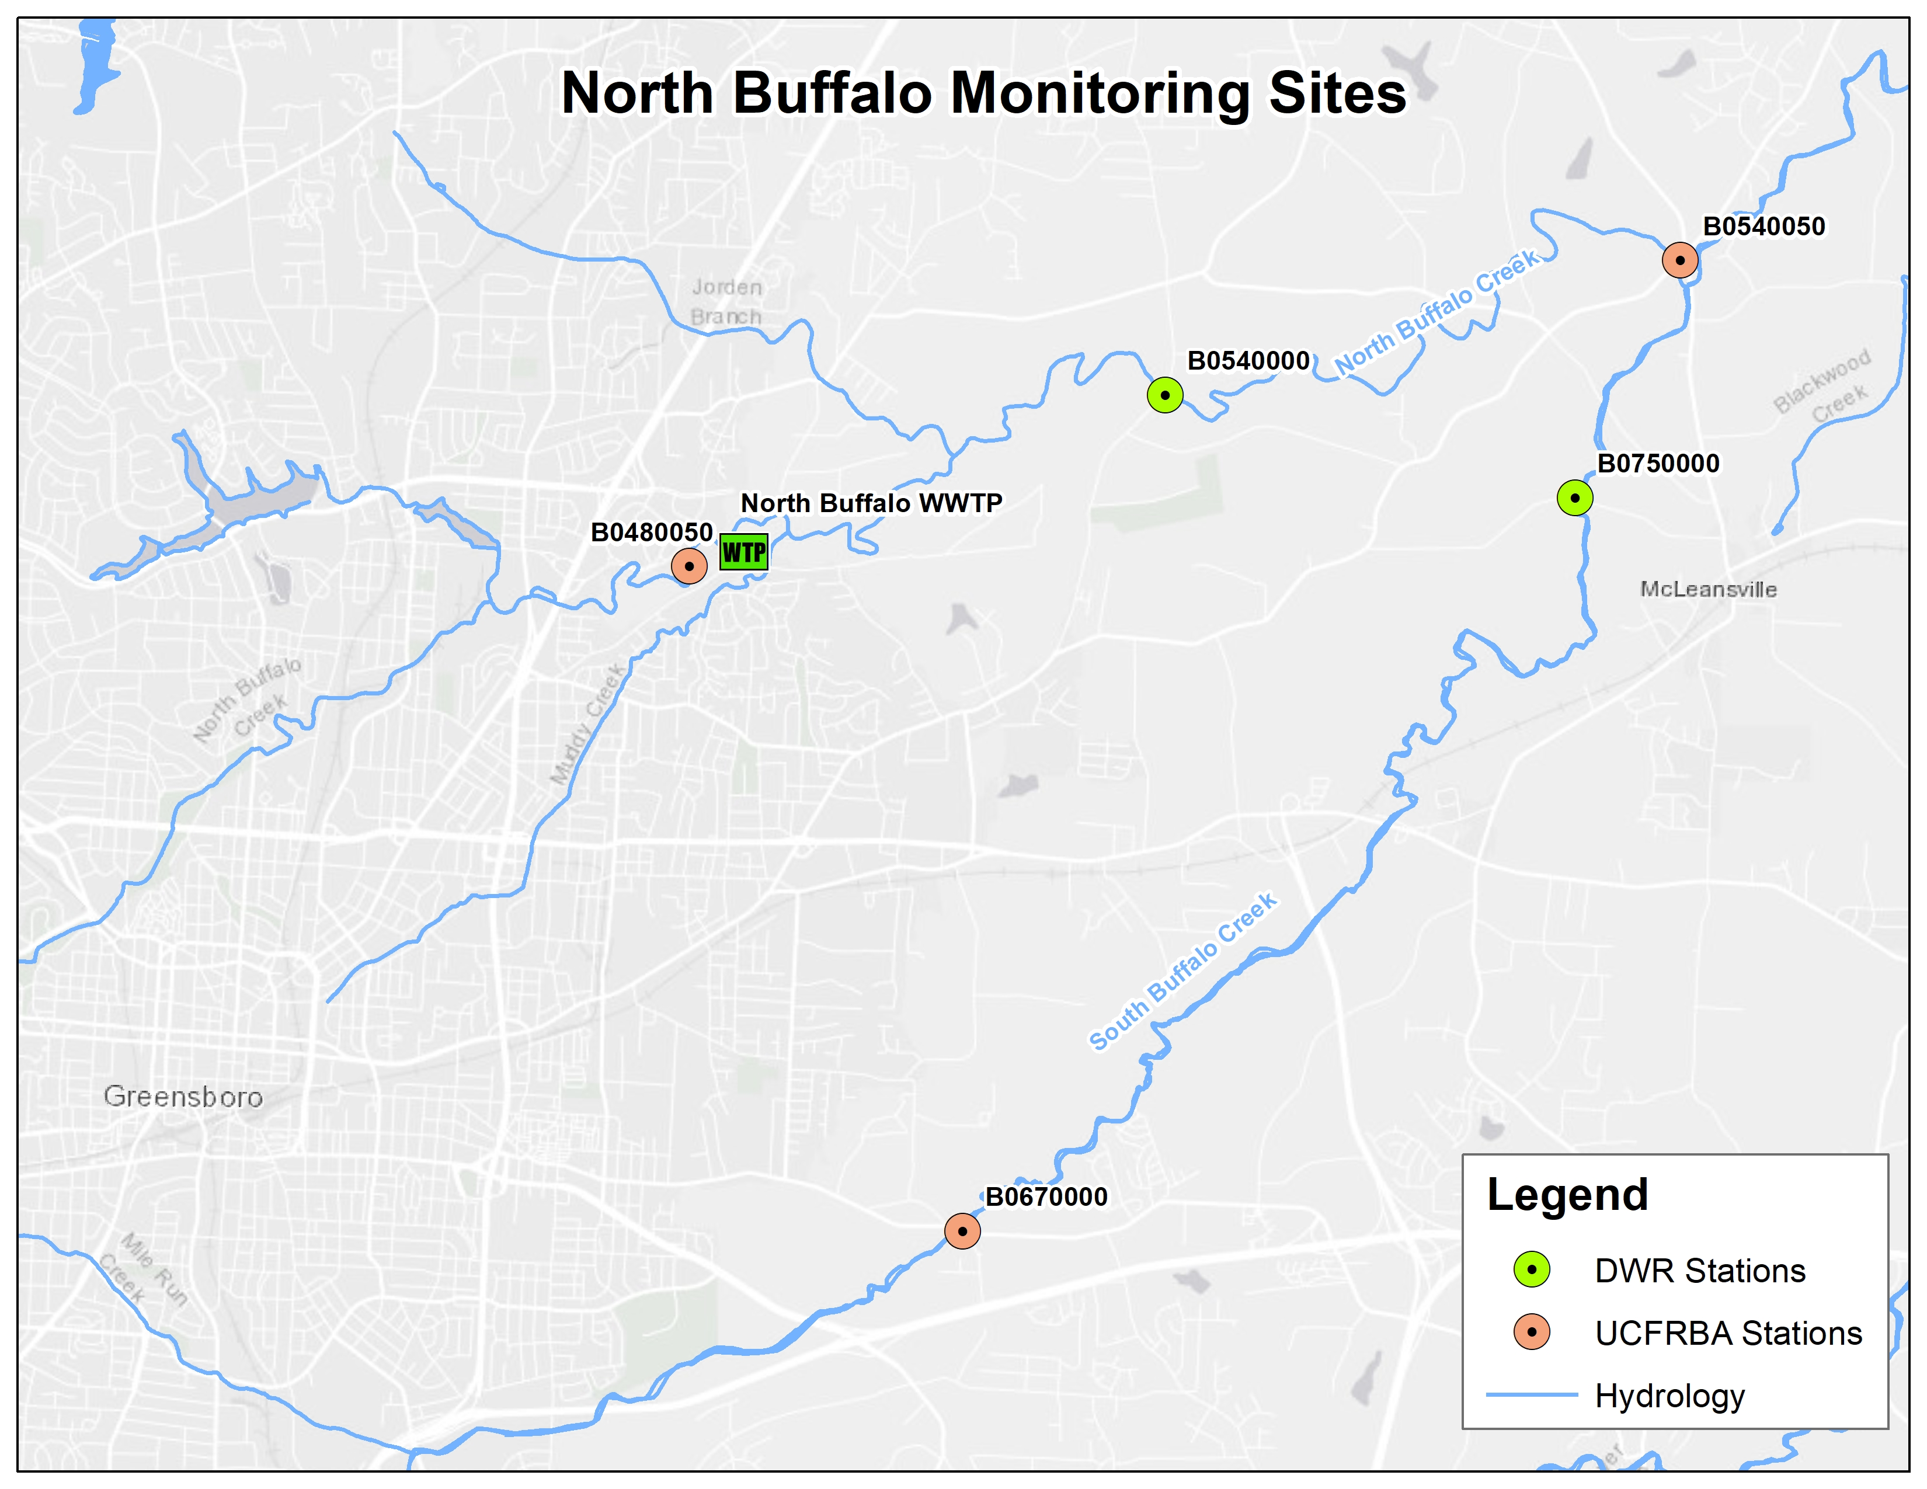
North Buffalo Monitoring Stations
Background Information
North Buffalo WWTP placed out of service on October 6, 2017
NPDES permit was rescinded in December 2017, which required one upstream and two downstream monitoring locations
MOA with DWR will need to be renegotiated before 2020
Impacted UCFRBA Stations
DWQ Station Number | Location | Station Information | Latitude | Longitude
B0480050 | N Buffalo Crk at N Buffalo Crk WWTP Influent Conduit Pier at Greensboro | Ups N. Buffalo WWTP | 36.1074 | -79.7502
B05400504 | N Buffalo Crk at sr 2770 Huffine Mill Rd nr McLeansville | Dns N. Buffalo WWTP | 36.1299 | -79.6626

