Slide 1
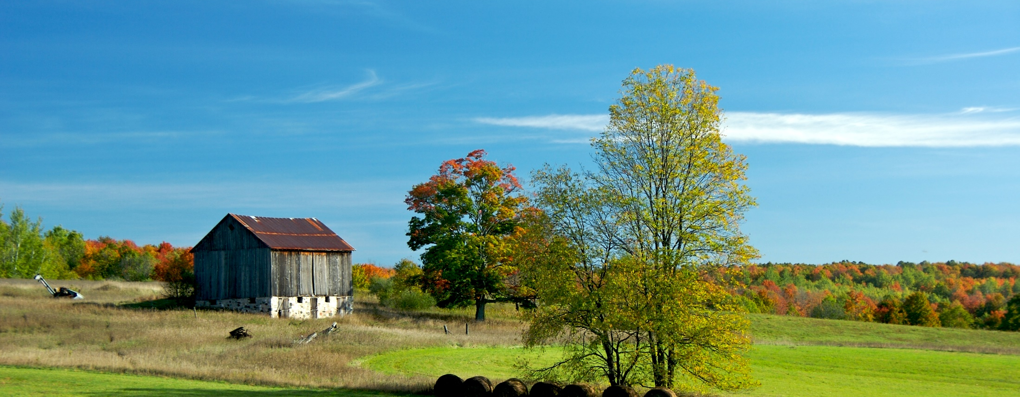
Davie County Comprehensive Land Development Plan Growth Strategy Sub-Committee 11.9.18 • Davie County Development Services
Jesse Day, Planning Director Cameron Colvin, Regional Planner Malinda Ford, GIS Manager

Slide 2
Future Growth Scenario Modeling
Helps planners to make decisions about development, land use, transportation and conservation.
Visualize where future homes and jobs might go within the County.
Compare scenarios of different land use regulations

Slide 3
Control Totals
GIS Software will allocate NEW homes and jobs that are projected to locate to Davie County between 2016 (base year) and 2050 (horizon year).
Davie County Total | Base Year (2016) | Horizon Year (2050) | Change
Population | 42,211 | 64,135 | 21,924
Dwelling Units | 15,888 | 24,140 | 8,252
Single-Family | 12,087 | 18,829 | 6,742
Multi-Family | 793 | 1,207 | 414
Mobile Homes | 3,008 | 4,104 | 1,095
Employment | 18,498 | 27,736 | 9,238
Retail/Office | 6,969 | 12,949 | 5,980
Industrial | 6,149 | 7,553 | 1,404
Institutional | 5,380 | 7,234 | 1,854
Source: NC OSBM
Source: Population in households divided by 2016 average household size (2.63);
Assumed trend continuation for SF/MF/Mobile split
Source: Woods & Poole (US BEA)
Notes:
Population projections from NC OSMB
Derived DU projections by calculating population in households and using the average HH size from 2016 (2.63)
Assumed continuation in trends of SF/MF/Mobile split
SF slight increase, assumed 78%
MF slight decrease, assumed 5%
Mobile slight decrease, assumed 17%
Employment Projections from Woods & Poole who use BEA data

Slide 4
Control Totals
Break down by jurisdiction, assuming current allocation of population and jobs.
Assuming 79% of population lives outside municipal limits and about 38% of jobs are located outside limits
Change (2016-2050) | County Total | Unincorporated Areas | Mocksville | Bermuda Run | Cooleemee
Dwelling Units | 8,252 | 6,342 | 1,075 | 676 | 159
Single-Family | 6,742 | 5,225 | 808 | 561 | 148
Multi-Family | 414 | 47 | 251 | 112 | 4
Mobile Homes | 1,095 | 1,070 | 16 | 3 | 6
Employment | 9,238 | 3,479 | 4,625 | 1,126 | 8
Retail/Office | 5,980 | 1,965 | 3,192 | 816 | 7
Industrial | 1,404 | 914 | 479 | 10 | 1
Institutional | 1,854 | 600 | 954 | 300 | 0

Slide 5
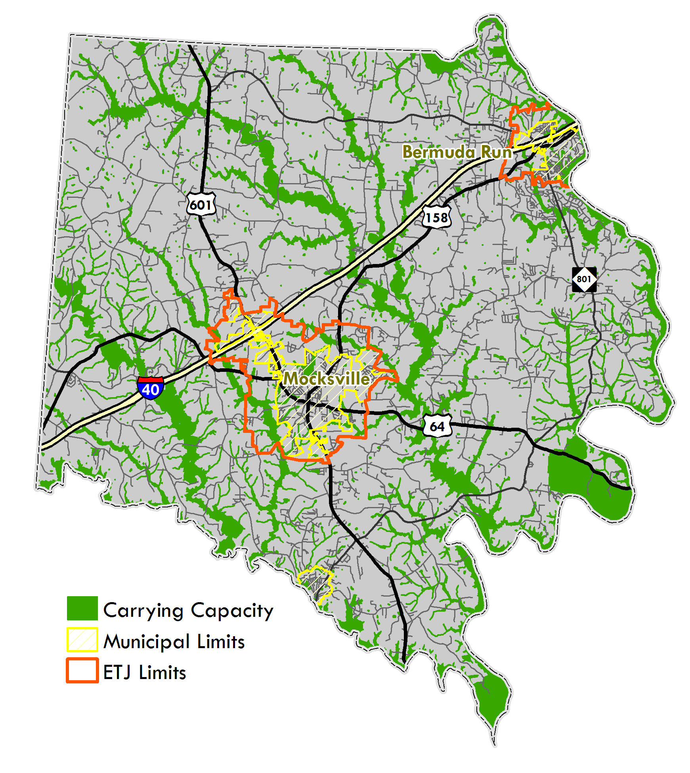
Development Constraints
Remove highly constrained areas from future development
Wetlands
100-year floodplain
30-foot stream buffers (perennial streams in water supply watersheds)
Conservation lands (managed lands in Natural Heritage Program database)
Calculated developable area for each parcel

Slide 6
Build Out Potential
How many homes and jobs COULD be allocated to each parcel based on current zoning and watershed restrictions.
Each parcel coded for:
Jurisdiction (Mocksville, Bermuda Run, Cooleemee, Davie County)
Water Supply Watershed (III-P, III-C, IV-P, IV-C, none)
Development Status (Developed, Un-developed, Under-developed, Conservation)
Only Un-developed and Under-developed parcels will receive future growth
Development Type (zoning)
Notes:
Assumed only 1 DU/ per acre for RA (instead of 1.45)

Slide 7
Build Out Potential
Rules established for each development type (zoning category)
Site Efficiency – removes areas for right-of-ways, lot setbacks, open space
Percent Residential/Non-Residential
Percent Single Family, Multi-family, or Mobile Homes
Percent Retail/Office, Industrial, or Institutional
Residential Density (homes per acre)
Non-residential Intensity (Floor Area Ratio)
Employee Space Ratios (employees per square foot)

Slide 8
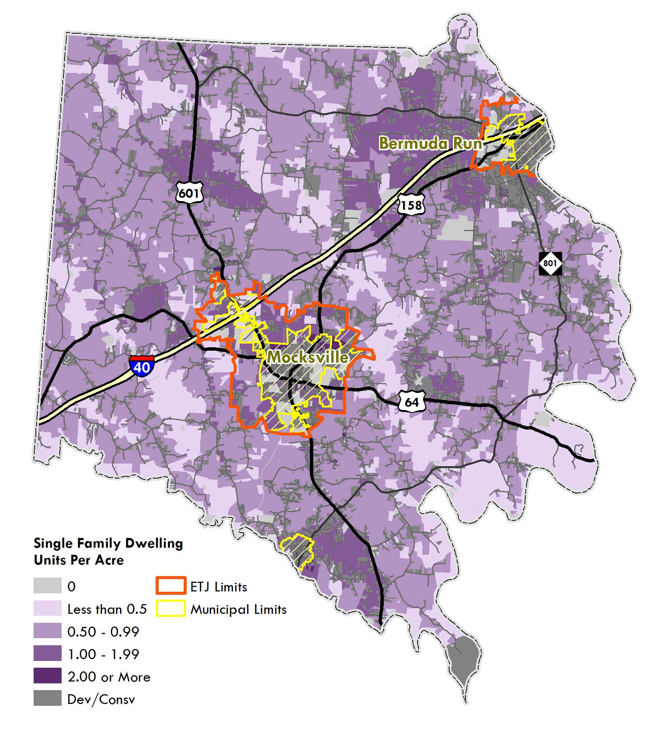
Build Out Potential
If every parcels was developed to the fullest extent:
 | TOTAL COUNTY |  | Unincorporated
TOTAL | Control Totals | BOP | Control Totals | BOP
Dwelling Units | 8,252 | 116,362 | 6,342 | 108,027
Single-Family | 6,742 | 81,595 | 5,225 | 75,728
Multi-Family | 414 | 4,437 | 47 | 2,744
Mobile Homes | 1,095 | 30,330 | 1,070 | 29,555
Employment | 9,238 | 74,707 | 3,479 | 19,689
Retail/Office | 5,980 | 22,281 | 1,965 | 2,563
Industrial | 1,404 | 14,404 | 914 | 1,823
Institutional | 1,854 | 38,022 | 600 | 15,303

Slide 9
Land Suitability
Land Suitability Factors
Growth Areas
Municipal Limits | 2
ETJ Limits | 1
Sewer Service Area
Within Town limits or within 100-feet of a gravity fed sewer line | 1.5
Water Service Area
Within Town limits or within 100-feet of a water line | 1
Farmland
Voluntary Agricultural District | -2
Natural Heritage Areas
Significant Natural Heritage Areas & Element Occurrences | -1
Steep Slopes
Slopes greater than 15% | -1 to 0
Poor Soils
Limited for septic systems | -2 to 0
Transportation Nodes
Within 1-mile of interstate interchange | 0 to 2.8
Within 0.5 miles of road network intersection
Destinations
Major destinations such as employment centers, grocery stores, schools, hospitals, recreation facilities | 0 to 2.5
Measures appropriateness of future development for each parcel
Final suitability value calculated for each parcel

Slide 10
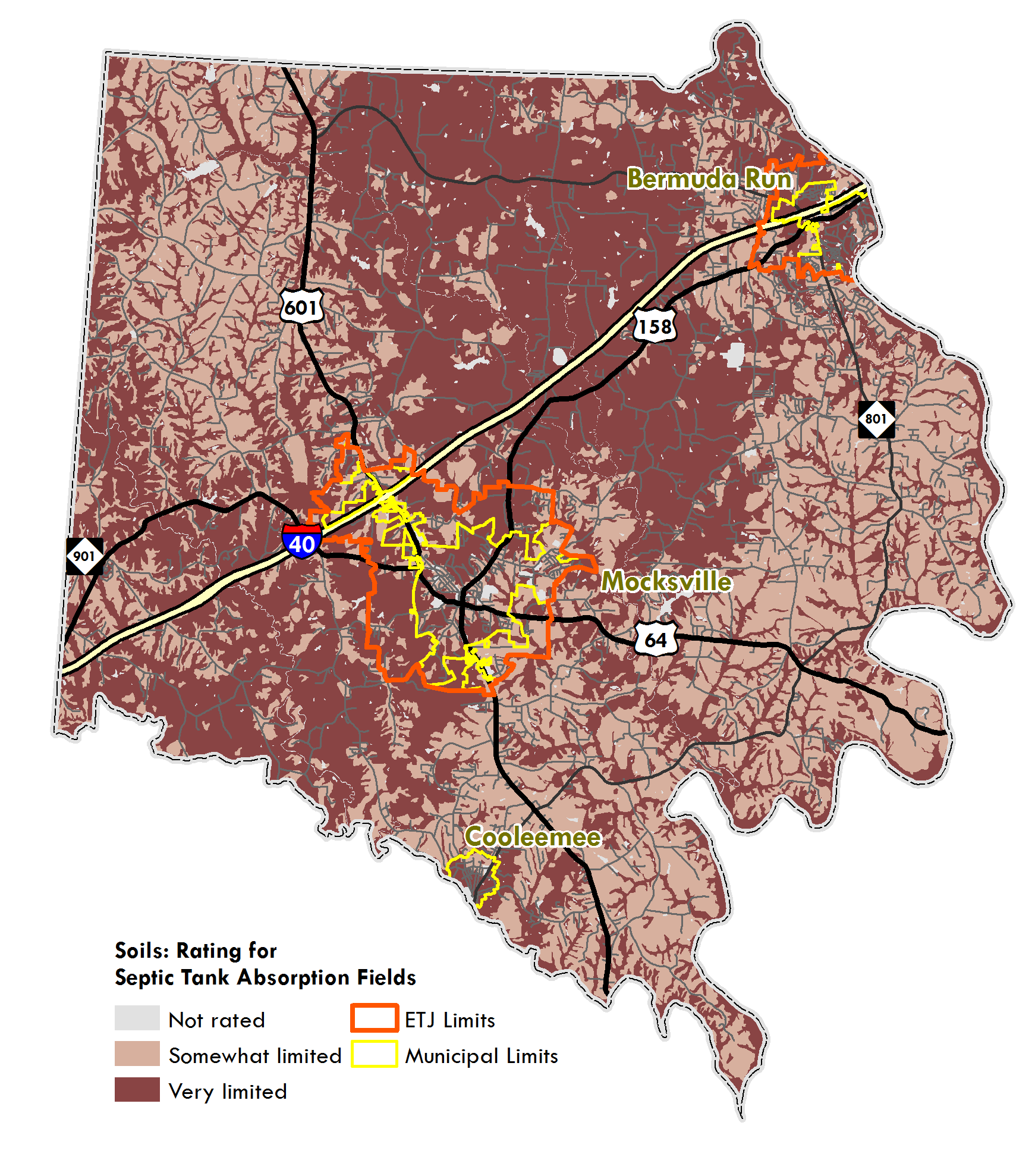
Land Suitability
Soils limited for septic tank absorption fields

Slide 11
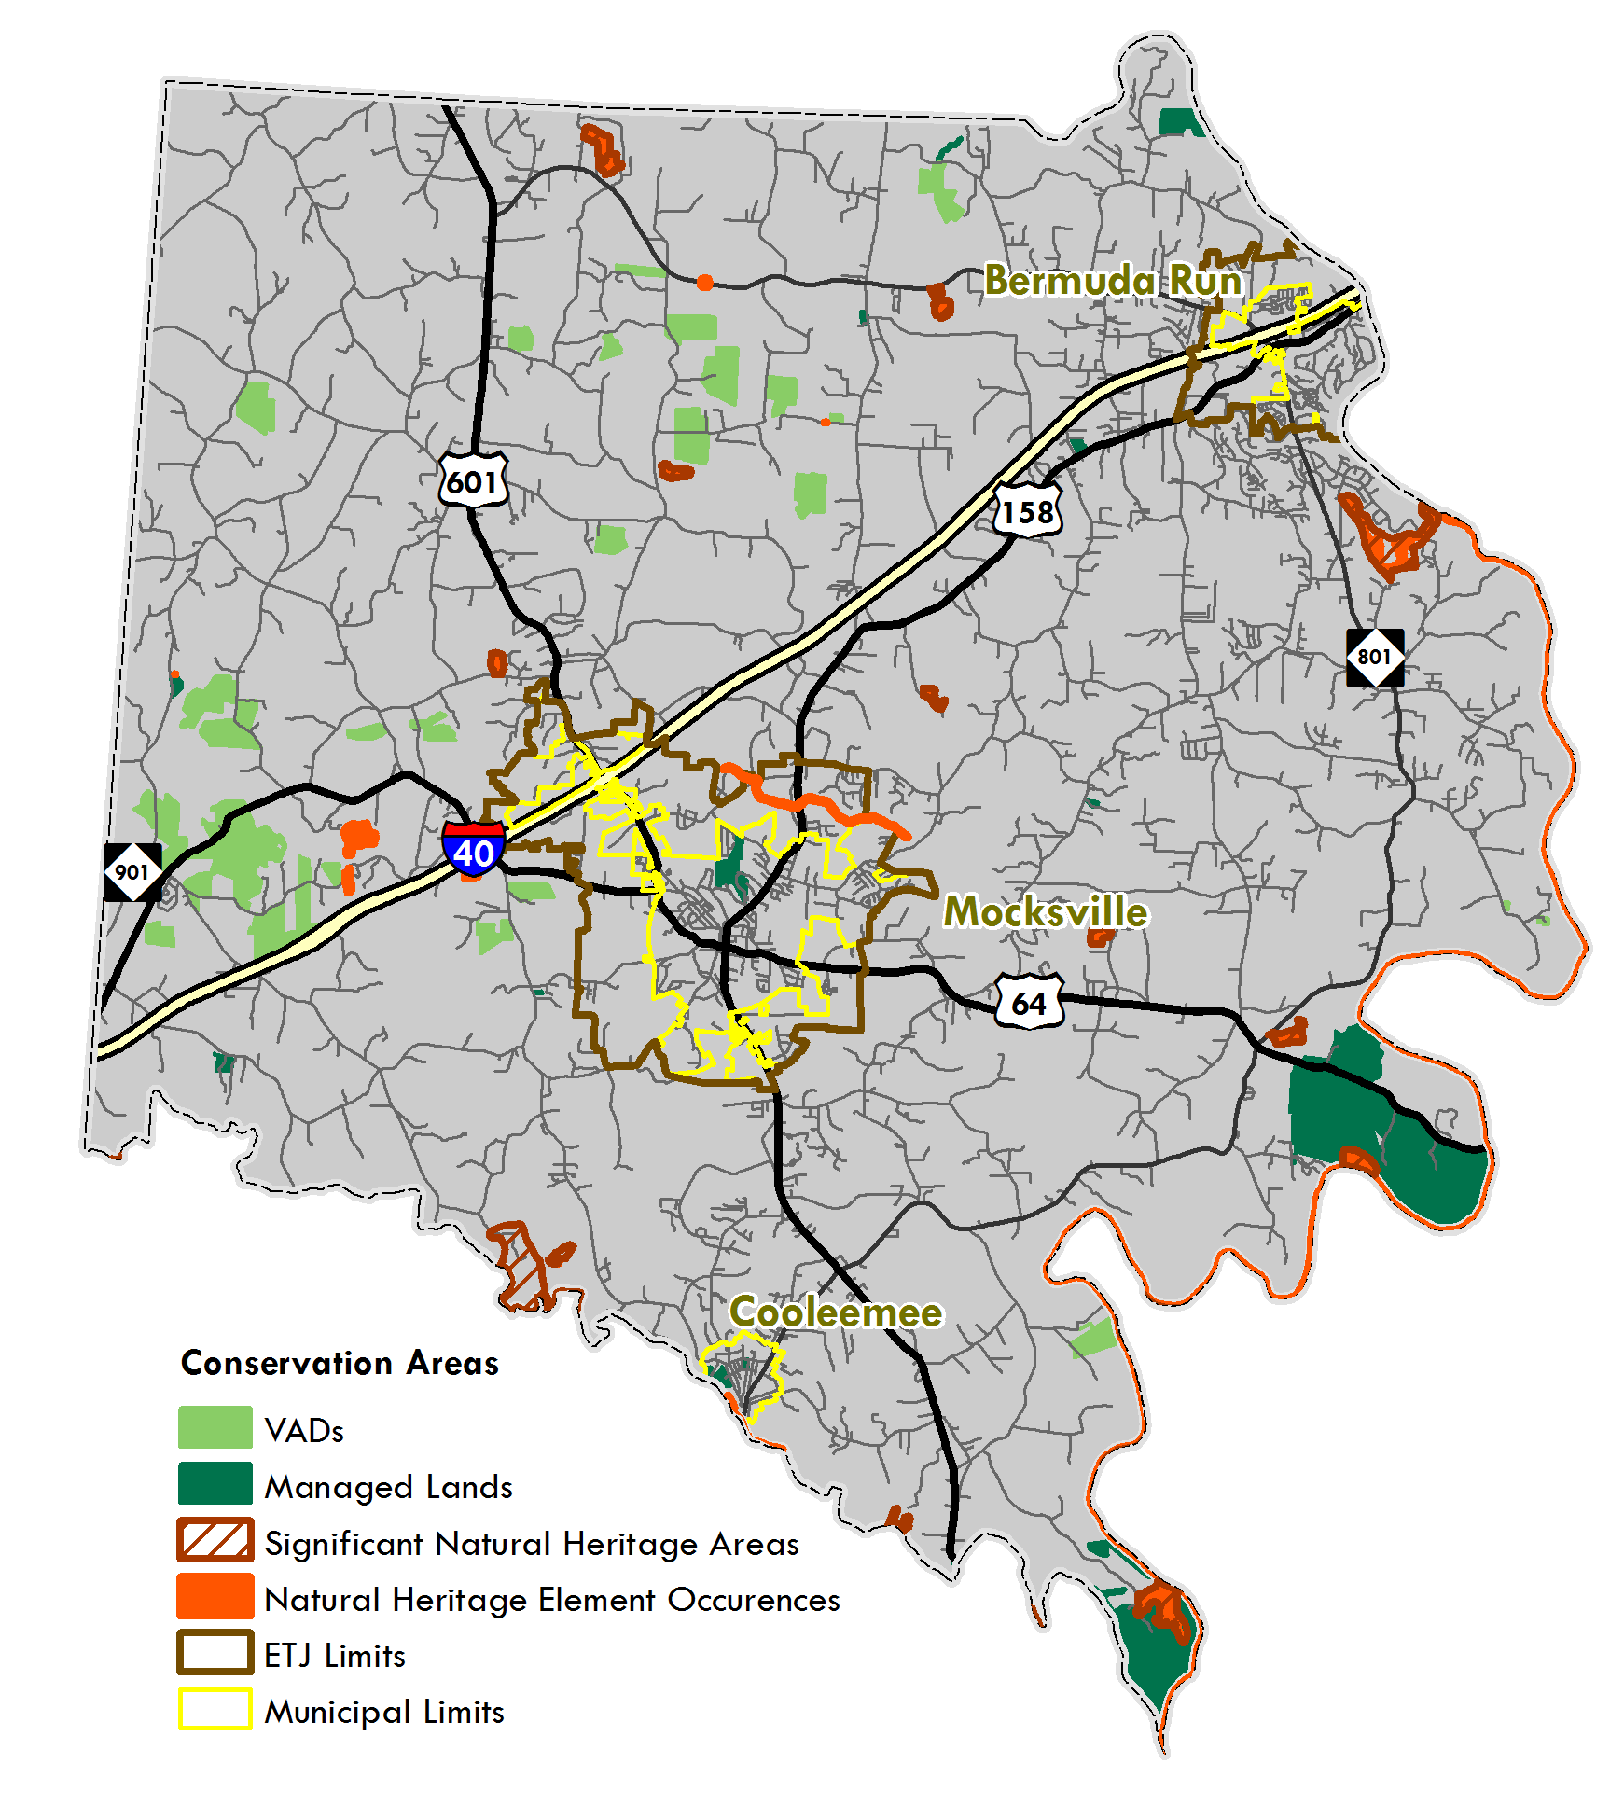
Conservation Areas

Slide 12
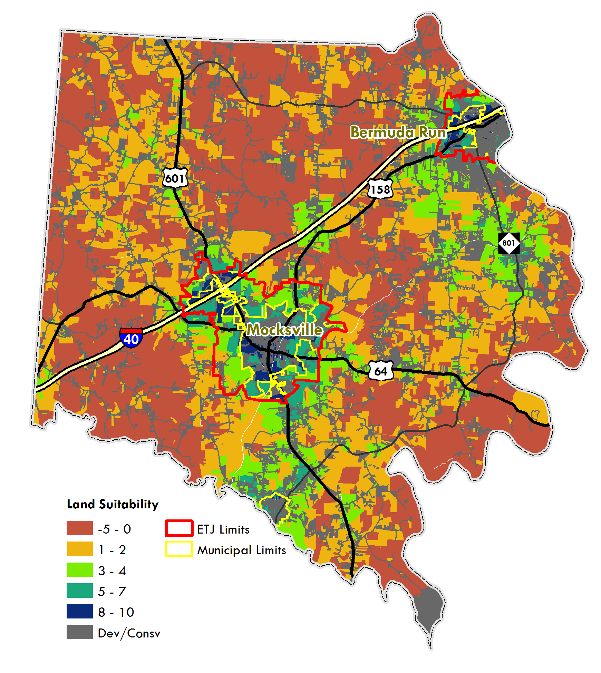
Land Suitability
Measures appropriateness of future development for each parcel
Final suitability value calculated for each parcel
Doesn’t account for market pressures

Slide 13
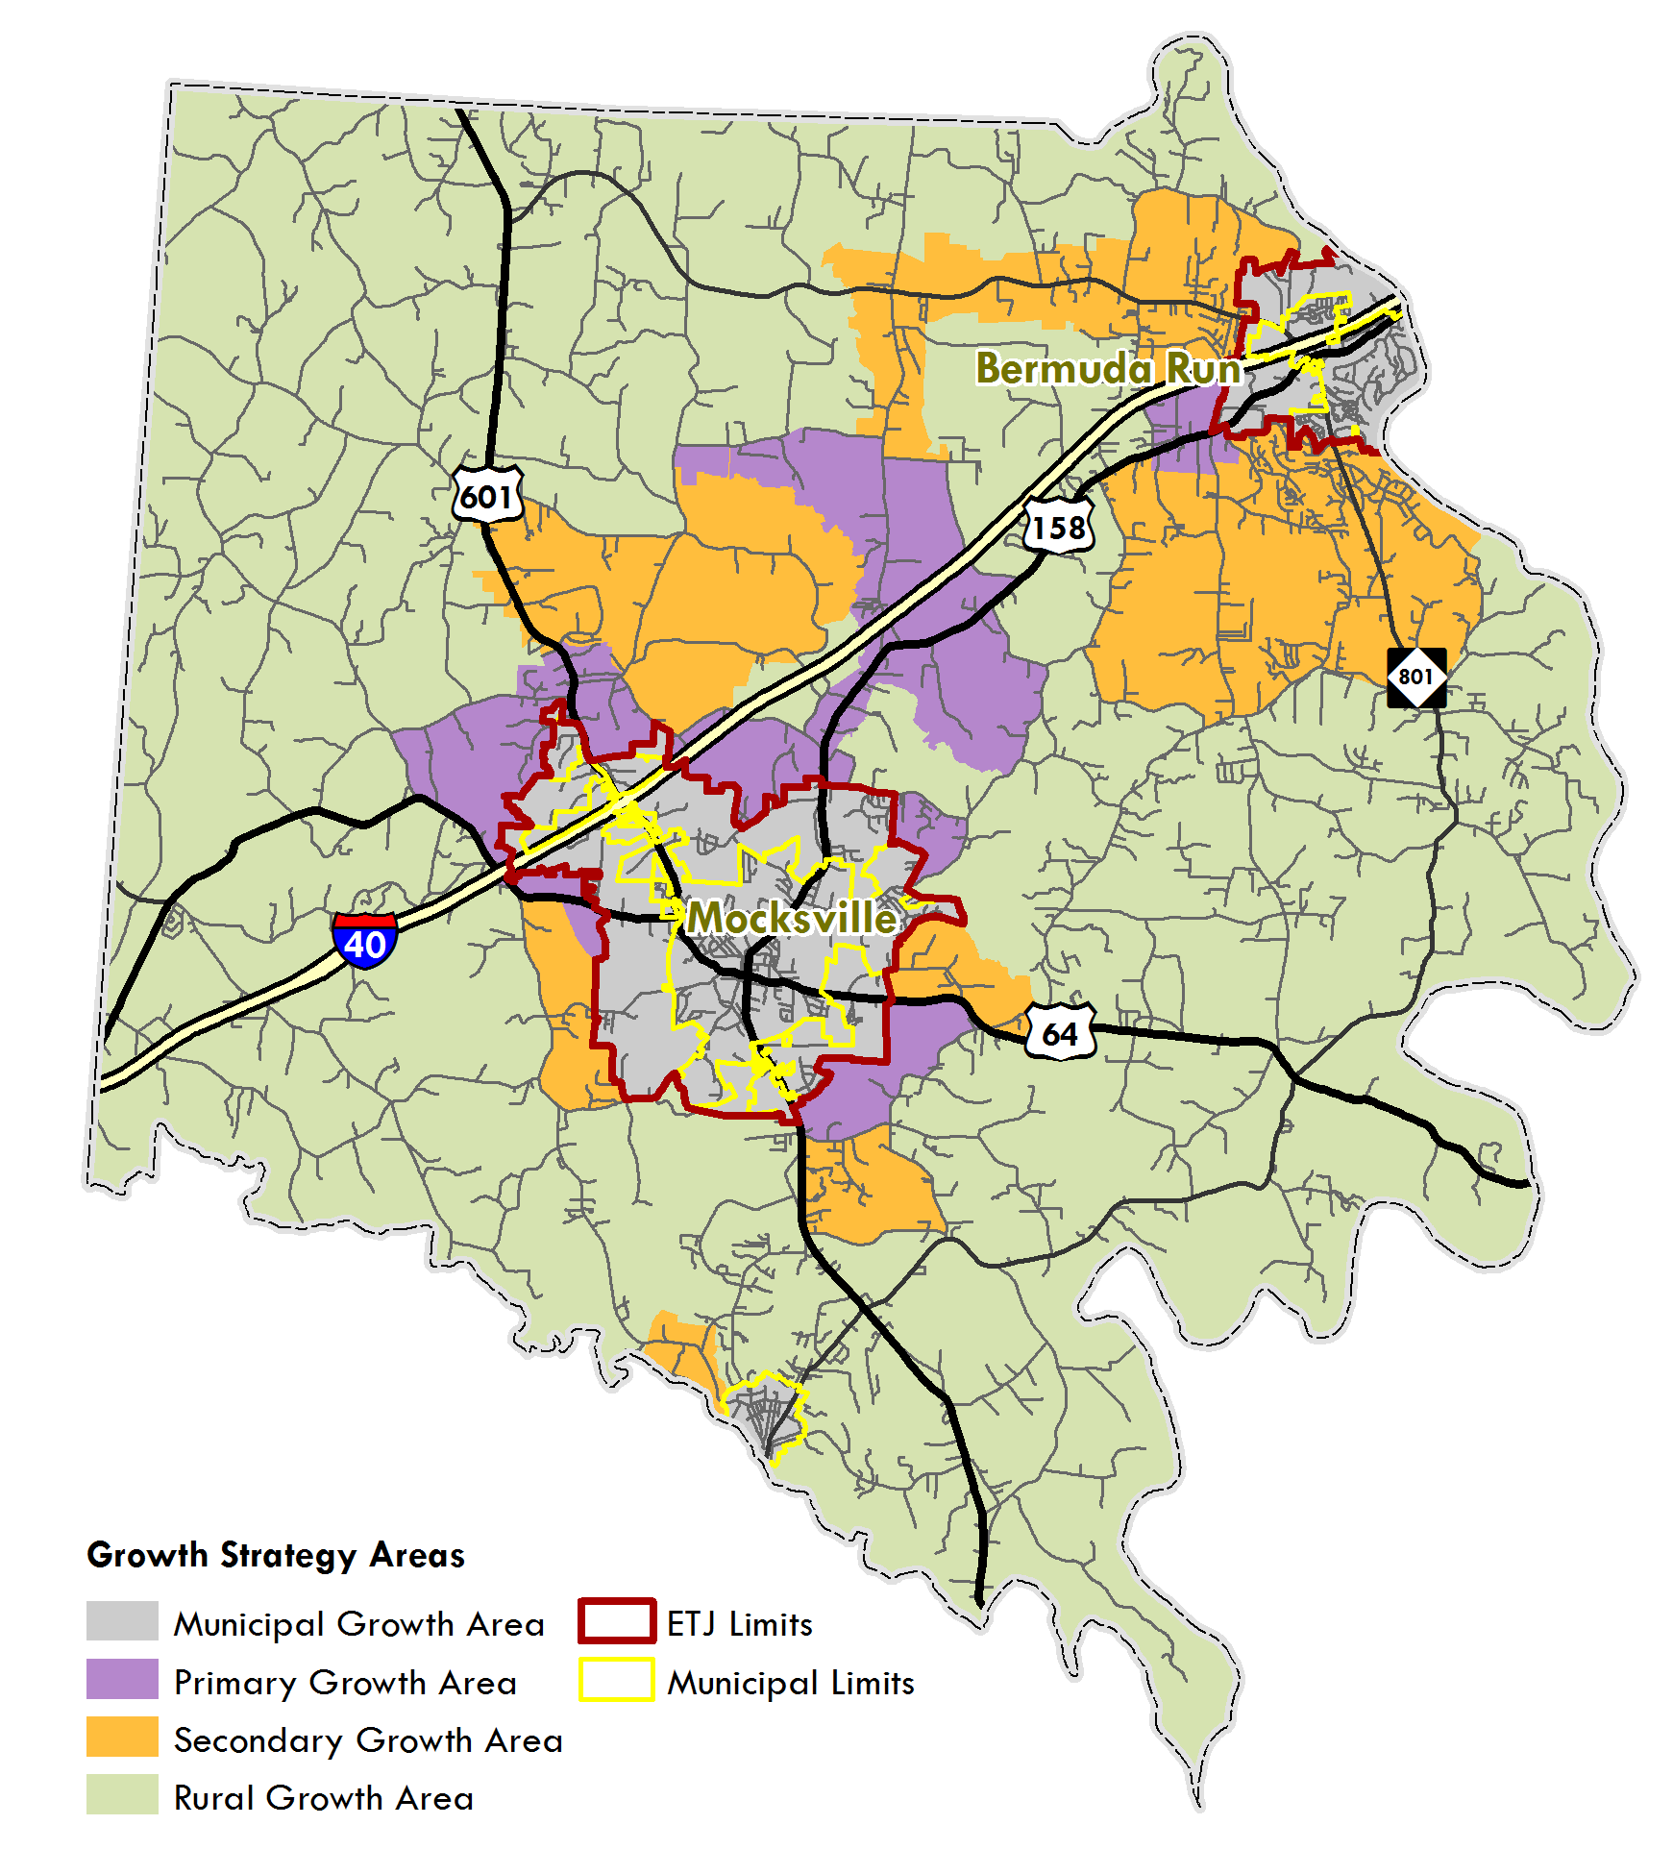
Growth Strategy Areas
Strategic Growth Areas | Acres
Primary Growth Area | 11,199
Secondary Growth Area | 23,259
Rural Growth Area | 122,125

Slide 15
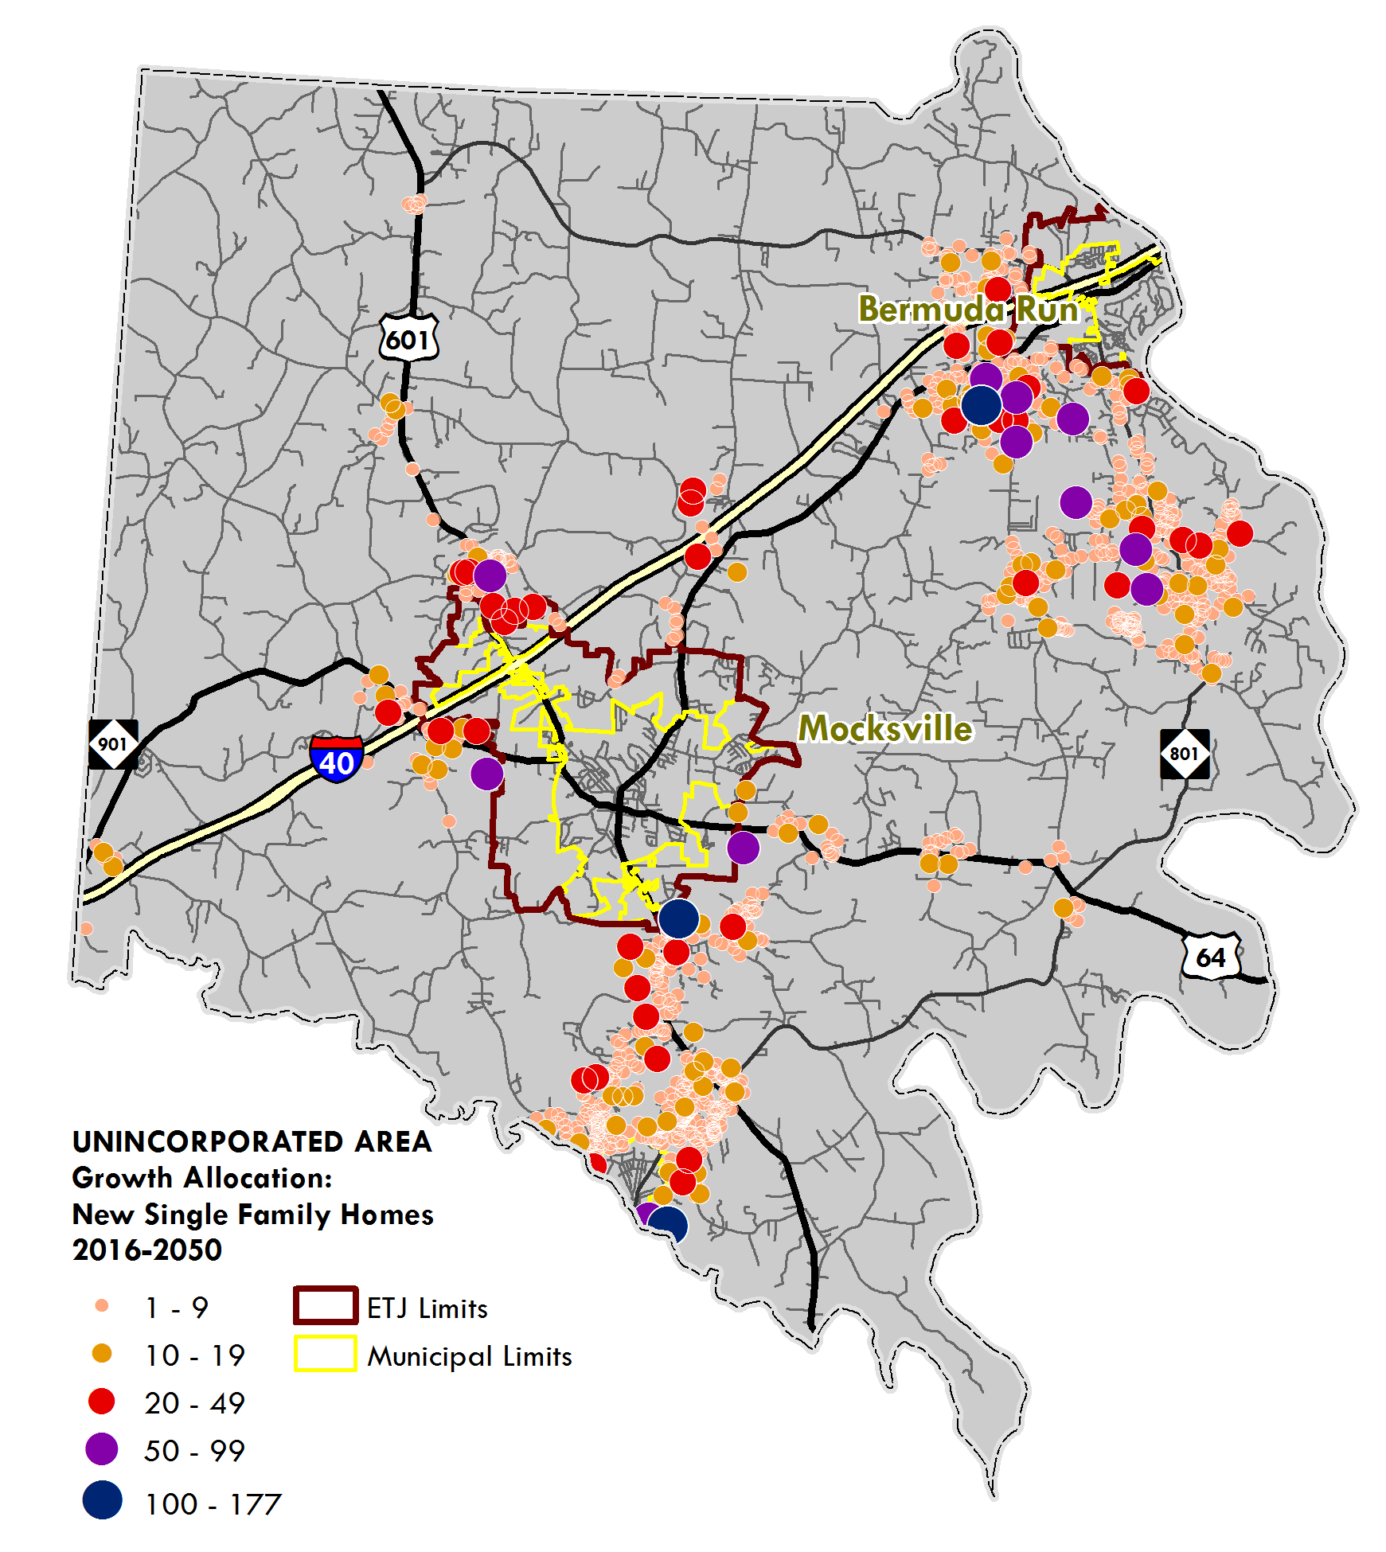
Growth Allocation
Developing most suitable parcels first. Showing growth in unincorporated area only.
TOTAL | Control Totals | BOP
Dwelling Units | 6,342 | 108,027
Single-Family | 5,225 | 75,728
Multi-Family | 47 | 2,744
Mobile Homes | 1,070 | 29,555
Employment | 3,479 | 19,689
Retail/Office | 1,965 | 2,563
Industrial | 914 | 1,823
Institutional | 600 | 15,303

Slide 16
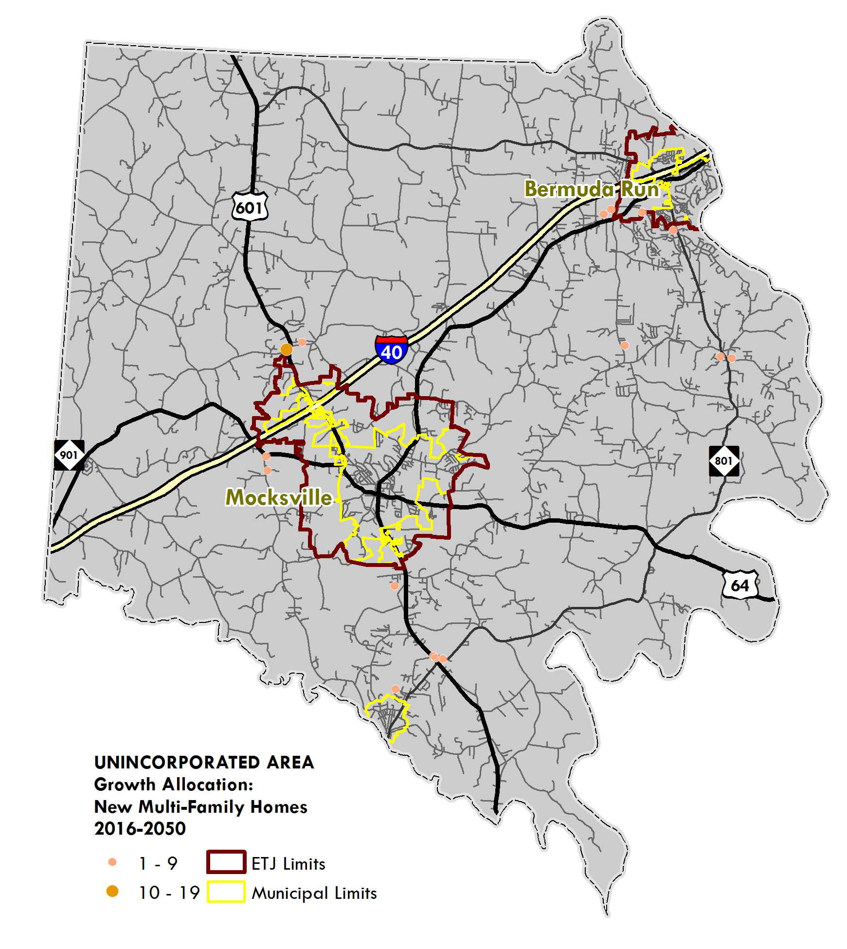
Growth Allocation
Developing most suitable parcels first. Showing growth in unincorporated area only.
TOTAL | Control Totals | BOP
Dwelling Units | 6,342 | 108,027
Single-Family | 5,225 | 75,728
Multi-Family | 47 | 2,744
Mobile Homes | 1,070 | 29,555
Employment | 3,479 | 19,689
Retail/Office | 1,965 | 2,563
Industrial | 914 | 1,823
Institutional | 600 | 15,303

Slide 17
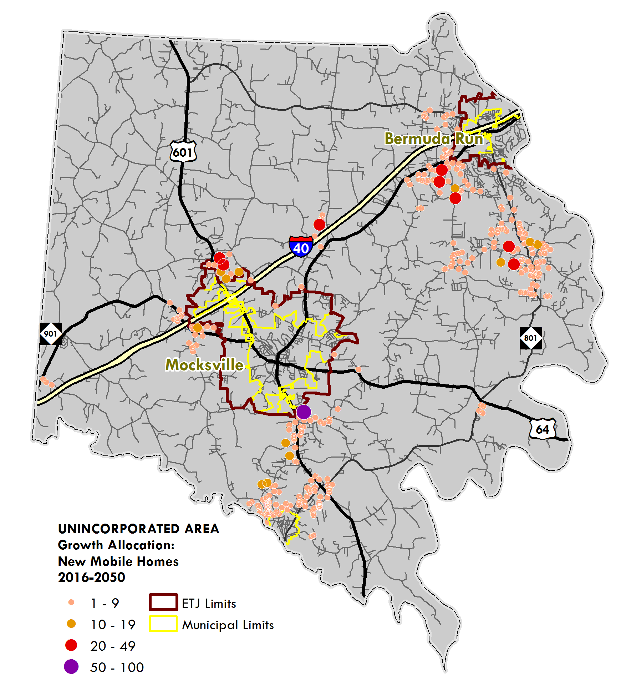
Growth Allocation
Developing most suitable parcels first. Showing growth in unincorporated area only.
TOTAL | Control Totals | BOP
Dwelling Units | 6,342 | 108,027
Single-Family | 5,225 | 75,728
Multi-Family | 47 | 2,744
Mobile Homes | 1,070 | 29,555
Employment | 3,479 | 19,689
Retail/Office | 1,965 | 2,563
Industrial | 914 | 1,823
Institutional | 600 | 15,303

Slide 18
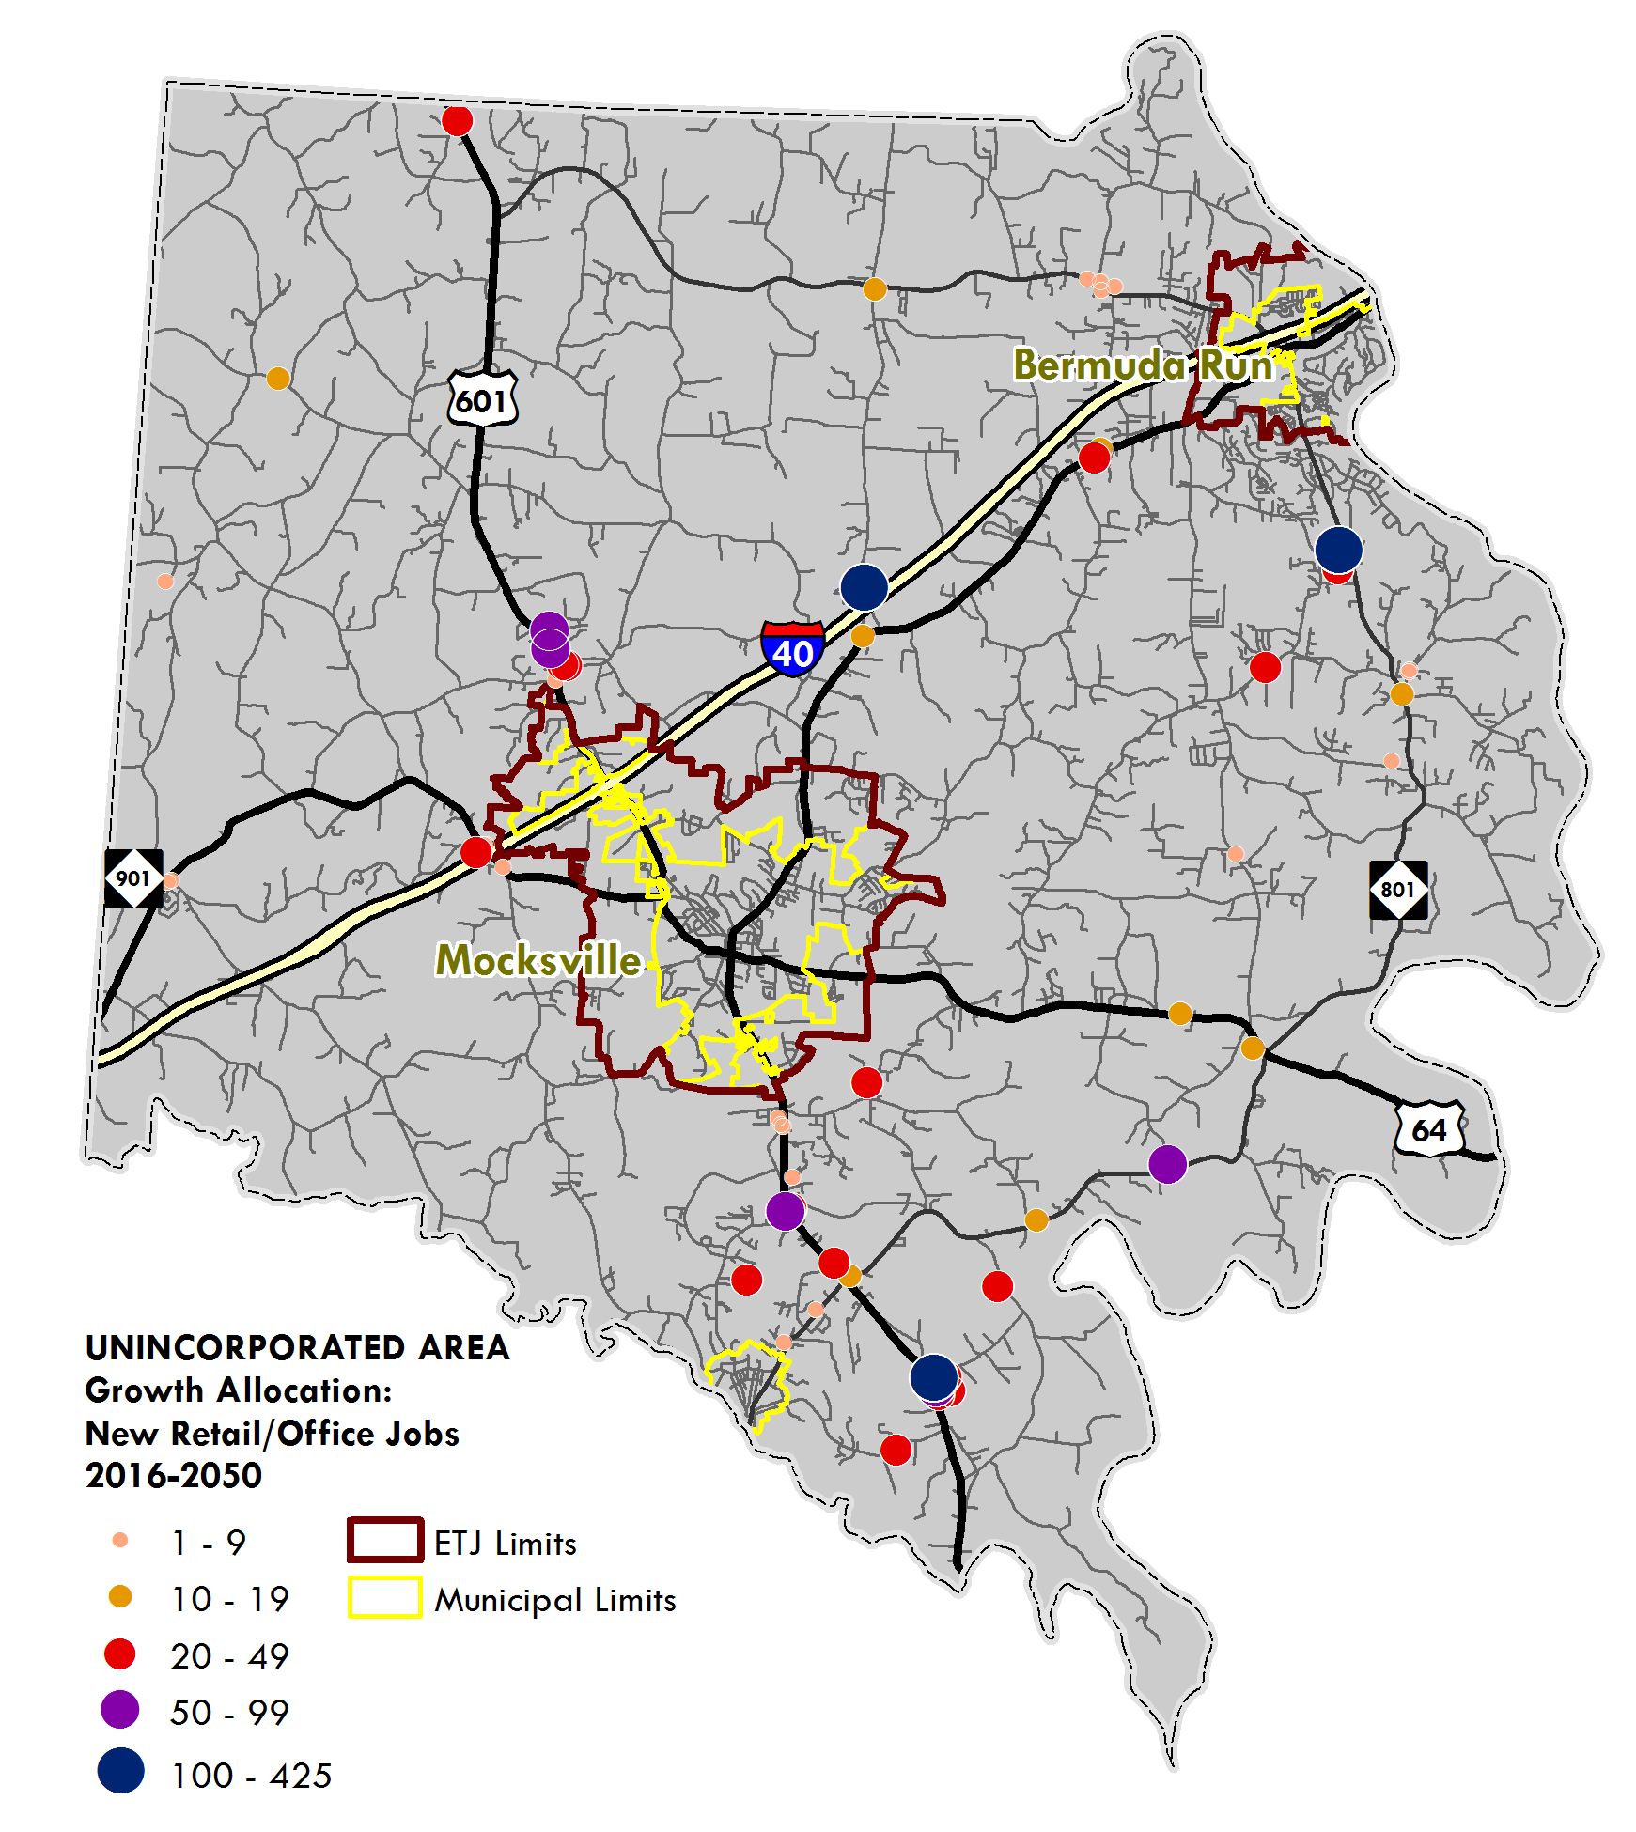
Growth Allocation
Developing most suitable parcels first. Showing growth in unincorporated area only.
TOTAL | Control Totals | BOP
Dwelling Units | 6,342 | 108,027
Single-Family | 5,225 | 75,728
Multi-Family | 47 | 2,744
Mobile Homes | 1,070 | 29,555
Employment | 3,479 | 19,689
Retail/Office | 1,965 | 2,563
Industrial | 914 | 1,823
Institutional | 600 | 15,303

Slide 19
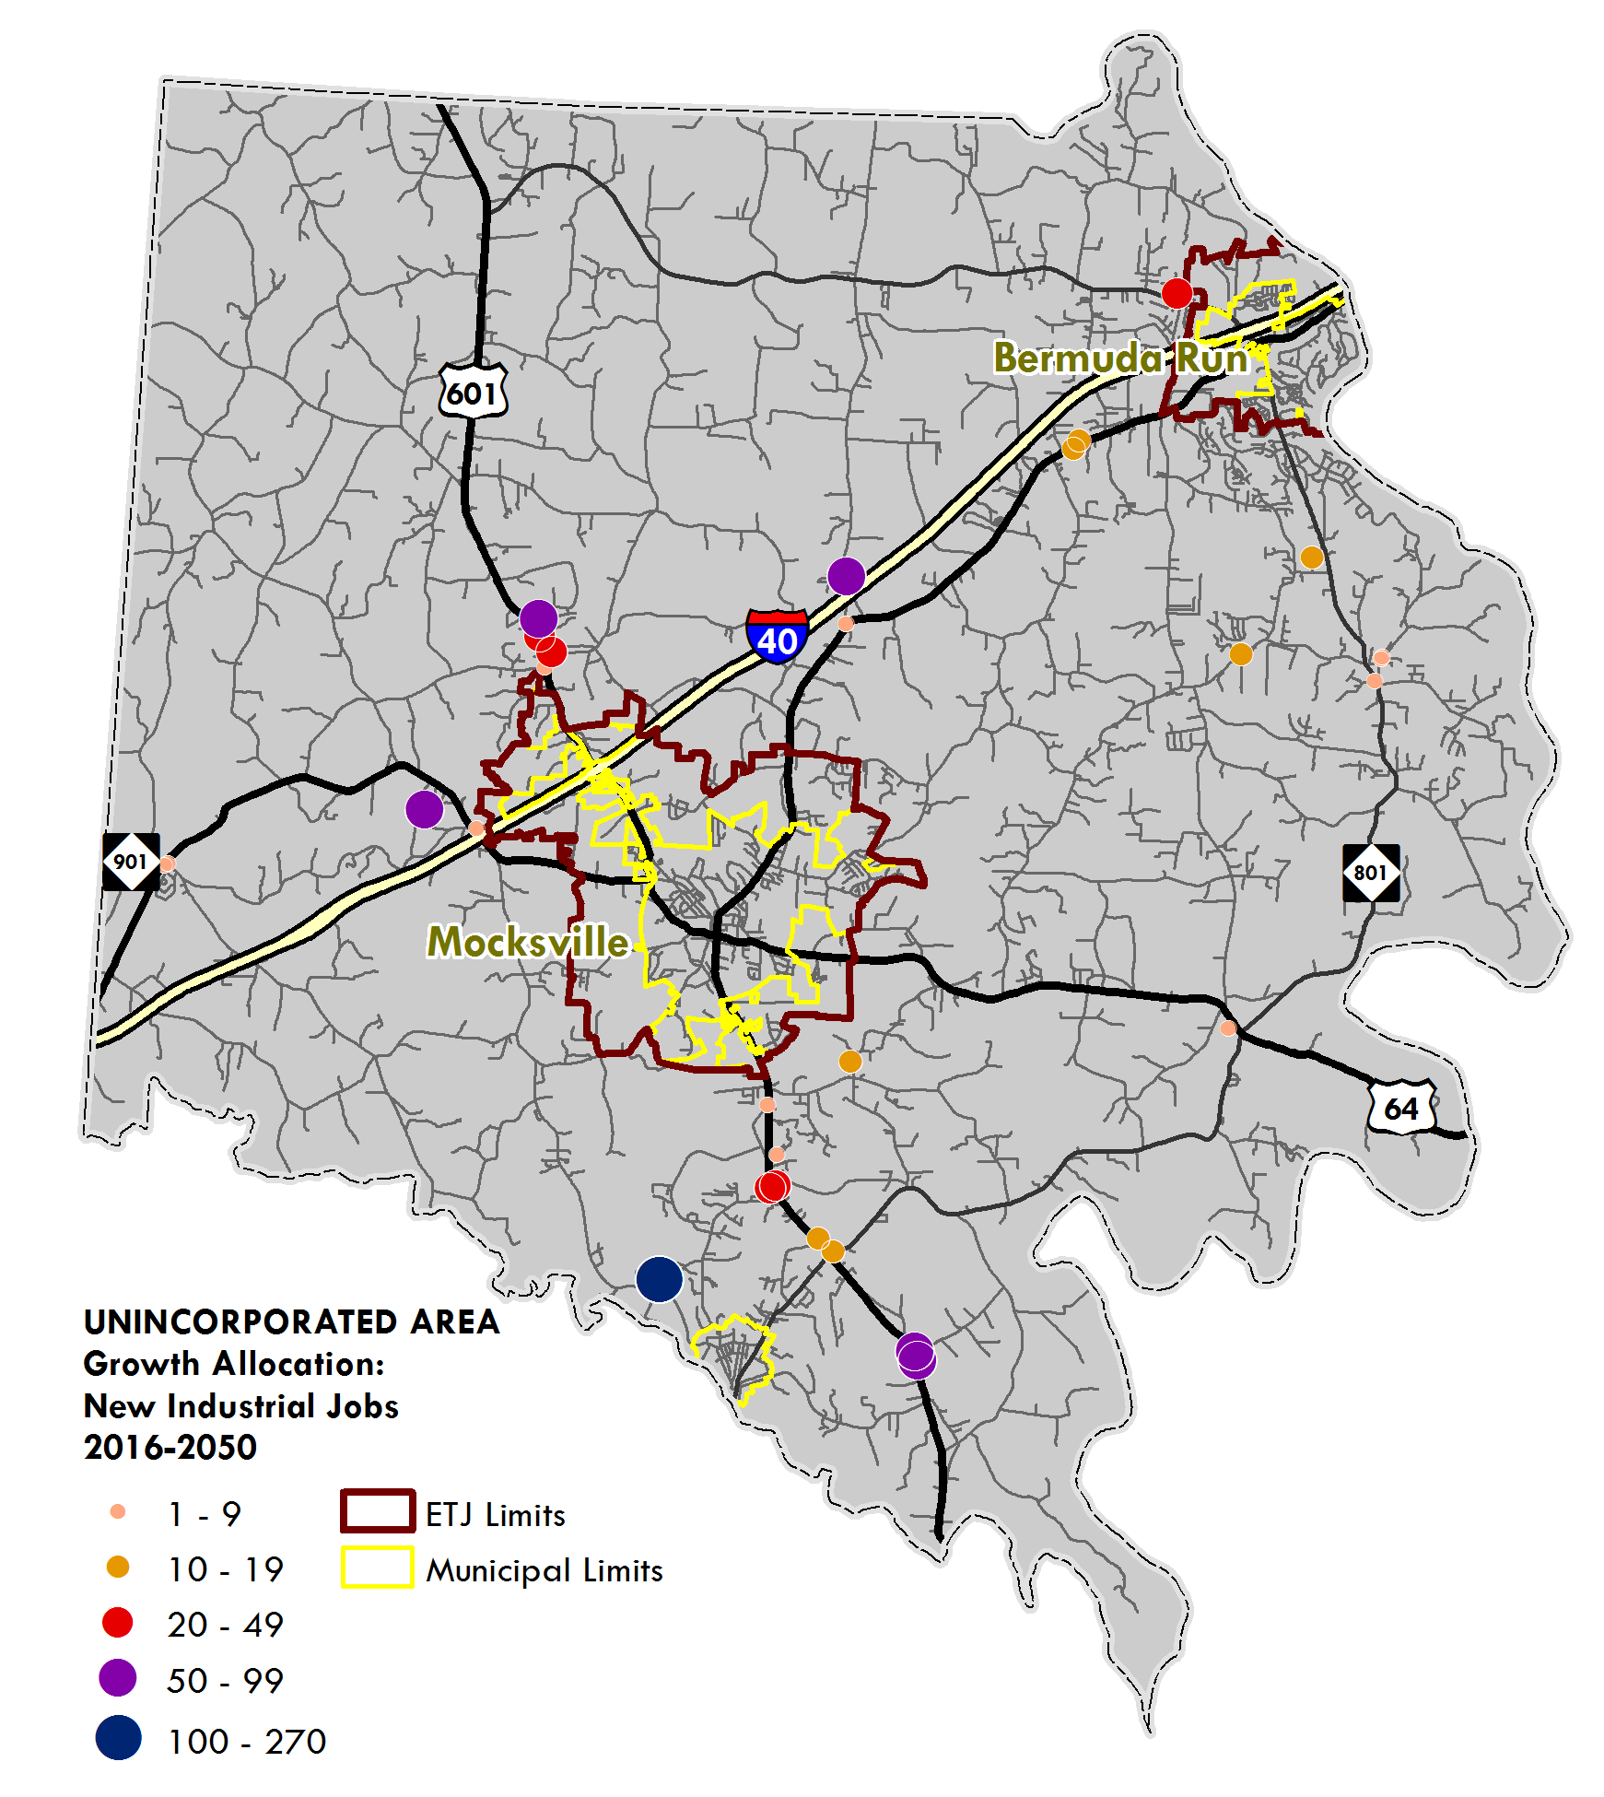
Growth Allocation
Developing most suitable parcels first. Showing growth in unincorporated area only.
TOTAL | Control Totals | BOP
Dwelling Units | 6,342 | 108,027
Single-Family | 5,225 | 75,728
Multi-Family | 47 | 2,744
Mobile Homes | 1,070 | 29,555
Employment | 3,479 | 19,689
Retail/Office | 1,965 | 2,563
Industrial | 914 | 1,823
Institutional | 600 | 15,303

Slide 20
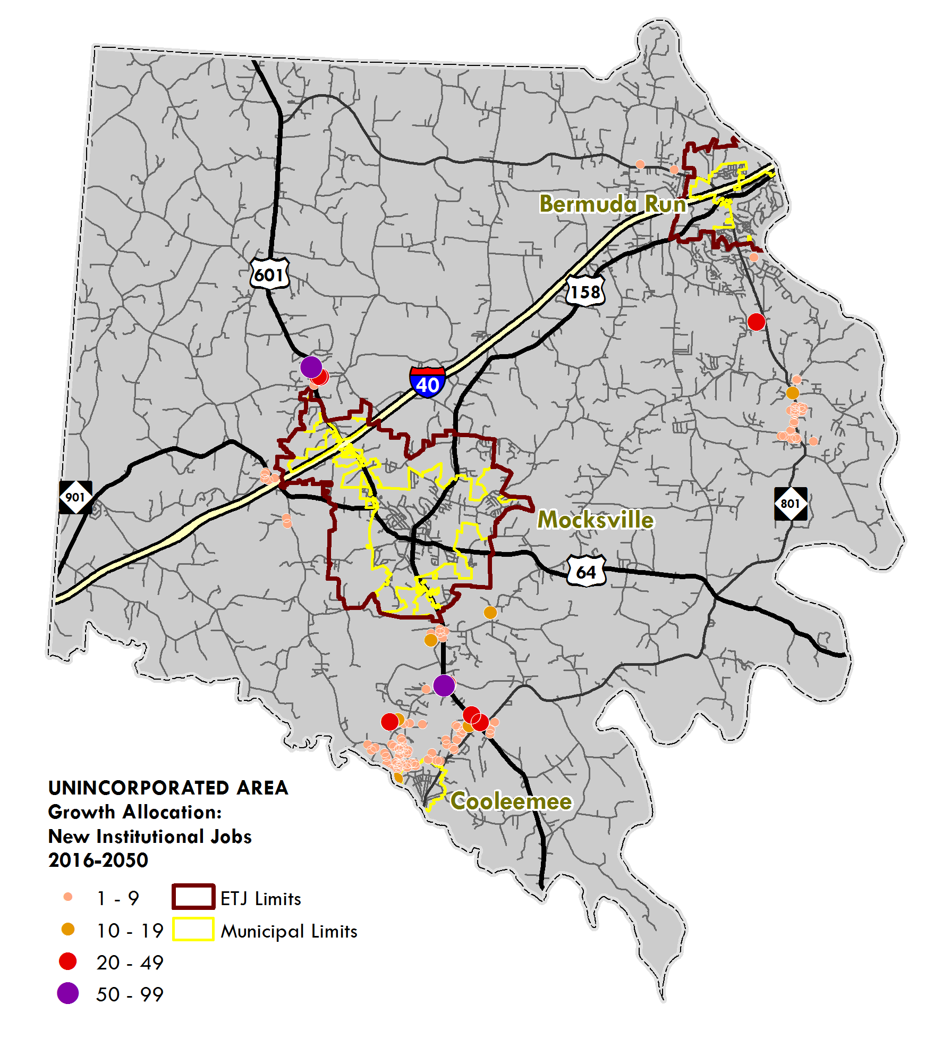
Growth Allocation
Developing most suitable parcels first. Showing growth in unincorporated area only.
TOTAL | Control Totals | BOP
Dwelling Units | 6,342 | 108,027
Single-Family | 5,225 | 75,728
Multi-Family | 47 | 2,744
Mobile Homes | 1,070 | 29,555
Employment | 3,479 | 19,689
Retail/Office | 1,965 | 2,563
Industrial | 914 | 1,823
Institutional | 600 | 15,303

Slide 21
Thanks!
Jesse Day
jday@ptrc.org
336.904.3000 • www.ptrc.org

